Slide 1
Lesson 4
Connecting to Databases
What is a Database?
Database Standards
Connecting to a Database in LabVIEW
Performing Standard Database Operations in LabVIEW
Structured Query Language
Notes:
Lesson 4: Databases
Databases are good for storing data and offer enterprise connectivity to the data. This lesson describes database terminology and database programming in LabVIEW. At the end of this lesson you will be able to connect to a database with LabVIEW, view the contents of the database, insert data into the database, and execute SQL statements on the database.
Lesson objectives:
At the end of this lesson learners should be able to connect to a database with LabVIEW, view the contents of the database, insert data into the database, and execute SQL statements on the database.

Slide 2

A. What is a Database?
Database Definition
Database Terminology
Database Table
Data Type of Fields
Advantages of Databases

Slide 3
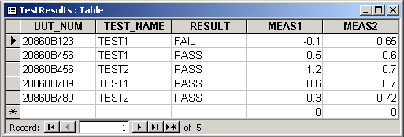
Database Terminology
  Database
    Consists of an organized collection of data
  Database Management System (DBMS)
    A group of software for organizing the information in a database that may contain routines for data input, verification, storage, retrieval, and combination
    Microsoft Access, Oracle, SQL Server, MySQL, etc

Slide 4
Database Terminology
  Most modern relational DBMS store data in tables
Database
Table
Notes:
Database Terminology
Before learning more about the Database Connectivity Toolkit, there are some important terms that need to be defined.
Database: Organized collection of data consisting of data structures called tables.
Table: Collection of rows (records) and columns of data in a database. Each table has a unique name in a database.
Field: This refers to the searchable items in a database. Database fields can be customized according to your needs. Together the fields make up a database record.
Record: An entry (row) in a table that has values for fields in the table. A record can have empty fields which means that it contains NULL values. These NULL values are often referred to as SQL NULL values because they are not exactly the same as other NULL values such as NULL values in C programming.
Primary Key: Field (or collection of fields) that uniquely identifies each record in a table.
Recordset: Collection of records - usually referring to records that match a specific search criteria.
DBMS: A collection of software for organizing the information in a database that might contain routines for data input, verification, storage, retrieval, and combination.

Slide 5
Database Table
  Most modern relational DBMS store data in tables
  Each table must have a unique name
  Each field in a table must have a unique name
  Records may or may not have entries in all fields
Fields/Columns
Record/Row
Notes:
Database Table Example
The example above shows an example table. Each table in a database and each field in a table must have a unique name. In this example the results from a test sequence on Units Under Tests (UUTs) are store in a table. Each UUT has a serial number which is stored in the UUT_NUM field. The test that was performed on the UUT is stored in the TEST_NAME field and the result of the test is stored in the RESULT field. Also, the MEAS1 and MEAS2 fields display measurement information for the UUT during the test. Notice that there is a different record (row) for each test for the UUT.
Field: This refers to the searchable items in a database. Database fields can be customized according to your needs. Together the fields make up a database record.
Record: An entry (row) in a table that has values for fields in the table. A record can have empty fields which means that it contains NULL values. These NULL values are often referred to as SQL NULL values because they are not exactly the same as other NULL values such as NULL values in C programming.

Slide 6
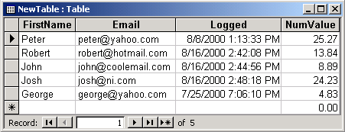
Data Type of Fields
  Each field (column) has a data type
  Field data types are defined when creating a table
  Data types vary with different types of databases
    Microsoft Access, Oracle, SQL Server
text
Date/time
double
Notes:
Data Type of Fields
When you create a table each of the fields has properties associate with it:
Name: The physical name of the field. Each field must have a unique name.
Data Type: The data type that the field can accept. For instance a field may be a string, a number, or a date/time string.
Size: Maximum size of a field in a database – only used with strings.
Allow Null: You can have an empty field in a record that contains no data. If this value is true, then this field will allow NULL values for records, and if it is false the field must have a value.
The data types that are available in a database vary depending on the DBMS. LabVIEW uses a few common data types for its operations, and conversions to the native data types are done automatically.

Slide 7
Relational and Non-relational Databases
  Non-relational Databases
  Store all information in one large table
  Sometimes inefficient
    All information in one table
    Searching can be difficult and time-consuming
Notes:
Non-relational databases allow you to store all the information in one large structure. This method is sometimes inefficient, because all of the information is one table, and searching for a specific piece of data can be difficult and time-consuming

Slide 8
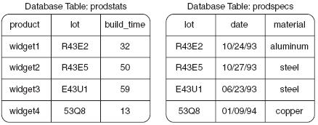
Relational and Non-relational Databases
  Relational Databases
  Information stored in multiple tables
  Each table can contain a specific subset of information
Notes:
Relational databases have information stored in multiple structures, or tables, where each table can be smaller and contain a specific subset of information. The figure in the slide shows two database tables that are related to each other through the lot field.

Slide 9


Advantages of Databases
  Searchable data
  Large number of simultaneous users
  Security
  Enterprise connectivity
Notes:
Data – You can make specific queries to return the data that you want instead of manually searching and parsing through every piece of data.
Large number of simultaneous users – Databases were designed to allow many users to access data at the same time.
Security – You have the option of setting passwords and read/write access for users of a database.
Enterprise connectivity – Many companies already have a database set up to store many types of information such as manufacturing numbers, sales orders, and statistics. Integrate your data into existing databases to leverage existing technology and make your data accessible to other users of the database.

Slide 10
B. Database Standards
  LabVIEW Database Connectivity Toolkit
  Works with any database driver that complies with ODBC or OLE DB
    Open Database Connectivity (ODBC) Standard
    Object Linking and Embedding Database (OLE DB) Standard
Notes:
ODBC is the older technology. LabVIEW supports both standards, however this course (and the exercises) focuses on OLE.

Slide 11
Communication Hierarchy
Database Connectivity Toolkit VIs
ODBC
(Data Source Name)
OLE DB
(Universal Data Link)
Database
Notes:
Communication Hierarchy
At a high level you can think of communication with a database as a hierarchy. LabVIEW will make calls to Microsoft ActiveX Data Object (ADO). Then, communication is done to the database through either the ODBC standard (uses a DSN) or the OLE DB standard (uses a UDL file) to the DBMS. There are layers within these layers as we have already discussed, but generally, this is how communication with a database is set up and accomplished with the Database Connectivity Toolkit.

Slide 12
Exercise 4-1: View Database Contents
Examine the contents of a database using Microsoft Excel.
Notes:
Exercise time: 10 minutes

Slide 13
Exercise 4-1: View Database Contents
Is the TheatreDatabase.mdb a relational or non-relational database?
How can you tell?
Notes:
The TheatreDatabase.mdb is a relational database.
First of all, Access is a relational database management system that supports relational databases.
However, in this particular example, we see that Production_ID is a field that appears in all three of the tables that were viewed in this exercise.

Slide 14

C. Connecting to a Database in LabVIEW
  Database Programming Model
    Typical database operations involve the following process:
Connect
To
Database
Perform
Operations
On Database
Close
Connection
To Database
Check for
Errors

Slide 15
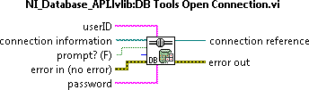
Connect to Database
  Connect using ODBC or OLE DB
OLE DB
ODBC
Notes:
Step 1: Connect To Database
The first step in doing database operations with the Database Connectivity Toolkit is to connect to the database. The DB Tools Open Connection VI is used to open connections to the database. This VI determines the connection from the connection information terminal. This polymorphic VI will accept a path to a User DSN or UDL, or the name of System or User DSNs. If a connection has not yet been established to a database a connection can be create through the optional prompt terminal.
The connection reference output terminal is actually an ActiveX ADO refnum.

Slide 16
Connect to Database – OLE DB
  OLE DB Standard
    Uses a Universal Data Link (UDL) for the connection
  Create a UDL File
    Contains the following information
      what OLE DB provider is used
      server information
      user ID and password
      default database
      other related information

Slide 17
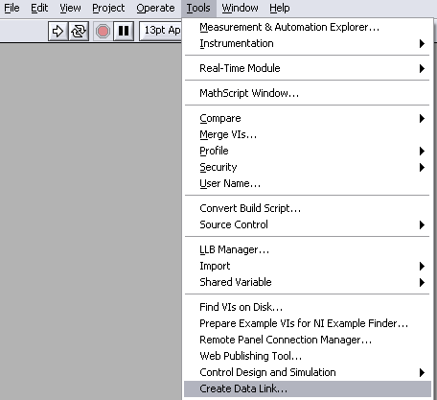


Connect to Database – OLE DB
  Methods to create a UDL file
    Prompt input of the DB Tools Open Connection VI
    Tools»Create Data Link in LabVIEW
    Manually create UDL file using a text editor
Notes:
You can create a UDL in one of the following three ways:
Use the prompt? input of the DB Tools Open Connection VI. The prompt? input displays the Data Link Properties dialog box when the DB Tools Open Connection VI runs. You can select the appropriate options in this dialog box to make the database connection.
Select Tools»Create Data Link in LabVIEW to display the Data Link Properties dialog box. (The Database Connectivity Toolkit installer creates a directory called data links inside the labview/Database directory. Save all UDL files and file DSNs to this directory so you can find them easily)
In Windows Explorer, right-click an empty location in a folder and select New»Text Document from the shortcut menu. Change the file extension of this document from .txt to .udl. You then can double-click the UDL file to display the Data Link Properties dialog box.

Slide 18
Connect to a Database Using OLE DB Standard
Demonstrate different methods of connecting to a database in LabVIEW using the OLE DB standard.
Notes:
Demonstrate the steps listed in <Exercises>\LabVIEW Connectivity\Demonstrations\OLE DB\OLE DB Demo Script.docx.

Slide 19
Exercise 4-2: Connect to Theatre Database Using LabVIEW
Configure and open a connection to a database using LabVIEW.
Notes:
Exercise time: 10 minutes

Slide 20
Exercise 4-2: Connect to Theatre Database Using LabVIEW
When do you need to update or recreate a UDL file?
Notes:
The UDL file contains information about the provider as well as the database location.
In this case, the provider is Microsoft Jet 4.0 OLE DB.
You do not need to recreate the UDL file each time you access the database.
However, if you move your database file, you will need to update the UDL file. For example, if you deploy to another system.

Slide 21
D. Performing Standard Database Operations in LabVIEW
  You can perform many operations on a database
    Insert records - SQL statements
    Query records - Create tables
    Update records - More…
Connect
To
Database
Perform
Operations
On Database
Close
Connection
To Database
Check for
Errors
Notes:
Step 2: Insert or Select Data
After the connection to the database is established, you can insert data into the database or select data from the database in a number of methods. The highest level inserts are done with the DB Tools Insert Data VI. To use this VI a connection reference must be wired in. Also, the table used for storing the data must be specified. You can select to create the table if it does not already exist. You can also specify which columns the data is to be inserted into. The data itself is inserted into the database in the data terminal. Each record to be inserted is bundled together as a cluster. An array of clusters should be created to insert more than one record into the database.
If you want to select data from the database, then, at the highest level, use the DB Tools Select Data VI to extract information. To use this VI, you first need to wire in a connection reference and the name of the table that you want to extract the information from. You can also specify specific columns to extract. The DB Tools Select Data VI will return all of the fields from all of the records that are in the columns supplied and meet the optional clause. The optional clause is an SQL statement that is optional. If no SQL statement is wired into the optional clause it will extract the data from all of the records. If you want to extract all of the fields of all the records, then simply leave the optional clause and columns terminal empty. The data will be returned through the data terminal. It will be returned as an two-dimensional array of variants. Each row of the array is a different record and each column is a different field in the record. Use the Database Variant To Data VI to convert from the variant to the correct data type.

Slide 22

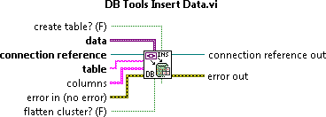
Perform Operations on the Database
  Select or Insert Data
  Uses connection reference
  Select/Insert by tables
  Specify columns of data for
  selection or insertion
  Can create tables
  Data is in Variant data type
Notes:
Step 2: Insert or Select Data
After the connection to the database is established, you can insert data into the database or select data from the database in a number of methods. The highest level inserts are done with the DB Tools Insert Data VI. To use this VI a connection reference must be wired in. Also, the table used for storing the data must be specified. You can select to create the table if it does not already exist. You can also specify which columns the data is to be inserted into. The data itself is inserted into the database in the data terminal. Each record to be inserted is bundled together as a cluster. An array of clusters should be created to insert more than one record into the database.
If you want to select data from the database, then, at the highest level, use the DB Tools Select Data VI to extract information. To use this VI, you first need to wire in a connection reference and the name of the table that you want to extract the information from. You can also specify specific columns to extract. The DB Tools Select Data VI will return all of the fields from all of the records that are in the columns supplied and meet the optional clause. The optional clause is an SQL statement that is optional. If no SQL statement is wired into the optional clause it will extract the data from all of the records. If you want to extract all of the fields of all the records, then simply leave the optional clause and columns terminal empty. The data will be returned through the data terminal. It will be returned as an two-dimensional array of variants. Each row of the array is a different record and each column is a different field in the record. Use the Database Variant To Data VI to convert from the variant to the correct data type.

Slide 23
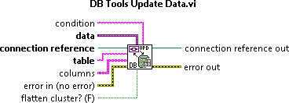

Perform Operations on the Database
  Update Data
    Uses connection reference
    Specify columns to update
    Data is Variant data type
  Delete Data
    Uses connection reference
    Delete all data or specific data from a table

Slide 24

Converting Variant Data Types
  Database Variant to Data function
  Converts a database variant to the LabVIEW data type specified in type
  Converted data can then be used by another function or subVI
Notes:
Database Variant To Data
Converts a Database Variant to the LabVIEW data type specified in type so that the data can be used in another function or subVI.

Slide 25
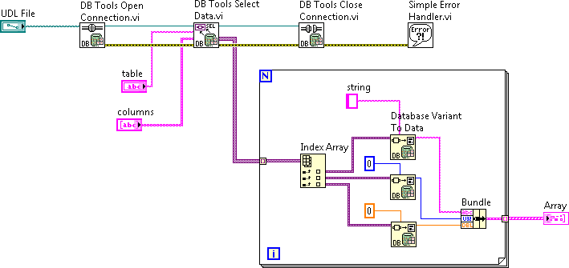
Converting Variant Data Types
  Database Variant to Data example
Notes:
If you want to select data from the database, then, at the highest level, use the DB Tools Select Data VI to extract information. To use this VI, you first need to wire in a connection reference and the name of the table that you want to extract the information from. You can also specify specific columns to extract. The DB Tools Select Data VI will return all of the fields from all of the records that are in the columns supplied and meet the optional clause. The optional clause is an SQL statement that is optional. If no SQL statement is wired into the optional clause it will extract the data from all of the records. If you want to extract all of the fields of all the records, then simply leave the optional clause and columns terminal empty. The data will be returned through the data terminal. It will be returned as an two-dimensional array of variants. Each row of the array is a different record and each column is a different field in the record. Use the Database Variant To Data VI to convert from the variant to the correct data type.
This example shows that you can selectively extract specific fields from a record. If you were interested in all the fields, you could skip the auto-indexing and bundling by wiring in an array of clusters to the Database Variant to Data node. Users will see this contrasting approach in the next exercise (Ex 4-3).

Slide 26

Close Connection to Database
  Closes connection to database
  Destroys reference
  Must open another connection before accessing database again

Slide 27
Exercise 4-3: Select Data from a Table
Retrieve data from the cue information table in the Theatre database.
Notes:
Exercise time: 15 minutes

Slide 28
Exercise 4-3: Select Data from a Table
Does the column list need to match the cluster elements in the type input Database Variant to Data function?
What do you expect to happen if they don’t match?
Notes:
Yes. The column list must match the cluster elements in the type input.
If the elements do not match, you will get a runtime error indicating that the data type of the variant is not compatible with the data type wired to the type input.
If the cluster is not in an array, you will get a broken wire indicating you have connected terminals of different type.

Slide 29
Exercise 4-4: Insert New Record
Insert new records of cue data into the cue information table in the Theatre database.
Notes:
Exercise time: 20 minutes

Slide 30
Exercise 4-4: Insert New Record
Why is there a coercion dot at the Data input of the DB Tools Insert Data VI?
Notes:
The Data input is of type Variant. The actual data being wired in is a cluster. Therefore, LabVIEW automatically coerces the data to a Variant.
Since the BD Tools Insert Data VI only compares column list with Data input at runtime, you will not get an edit-time error if these don’t match. You will get a runtime error indicating there is an argument error where the number of columns does not equal the number of parameters.

Slide 31
E. Structured Query Language (SQL)
  SQL—Set of character string commands used to describe, store, retrieve, and manipulate records and fields in database tables
  Example statement and query results:
    SELECT fname, lname, age FROM employees WHERE age >= 21
  Each DBMS has its own SQL dialect
Notes:
What is SQL
SQL is a set of character string commands that is a widely supported standard for database access. SQL statements can be used to store data into a database, query a database for records that match certain criteria, and many other database operations.
There are three different classes of SQL statements:
Data Definition/Control Language (DDL/CDL) – These statements define and control the structure of the database. They also define and grant access privileges. Use the statements to create, define, and change databases and tables.
Data Manipulation Language (DML) – Use these statements to operate on the data contents of tables. You can use these statements to insert, delete, and update records in a database table and conduct database transactions.
Queries – These are SQL SELECT statements that specify which tables and records are retrieved from the database.

Slide 32
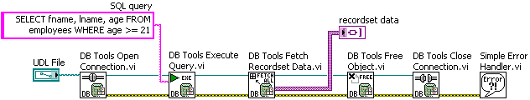
Execute SQL Statements in LabVIEW
  Execute SQL query statement
  Query returns a recordset (collection of records) reference
  Fetch data from recordset
  Data returned as variants
  Must free recordset reference
Notes:
Executing SQL Statements
If you want to execute an SQL statement and navigate through the returned data, you can use the Advanced VIs in the Database Connectivity Toolkit. To execute a query you use the DB Tools Execute Query VI. This VI accepts an SQL query string, which is an SQL query statement, and it returns a recordset reference. A recordset is a collection of records (usually referring to records that match a specific search criteria). The recordset referenced is a recordset corresponding to all of the records that matched the query parameters.
Once you have a reference to the matching data, you can fetch data from the recordset in a variety of forms. You can extract all of the data at once with the DB Tools Fetch Recordset Data VI, or you can navigate thought individual records or fields with other Advanced VIs.
After the data has been extracted from the recordset, you close the reference to the recordset and free up the recordset with the DB Tools Free Object VI.

Slide 33
Exercise 4-5: SQL Query
Execute an SQL query statement to retrieve data from the Theatre database.
Notes:
Exercise time: 10 minutes

Slide 34
Exercise 4-5: SQL Query
How would you change the VI to return only Cue Name and Wait Time?
Notes:
You would need to change both the SQL query AND the Cue Data cluster.
The Select list must match the number and data types of the cluster elements in the cluster array. If not, you will get a runtime error indicating the data type of the variant is not compatible with the data type wired to the type input.
Modified SQL query:
SELECT Cue_Name, Fade_Time FROM Cue_Information_Table WHERE Production_ID=4
Alternatively, you could extract the Cue Name and Wait File from the Cue Data array.

Slide 35
Summary – Quiz
1. Match each term to its description:
Database
Tables
SQL
Contains records and fields
Set of string commands for database access
Organized collection of data

Slide 36
Summary – Quiz Answers
1. Match each term to its description:
Database
Tables
SQL
Organized collection of data
Contains records and fields
Set of string commands for database access

Slide 37
Summary – Quiz
Which of the following are valid methods of connecting to a database using the OLE DB standard?
  Wire a True constant to the Prompt input of the DB Tools Open Connection VI
  Wire the filepath of a valid UDL file to the Filepath input of the DB Tools Open Connection
  Wire the name of a DSN to the Filepath input of the DB Tools Open Connection
Notes:
Answer is a and b.

Slide 38
Summary – Quiz Answers
Which of the following are valid methods of connecting to a database using the OLE DB standard?
  Wire a True constant to the Prompt input of the DB Tools Open Connection VI
  Wire the filepath of a valid UDL file to the Filepath input of the DB Tools Open Connection
  Wire the name of a DSN to the Filepath input of the DB Tools Open Connection
Notes:
Answer is a and b.

Slide 39
Summary – Quiz
Which VI converts database data into a more usable LabVIEW data type?
  DB Tools Open Connection
  DB Tools Select Data
  DB Tools Insert Data
  Database Variant to Data
Notes:
Answer is d) Database Variant to Data

Slide 40
Summary – Quiz Answer
Which VI converts database data into a more usable LabVIEW data type?
  DB Tools Open Connection
  DB Tools Select Data
  DB Tools Insert Data
  Database Variant to Data
Notes:
Answer is d) Database Variant to Data

