Slide 1
LabVIEW Connectivity

Slide 2

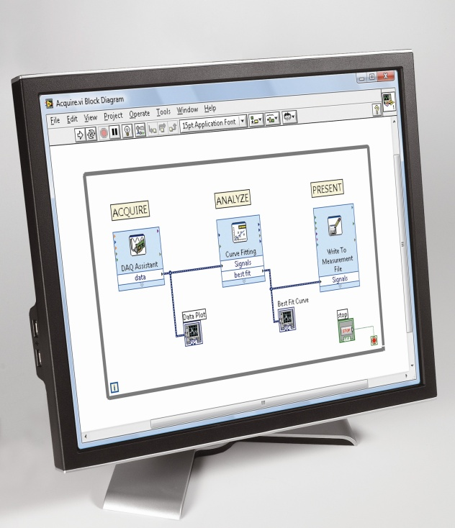
What You Need To Get Started
LabVIEW Connectivity Course Manual
LabVIEW Connectivity Exercises
LabVIEW Connectivity Course CD
.NET Framework version 2.0
Database Connectivity Toolkit
Computer running
LabVIEW 2010 and Windows 7/Vista/XP

Slide 3

File Locations
Root Directory
Exercises
<or>
Solutions
LabVIEW Connectivity
The course installer places the course files in the following location:

Slide 4
Instructional Methods
Lecture
Topic
Quizzes
Demonstrations
Concept Exercise
Development Exercise
  Lecture gives a foundation
  in the topic
  Instructor reinforces
  foundation through
  demonstrations and quizzes
  Concept exercises explore a topic further
    Watch a simulation, experiment with example VIs
  Development exercises provide hands-on experience
    Demonstration of a finished development exercise further reinforces the learning process

Slide 5
Getting The Most Out Of This Course
  Experiment with hands-on exercises to understand the methods used
  Implementations explore a possible solution—you may find a better one
  Do not come to class prepared to develop an outside application; concentrate on the exercises given to build a good foundation

Slide 6
New User Experienced User Advanced User
LabVIEW Core 1
LabVIEW Core 2
LabVIEW Core 3
Managing Software
Engineering in LabVIEW
Advanced Architectures in LabVIEW
LabVIEW Connectivity
Object-Oriented Design
and Programming in LabVIEW
LabVIEW Performance
Certifications
Certified LV Associate Developer Exam
Certified LabVIEW Developer Exam
Certified LabVIEW
Architect Exam
Other Courses
LabVIEW Real-Time 1
LabVIEW Real-Time 2
LabVIEW FPGA
DAQ & Signal Conditioning
LabVIEW Instrument Control
LabVIEW Modular Instruments
LabVIEW Machine Vision
RF Fundamentals
RF Application Development
Notes:
<Remove this slide if your class is not in the LabVIEW series.>

Slide 7
Course Learning Map
Lesson 1
Using.NET and ActiveX Objects in LabVIEW
Lesson 2
Calling Shared Libraries
Using VI Server
Lesson 3
Lesson 4
Connecting to Databases
Broadcasting Data and Serving Data to a Client
Lesson 5
Building and Running LabVIEW Web Services
Lesson 6
Notes:
Lesson 5 will cover UPD and TCP/IP

Slide 8
Course Goals
This course prepares you to:
  Develop integrated systems
  Use networking technologies
  Programmatically control VIs using VI Server
  Implement VIs that use DLLs, ActiveX, .NET, and databases
  Build and run LabVIEW Web Services
Notes:
Refer to the Course Outline posted on ni.com/training.

Slide 9
Configuring Your LabVIEW Environment
  Options Dialog Box
    Controls/Functions Palettes page
      Select Load palettes during launch to make Search Palettes immediately usable after launch
      Set Palette to Category (Icons and Text)
    Block Diagram page
      Uncheck Place front panel terminals as icons to display control and indicator terminals in a compact format
      Configure Block Diagram Cleanup to customize your block diagram
Notes:
This is an opportunity before the class starts for individuals to customize their environment with their favorite settings. The settings noted in the slide are suggested changes.
Other possible suggested changes based on instructor discretion:
Check Environment > General > Skip Getting Started window on launch
Uncheck Block Diagram>>Error Handling>>Enable automatic error handling in new VIs

Slide 10
Configuring Your LabVIEW Environment
  Controls Palette
    Tack the Controls palette and select Customize»Change Visible Palettes then click Select All and click OK
  Functions Palette
    Tack the Functions palette and select Customize»Change Visible Palettes then click Select All and click OK

Slide 11
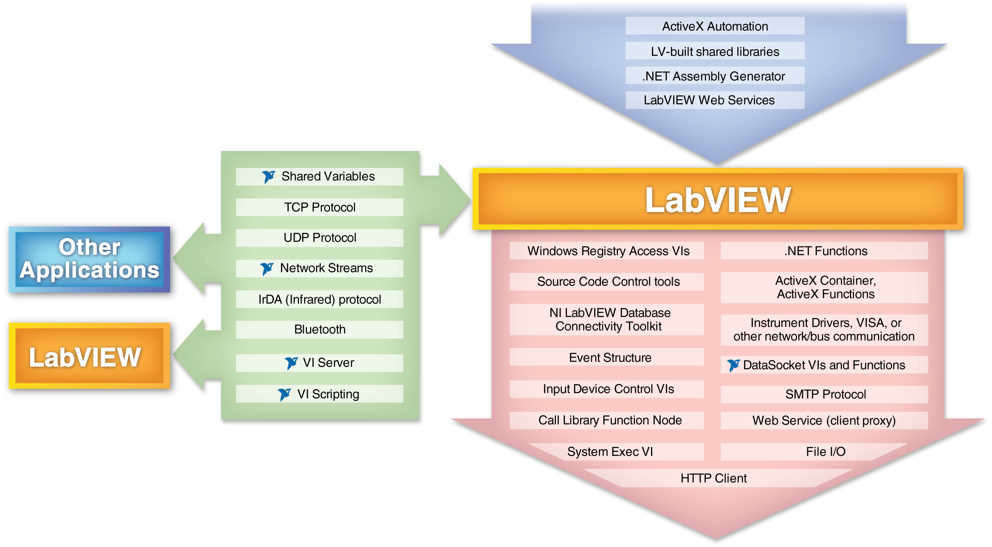
Connectivity in LabVIEW
Notes:
This graphic is intended to identify most (but probably not all) connectivity technologies that are used with LabVIEW.
Do NOT attempt to talk about all the technologies. Use this to show that there are so many connectivity technologies that we cannot cover all in a 2-day LV Connectivity course.
The arrows represent direction of control. For example, File I/O might include both reading and writing to a file. However, the LabVIEW application controls file access. On the flip side, one can create a LabVIEW built shared library – which allows other applications to call into LabVIEW as if it were a DLL. So the other application controls when and how the DLL is called.
There are many technologies that allow control to and from LabVIEW or between LabVIEW applications. For example, in this course users learn how to create both client and server applications using TCP/IP.
Details of this graphics are included at the back of the course manual. So direct students to Appendix A of their manual.
The next slide shows the technologies we cover in the course.

Slide 12
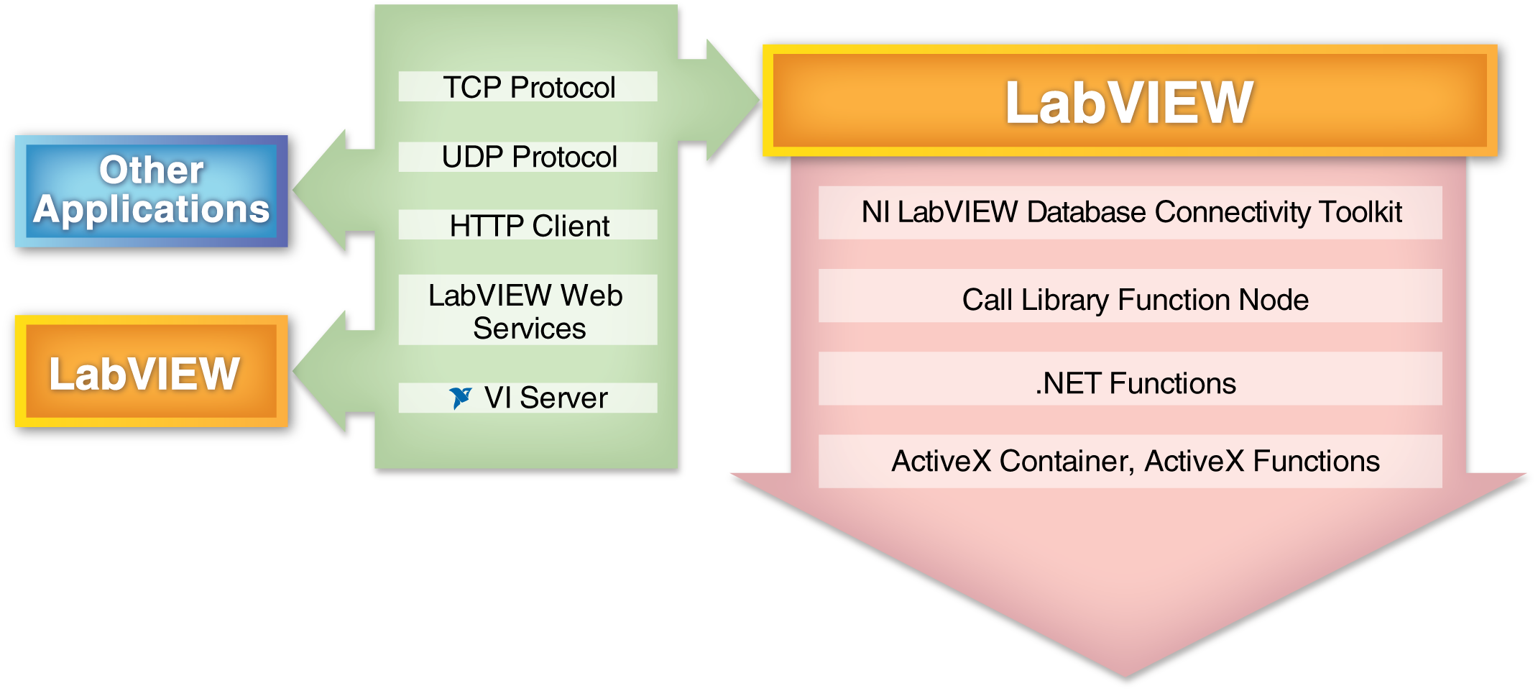
Connectivity Covered in this Course
Notes:
This slide represents the technologies covered in this course. Help students realize that this course covers a broad range of connectivity topics. Some of the technologies are use to control other applications – such as .NET functions – while some technologies allow the user to communicate between LabVIEW applications or between LabVIEW and another application.
Note: The green bi-directional technologies are typically client/server technologies. However, the HTTP Client VIs are only for client use. Similarly, LV Web Services are only for serving up web services. However, these two technologies work can work as a pair. Hence, for simplicity of the graphic, the HTTP Client and LV Web Services are listed along with other client/server technologies.

Slide 13
Lesson 1
Calling Shared Libraries in LabVIEW
Shared Libraries Overview
Calling Shared Libraries
Using the Import Shared Library Wizard
Notes:
Lesson objectives:
The learner should be able to
List items needed to call a function in a shared library
Function parameters, data types, calling conventions, path
Given a shared library and appropriate function documentation, create a VI to call the library from LabVIEW
Understand how to configure, wire and use the Call Library Function node
If a shared library is not thread safe, the user should select option to run in UI thread
List benefits and caveats of the Import Shared Library Wizard

Slide 14
A. Shared Library Overview
  A shared library is a software module containing executable code and data that can be called by applications or other shared libraries
  Functions and data in a shared library are loaded and linked at run time
  Shared libraries can be written in a variety of languages

Slide 15
Shared Library Overview (continued)
  Shared libraries expose functions and data through a standardized interface
  Most types of shared library definitions are similar to function definitions in the C programming language
  Shared libraries are often called by different names depending upon the platform where they are used
    Windows = DLLs
    MacOS = Frameworks
    Unix = Shared Libraries

Slide 16
Advantages of Shared Libraries
  Most changes to a shared library do not require changes to the calling VI
  Shared libraries allow you to call existing code in another language
  Most modern development environments provide support for creating shared libraries

Slide 17
B. Calling Shared Libraries
Two methods for calling a Shared Library from LabVIEW:
  Configure functions manually using the Call Library Function Node
  Allow LabVIEW to generate code by using the Import Shared Library wizard
Notes:
In this lesson we focus on the Call Library Function Node as it is the key node for interfacing with shared libraries. The Import Shared Library Wizard helps to automate the VI Wrapper creation process. However, the user still needs to know the details of using the Call Library Function Node. The Wizard is not a substitute for understanding the important decisions that need to be made when configuring the Call Library Function Node.

Slide 18
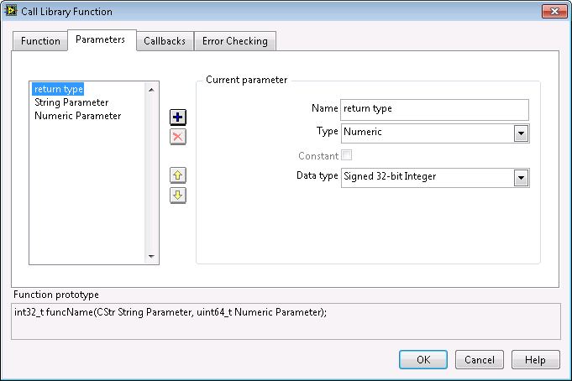
Call Library Function Node

Slide 19
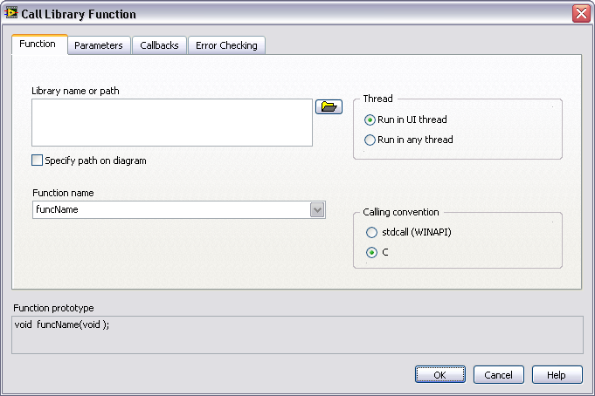
Thread Safe and Thread Unsafe DLLs
  By default all library calls run in the User Interface thread
  Changing the Thread option to Run in any thread:
    Allows the library to be called multiple times simultaneously
    Requires that the library is thread safe or G code to make sure the library is called only in a
    thread safe manner
Notes:
Introduce threads to the students.
Do not spent much time covering threads and thread safety. Thread safety is not a concept unique to LabVIEW. Through documentation or other sources, users need to assess if their shared libraries are thread safe or not. If they have doubts about whether or not their shared library is thread safe, then they should configure the Call Library Function Node to run in the UI thread.

Slide 20
Thread Safe DLL Characteristics
  Does not contain any unprotected global data
  Does not access any hardware
  Does not call functions that are not thread safe
Run in UI thread
Run in any thread

Slide 21
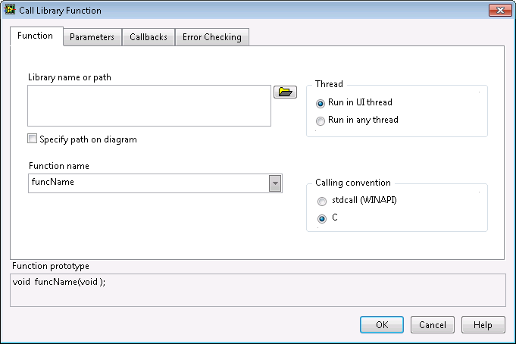
Calling Convention
The Calling convention defines the way parameters are passed to and from the shared library
  Stdcall (WINAPI)
  C
Shared library
documentation
generally specifies the
calling convention
Notes:
Calling conventions define the way to pass information from a piece of code to a function.
Refer to shared library documentation to set the appropriate calling convention. Using the incorrect calling convention can cause an irregular shutdown of LabVIEW.
So it is important setting in the Call Library Function Node.

Slide 22

Parameters
Each parameter corresponds to a terminal pair on the
Call Library Function Node
Notes:
Describe to the students how the function prototype needs to match the DLL that is being called.

Slide 23
Parameter Types
Select a data type for each parameter
Common Parameter Types
  Numeric
  Array
  String
  Adapt to Type
Notes:
This is an introduction slide. Emphasize the most used types which are: numeric, array, and string.

Slide 24
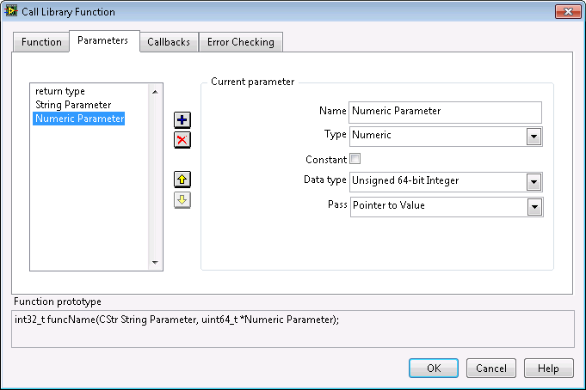
Numeric Parameter Type
Specify the numeric representation
Determine whether to pass by value or by reference
Notes:
Pass by value = passing the actual value (e.g. 101 = 101)
Pass by reference = refers the value, not the actual

Slide 25
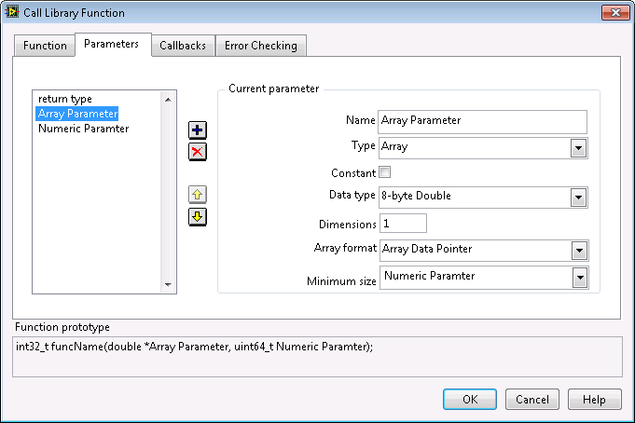
Array Parameter Type
  Select the data type of the array
  Select the number of dimensions for the array
  Determine how to pass the array (Array format)
  Create another parameter to specify the array size if the Array format is Array Data Pointer

Slide 26
Array Formats
Array Data Pointer
  Type *Array — Pointer to the first element of the array
    Shared library cannot change the array’s location in memory
Array Handle
  Type **Array — Pointer to a pointer to the array size and array data
    Shared library can resize the array
Array Handle Pointer
  Type ***Array — Pointer to a pointer to a pointer of the array size and array data
    Shared library can resize the array
    Shared library can delete the array or allocate a new array

Slide 27

String Parameter Type
Define the string format
Allocate memory for the string if necessary
  Create another parameter to define the string size if the String format is C or Pascal
  Allocate the buffer manually by passing a string with sufficient length into the input terminal

Slide 28
String Formats
\00 \00 \00 \04 t e x t
LabVIEW String Handles
string length string data
\04 t e x t
Pascal String Format
string length string data
t e x t \00
C String Format
string data NULL
Character
Notes:
LabVIEW stores strings as arrays (that is, structures pointed to by handles). The Call Library Function works with C and Pascal-style string pointers or LabVIEW String Handles.
You can think of a string as an array of characters; assembling the characters in order forms a string. LabVIEW stores a string in a special format in which the first four bytes of the array of characters form a signed 32-bit integer that stores how many characters appear in the string. Thus, a string with n characters will require n + 4 bytes to store in memory. For example, the string text contains four characters. When LabVIEW stores the string, the first four bytes contain the value 4 as a signed 32-bit number, and each of the following four bytes contains a character of the string. The advantage of this type of string storage is that NULL characters are allowed in the string. Strings are virtually unlimited in length (up to 2³¹ characters).
The Pascal string format is similar to the LabVIEW string format, but instead of storing the length of the string as a signed 32-bit integer, it is stored as an unsigned 8-bit integer. This limits the length of a Pascal style string to 255 characters. A Pascal string that is n characters long will require n + 1 bytes of memory to store.
C strings are probably the type of strings you will deal with most often. The similarities between the C-style string and normal numeric arrays in C becomes much clearer when one observes that C strings are declared as char *. C strings do not contain any information that directly gives the length of the string, as do the LabVIEW and Pascal strings. Instead, C strings use a special character, called the NULL character, to indicate the end of the string. NULL is defined to have a value of zero in the ASCII character set. Note that this is the number zero and not the character “0”.
Thus, in C, a string containing n characters requires n + 1 bytes of memory to store: n bytes for the characters in the string and one additional byte for the NULL termination character. The advantage of C-style strings is that they are limited in size only by available memory. However, if you are acquiring data from an instrument that returns numeric data as a binary string, as is common with serial or GPIB instruments, values of zero in the string are possible. For binary data where NULLs may be present, you probably should use an array of unsigned 8-bit integers. If you treat the string as a C-style string, your program will assume incorrectly that the end of the string has been reached, when in fact your instrument is returning a numeric value of zero.

Slide 29
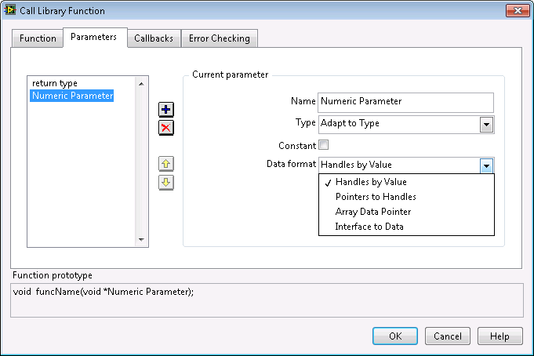
Adapt to Type Parameter
Use to pass arbitrary LabVIEW data types to DLLs
  Scalars are passed by reference
  Arrays and strings are passed according to Data format
  Clusters are passed by reference
  Call Shared Library Function Node does not enforce type of items wired to it
Notes:
Wiring a new type to a Call Shared Library Node will pass the new type to the shared library

Slide 30
Working with Unusual Data Types
Calling a function with unusual data types requires a deep understanding of the data and how it is represented in memory
  If data does not contain pointers:
    Use Flatten to String to create a string containing the binary image of the data
    Use byte order input to Flatten to String to specify native byte order
  If data contains pointers or is otherwise complex:
    Create a bridge DLL that accepts the data from LabVIEW and then calls the other library with the expected data structure
Notes:
Shared library data types can be extremely complex. Depending on the complexity, the user might have extra work to do for LabVIEW to interface with the shared library function.
Use of Flatten to String might be one way of passing data. Another option is to create a wrapper DLL. Where the wrapper DLL splits out the complex data type into more simple data types that can easily be called from LabVIEW.

Slide 31
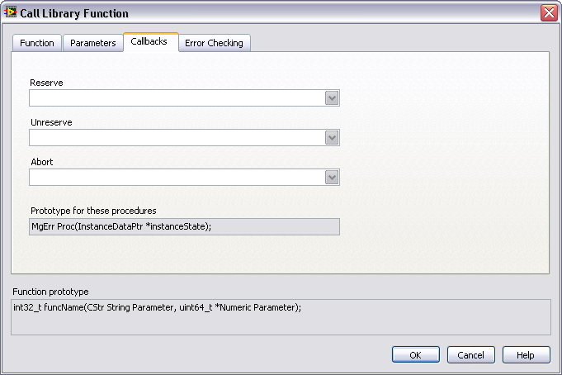
Callbacks
  Callbacks allow you to automatically call functions from the DLL when certain events occur in the program
  Most commonly used to clean up resources allocated by the DLL in the event of an aborted VI

Slide 32
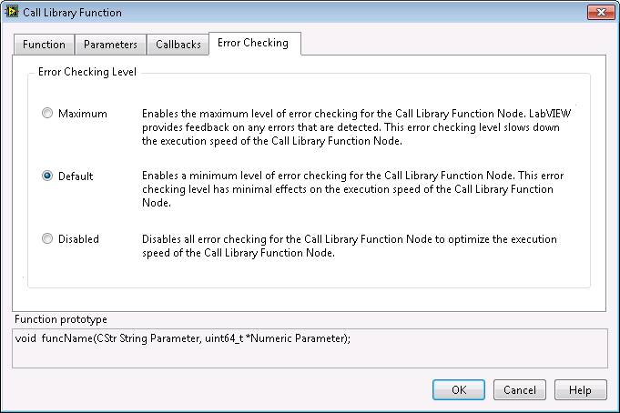
Error Checking
  Disabled – does not provide error checking
  Default mode – catches exceptions thrown from the DLL
  Maximum – catches exceptions and pads arrays and strings with guard bytes

Slide 33
Exercise 1-1: Computer Name
Call a DLL function from the Windows API
Notes:
Exercise time: 30 minutes

Slide 34
Exercise 1-1: Computer Name
Why is the FormatMessage function called when the GetComputerName return value is zero?
How do you know that you should check for zero?
Notes:
According to the GetComputerName function description,
If the function succeeds, the return value is a nonzero value.
If the function fails, the return value is zero. To get extended error information, call GetLastError.
Therefore, we only need to format the error message when the GetComputerName fails. Returning a non-zero value when a function succeeds is different from common Error Handling practices in LabVIEW where the non-zero value error code returned in an Error Cluster is often signifies failure, not success. Therefore, it is critical to read function documentation when interfacing with applications outside of LabVIEW.
You know to check for a zero return value because the function description indicates this behavior. The function descriptions for this exercise are included in your exercise folder. You should always consult function help when configuring Call Library Nodes.
Other discussion topics:
- Why is GetLastError not included in the case structure?
- According to documentation, GetLastError needs to be called as quickly as possible after the previous function call. The further away it is, the more likely another function could be called that will cause the GetLastError value to be incorrect. Also, we include the GetLastError in a sequence structure to ensure it is called in the same thread. The GetlastError function is typically a fast function call so shouldn’t add much overhead. However, to squeeze out extra performance, could include another Case structure within the sequence structure.

Slide 35
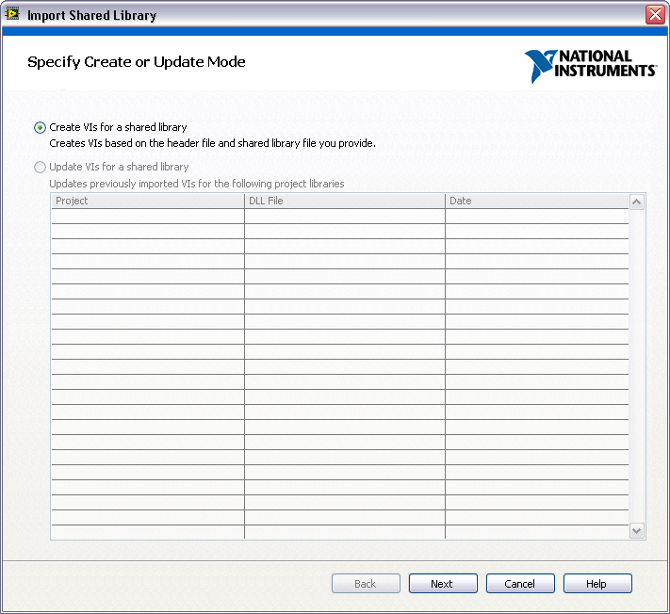
C. Using the Import Shared Library Wizard
  Wizard generates Call Library Function Nodes and creates a library of subVIs from shared libraries
  To start the wizard, select Tools»Import»Shared Library
  Wizard requires a header file for the shared library

Slide 36
Benefits of Import Shared Library Wizard
  Reduces time to create and edit VI wrappers
    Automates process using configuration-based wizard
    Stores configuration information in order to refine generated API
  Converts a pointer to a value to access strings, arrays, structs
Notes:
Benefits of using the Import Shared Library Wizard
· Reduce time needed to create and edit VI wrappers over Call Library Nodes that call a shared library.
o Automate process using a configuration-based wizard
o Stores configuration information allowing you to refine or tweak generated API.
· Convert a pointer to a value to get access of strings, arrays, and structs in LabVIEW.

Slide 37
Caveats of Using Import Shared Library Wizard
  Requires knowledge of C prototypes
    Greater familiarity allows better optimization of LabVIEW wrapper VIs
  Must have a header file for shared library
    Custom header files to simplify parsing complex header files might be required
  Some complex parameter types not supported
    Examples: array of structures, structs as return values
    To work around, create and link to a custom control
Notes:
Caveats:
· Use of the wizard still requires knowledge of the C prototypes
o The more familiar you are with the C API, the better you can optimize the LabVIEW wrapper VIs
o The more complex your function prototypes, the more important it is to understand your C API and the conversion to a LabVIEW interface
· You must have a header file for your shared library
o You might need to create a custom header file to simplify parsing of complex header files (deep nesting, many predefined symbols, use of macros, etc.)
· Some complex parameter types are not supported
o Example: array of structures, structs as return values, etc.
o Refer to Supported Data Types for the Import Shared Library Wizard help topic for detailed list of supported data types.
o To work around this limitation, you may need to create a custom control and link to it.
· Refer to Troubleshooting the Import Shared Library Wizard help topic for troubleshooting common issues.
Note: If students are interested in shared libraries, instructors can optionally demo the Import Shared Library wizard using demo files found in the exercises/demonstrations folder.

Slide 38
Summary – Quiz
Which of the following do you need to know to call a function in a shared library?
  Data type returned by the function
  Calling convention
  Development environment that created the shared library
  Order of parameters to be sent to the function

Slide 39
Summary – Quiz Answers
Which of the following do you need to know to call a function in a shared library?
  Data type returned by the function
  Calling convention
  Development environment that created the shared library
  Order of parameters to be sent to the function
Notes:
The answer is a, b, and d. C is incorrect because you do not need to know what development environment (C, Visual Basic, etc) created the shared library. You do need to know the data type returned by the function, the calling convention used, the parameters to be sent to the function (types and order), the location of the shared library on your computer, and whether the function is thread-safe.

Slide 40
Summary – Quiz
You have inherited a DLL that accesses hardware and is known not to be thread safe. Which configuration would you choose for your Call Library Function Node?
  Run in UI thread
  Run in any thread

Slide 41
Summary – Quiz Answers
You have inherited a DLL that accesses hardware and is known not to be thread safe. Which configuration would you choose for your Call Library Function Node?
  Run in UI thread
  Run in any thread

Slide 42
Summary – Quiz
True or False? The only file the Import Shared Library Wizard requires is a shared library.

Slide 43
Summary – Quiz Answer
True or False? The only file the Import Shared Library Wizard requires is a shared library.
False. The Import Shared Library requires both a shared library and its header file.

