Slide 1
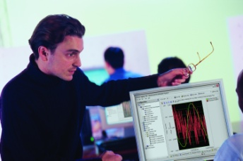














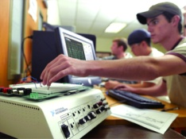
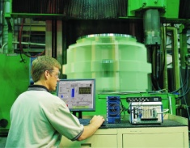




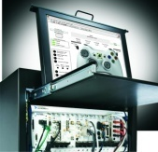


基于LabVIEW实现
数据采集

Slide 2
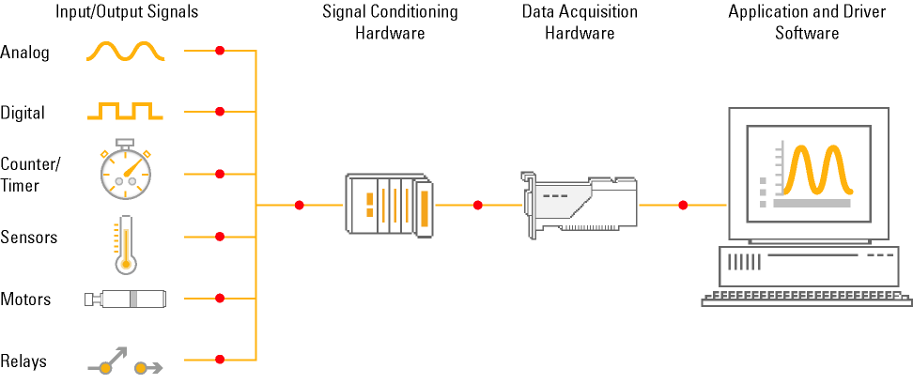
基于PC的数据采集系统 (DAQ)
Notes:
A typical data acquisition system based on virtual instrumentation consists of five parts:
Sensors or signals – The signals you are acquiring or generating with your data acquisition system.
Signal conditioning hardware – Used to remove noise, amplify the signal, or excite sensors. This hardware is sometimes integrated with DAQ hardware.
DAQ hardware – The interface between the computer and the outside world. Its primary function is to convert analog signals to digital so that the computer can interpret them.
Measurement Services software – Measurement Services software forms the layer between the hardware and your application software. It should provide configuration and installation services, a programming interface, self-calibration, and other features to simplify the interface with DAQ hardware.
Application-level software – This is the software program you develop using a standard programming environment such as LabVIEW, C, or Visual Basic.

Slide 3
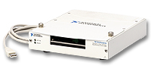
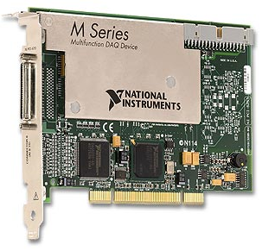
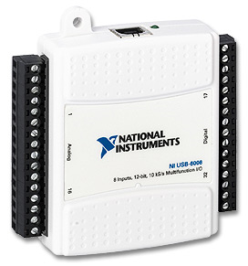
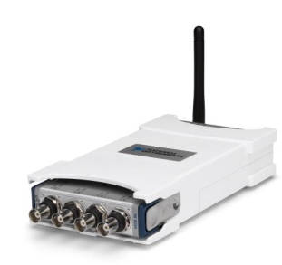
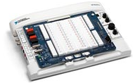
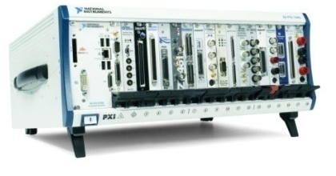
NI DAQ平台
数据采集硬件(DAQ)
  真实数据采集卡，USB、PCI、PXI或以太网总线接口
  在NI Measurement and Automation Explorer (MAX)硬件管理器中进行配置
Notes:
This LabVIEW course is designed for audiences with or without access to National Instruments hardware.
Each exercise is divided into three tracks, A, B, and C
Track A is designed to be used with hardware supported by the NI-DAQmx driver. This includes most USB, PCI, and PXI data acquisition devices with analog input. Some signal conditioning and excitation (external power) is required to use a microphone with a DAQ device.
Track B is designed to be used with no hardware. You can simulate the hardware with NI-DAQmx Version 8.0 and later. This is done by using the NI-DAQmx Simulated Device option in the Create New menu of MAX. The simulated device’s driver is loaded, and programs using it are fully verified.
Track C is designed to be used with a standard sound card and microphone. LabVIEW includes simple VIs for analog input and analog output using the sound card built into many PCs. This is convenient for laptops because the sound card and microphone are usually already built-in.

Slide 4
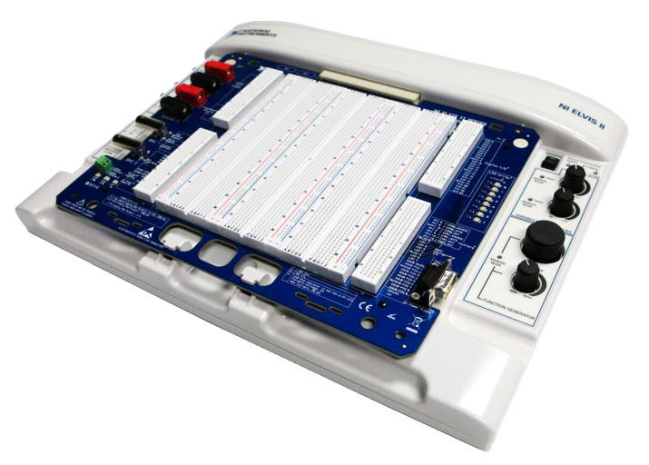
使用硬件——ELVISII平台硬件指标
内部电路保护
  可复位保险丝
新 ELVISII+
  100MS/s 采样率
  50MHz 带宽(-3dB)
  8 bit 分辨率
  ±20 V max. 输入范围
  AC/DC/GND 耦合
  20MHz 可选噪声滤波器
  1x 和 10x 探头
  BNC 连接
示波器
  16 bit 分辨率
  1.25 MS/s 单通道
  500kS/s 双通道共计
  1到1.5 MHz 带宽
  1x和10x探针
  ±10 V 输入范围
  AC/DC耦合
  BNC连接
USB连接
  即插即用
  USB 2.0
函数发生器
  10-bit
  ±5V范围
  0.2 Hz到5 MHz 正弦
  0.2 Hz到1 MHz 三角波/方波
  软件或手动可控
  BNC或原型板连接
数字万用表
  隔离
  5½ 位
  60 VDC，20Vrms, 2 ADC, 2 Arms, 100MΩ

Slide 5
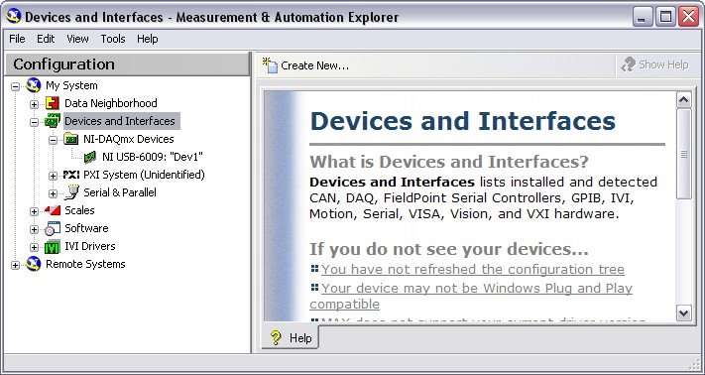

什么是MAX?
Measurement & Automation Explorer缩写
配置和管理所有NI的硬件，包括DAQ, PCI/PXI, GPIB, 图像采集, 仪器控制, 运动控制, VISA, and VXI设备
NI硬件功能测试
Windows桌面显示的图标
Notes:
The next level of software is called Measurement & Automation Explorer (MAX). MAX is a software interface that gives you access to all of your National Instruments DAQ, GPIB, IMAQ, IVI, Motion, VISA, and VXI devices. The shortcut to MAX appears on your desktop after installation. A picture of the icon is shown above. MAX is mainly used to configure and test your National Instruments hardware, but it does offer other functionality such as checking to see if you have the latest version of NI-DAQmx installed. When you run an application using NI-DAQmx, the software reads the MAX configuration to determine the devices you have configured. Therefore, you must configure DAQ devices first with MAX.
The functionality of MAX falls into six categories:
Data Neighborhood
Devices and Interfaces
IVI Instruments
Scales
Historical Data
Software
This course will focus on Data Neighborhood, Devices and Interfaces, Scales, Software, and learn about the functionality each one offers.
© National Instruments Corporation 11 Introduction to LabVIEW Hands-On

Slide 6
应用软件
NI LabVIEW
3000多测试例程
400个分析 VIs
DAQ
Assistant
逐步配置
自动代码生成
驱动软件 –
NI-DAQmx
API
虚拟通道
I/O 控制
多态 VIs
缩放
波形数据类型
函数 和 VIs
配置管理工具
Measurement &
Automation Explorer
Driver Engine
缓存/DMA
快速单点采集
多线程
测试面板
多功能仪器控制
硬件配置
数据存储
多仪器的时钟和同步
Notes:
NI-DAQmx manages a lot of the routing via the RTSI bus for the user. However, the user must tell the driver how the devices are connected to one another through internal busses. For PCI systems, you must register the RTSI cable that connects your devices together in MAX. For PXI systems, you must tell the driver what PXI Chassis you are using.

Slide 7
不仅仅是驱动软件：NI-DAQmx
通过Measurement and Automation Explorer (MAX)配置和验证建立数据采集任务
使用数据采集助手DAQ Assistant快速建立应用
最新的 API
  多态的函数
  自动代码生成
改进的驱动架构
  多线程测量
  即刻的校准
  单点操作快20倍
  代码生成
Application Software
Configuration
Manager
DAQ Assistant
API
Driver Engine (DLL)
Hardware
NI-DAQmx 测量和控制服务
Notes:
NI-DAQmx still performs as a driver and connects your hardware with your application software, but there is so much more.
Driver Engine technologies give you the highest performance out of your DAQ device. They eliminate the hidden cost of not achieving the desired DAQ specs.
- Buffering – needs to be robust so you don’t end up doing complicated, low-level programming
- Single-Point I/O – must be specifically optimized for. Most drivers are not.
- Multi-threading – Biggest and most important technology in NI-DAQmx
API
- Scaling – Takes raw binary and returns voltages. It should be unacceptable for a measurement services to just return binary.
- Virtual Channels – Most often overlooked feature in measurement services. None of the sensors on the drill test system returned voltage so why should my VIs return voltage.
- Polymorphic VIs- You save time by only having to learn one concept for all operations.
Configuration Manager – Reduces configuration, debug, and deployment time.
DAQ Assistant – Goal is to reduce time spent developing, plain and simple.
So we’ve discussed a lot of technologies which simplify development and reduce time spent. It is the goal of the entire measurement services software to make the hardware disappear with respect to you software application. You should spend little to no time learning about hardware or their intricacies. You should focus only on your measurement.

Slide 8
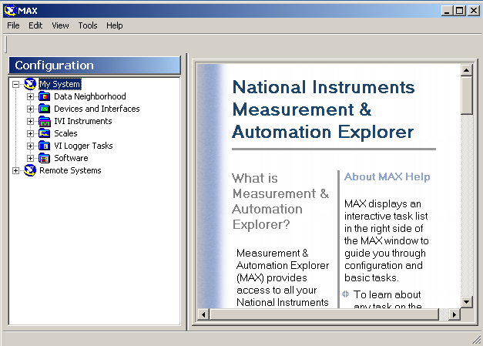
配置诊断工具 (MAX)
Measurement and Automation Explorer
系统管理工具
配置硬件
自校准
创建虚拟通道
硬件设备仿真
在驱动软件层将数据自动换算成工程单位
Notes:
MAX is a system management software , in which we can do lots of things about NI hardwares and softwares , such as hardware configuration, self-test & calibration, device simulation and so on.
The demo script will be located in (here)\demos\demo1 MAX.

Slide 9
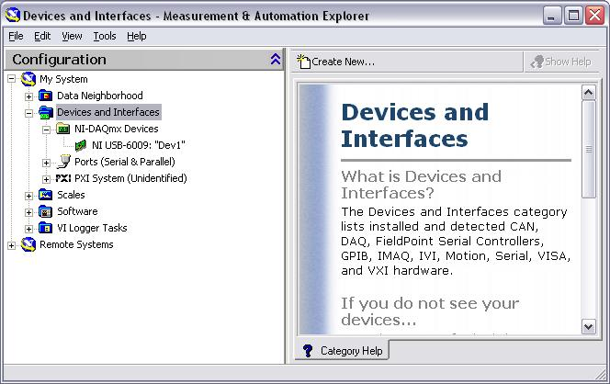
硬件安装
使用Measurement and Automation Explorer (MAX) :
  配置和测试真实的数据采集设备
真实硬件
Notes:
Exercise 1.1 – Testing Your Device (Track A)
In this exercise, use Measurement and Automation Explorer (MAX) to test
your USB-6009 DAQ device.
1. Launch MAX by double-clicking the icon on the desktop or by selecting Start»Programs»National Instruments»Measurement & Automation.
2. Expand the Devices and Interfaces section to view the installed National Instruments devices. MAX displays the National Instruments hardware and software in the computer.
3. Expand the NI-DAQmx Devices section to view the installed hardware that is compatible with NI-DAQmx. The device number appears in quotes following the device name. The data acquisition VIs use this device number to determine which device performs DAQ operations. Your hardware is listed as NI USB-6009: “Dev1.”
Perform a self-test on the device by right-clicking it in the configuration tree and choosing Self-Test or clicking “Self-Test” along the top of the window. This tests the system resources assigned to the device. The device should pass the test because it is already configured.
Check the pinout for your device. Right-click the device in the configuration tree and select Device Pinouts or click “Device Pinouts” along the top of the center window.
Open the test panels. Right-click the device in the configuration tree and select Test Panels… or click “Test Panels…” along the top of the center window. With test panels, you can test the available functionality of your device, analog input/output, digital input/output, and counter input/output without doing any programming.
On the Analog Input tab of the test panels, change Mode to “Continuous” and Rate to “10,000 Hz.” Click “Start” and hum or whistle into your microphone to observe the signal that is plotted. Click “Stop” when you are done.
On the Digital I/O tab, notice that initially the port is configured to be all input. Observe under Select State the LEDs that represent the state of the input lines. Click the “All Output” button under Select Direction. Notice you now have switches under Select State to specify the output state of the different lines. Toggle line 0 and watch the LED light up. Click “Close” to close the test panels.
Close MAX.
Introduction to LabVIEW Hands-On 12 ni.com

Slide 10
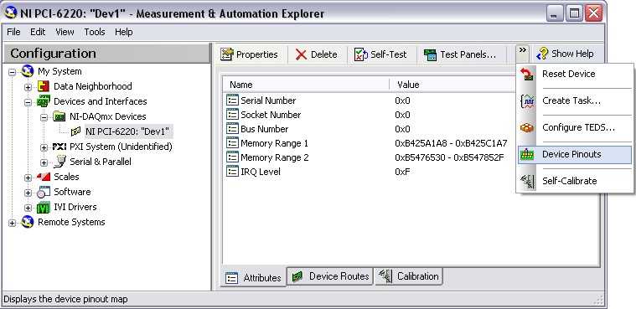
硬件仿真
使用Measurement and Automation Explorer (MAX):
  配置和测试在MAX中仿真的数据采集设备
Notes:
Exercise 1.1 – Setting Up Your Device (Track B)
In this exercise, use Measurement and Automation Explorer (MAX) to configure a simulated DAQ device.
Launch MAX by double-clicking the icon on the desktop or by selecting Start»Programs»National Instruments»Measurement & Automation.
Expand the Devices and Interfaces section to view the installed National Instruments devices. MAX displays the National Instruments hardware and software in the computer. The device number appears in quotes following the device name. The data acquisition VIs use this device number to determine which device performs DAQ operations.
Create a simulated DAQ device for use later in this course. Simulated devices are a powerful tool for development without having hardware physically installed in your computer. Right-click Devices and Interfaces and select Create New…»NI-DAQmx Simulated Device. Click “Finish.” The simulated device appears yellow in color.
Expand the M Series DAQ section. Select PCI-6220 or any other PCI device of your choice. Click “OK.”
The NI-DAQmx Devices folder expands to show a new entry for PCI-6220: “Dev1.” You have now created a simulated device.
Perform a self-test on the device by right-clicking it in the configuration tree and choosing Self-Test or clicking “Self-Test” along the top of the window. This tests the system resources assigned to the device. The device should pass the test because it is already configured.
Check the pinout for your device. Right-click the device in the configuration tree and select Device Pinouts or click “Device Pinouts” along the top of the center window.
Open the test panels. Right-click the device in the configuration tree and select Test Panels… or click “Test Panels…” along the top of the center window. The test panels allow you to test the available functionality of your device, analog input, digital input/output, and counter input/output without doing any programming.
On the Analog Input tab of the test panels, change Mode to “Continuous.” Click “Start” and observe the signal that is plotted. Click “Stop” when you are done.
Introduction to LabVIEW Hands-On 14 ni.com

Slide 11
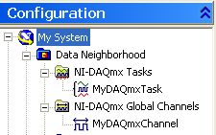

演示：在MAX中建立通道和任务
Demo
Notes:
MAX中创建一个Task或global channel，并将其自动转为labview代码（example，configuration共三种），同时演示一下labview中有关DAQ的这部分VI（所在的palette,大致的功能等等）
Demo 1 : MAX

Slide 12
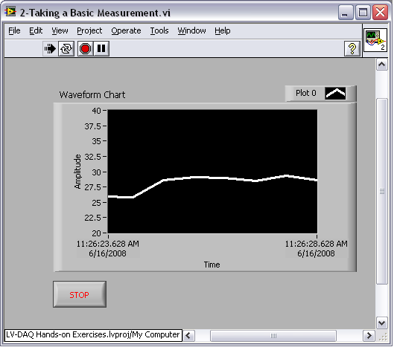
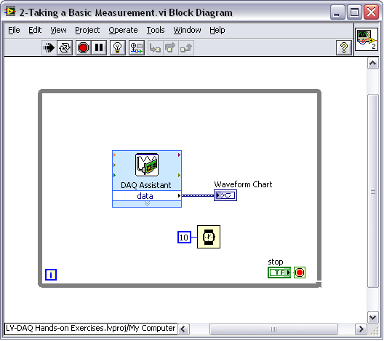
练习1 – 使用DAQ采集数据
  从DAQ设备采集虚拟信号至计算机
于波形图中即时显示
Notes:
Exercise 1.2 – Acquiring a Signal with DAQ (Track A)
Complete the following steps to create a VI that acquires data continuously from your
DAQ device.
Launch LabVIEW.
2. In the Getting Started window, click the File»New or More … link to display the New dialog box.
3. Open a data acquisition template. From the Create New list, select VI»From Template»DAQ»Data Acquisition with NI-DAQmx.vi and click “OK.”
4. Display the block diagram by clicking it or by selecting Window»Show Block Diagram. Read the instructions written there about how to complete the program.
5. Double-click the DAQ Assistant to launch the configuration wizard.
Configure an analog input operation.
a. Choose Acquire Signals»Analog Input»Voltage.
b. Choose Dev1 (USB-6009)»ai0 to acquire data on analog input channel 0 and click “Finish.”
c. In the next window, define the parameters of your analog input operation. To choose an input range that works well with your microphone, on the settings tab enter 2 V for the maximum and –2 V for the minimum. Under timing settings choose “Continuous” for the acquisition mode and enter 10000 for the rate. Leave all other choices set to their default values. Click “OK” to exit the wizard.
Place the Filter Express VI to the right of the DAQ Assistant on the block diagram. From the Functions palette, select Express»Signal Analysis»Filter and place it on the block diagram inside the while loop. When you bring up the Functions palette, press the small pushpin in the upper left-hand corner of the palette. This tacks down the palette so that it doesn’t disappear. This step is omitted in the following exercises, but you should repeat it. In the configuration window under Filtering Type, choose “Highpass.” Under Cutoff Frequency, use a value of 300 Hz. Click “OK.”
Introduction to LabVIEW Hands-On 28 ni.com

Slide 13
分析与信号处理

Slide 14
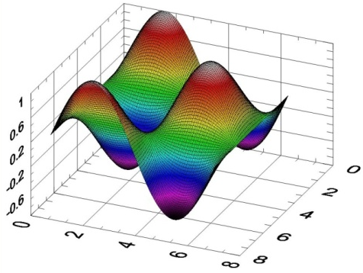
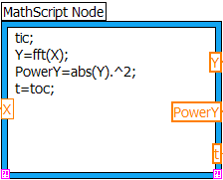
LabVIEW — 强大的信号处理分析能力
  内置1000多个信号处理、分析与数学运算函数
  频域分析、信号生成、数学计算、曲线拟合插值等
  基于文本的数学运算 (MathScript)
  多个面向特定应用的工具包（声音与振动、JTFA等）
  与数学分析标准软件的接口
Notes:
This platform is built is built on 3 key tenets we always try and support with each version of LabVIEW. For the Scientist who is an expert in his field but may not be a programmer, we want to make it easy for him to get his data. For the experienced developer, we provide tools to leverage their PCs to create powerful applications. At the same time, LabVIEW remains an open platform allowing users to integrate their external code, tools, and technologies

Slide 15
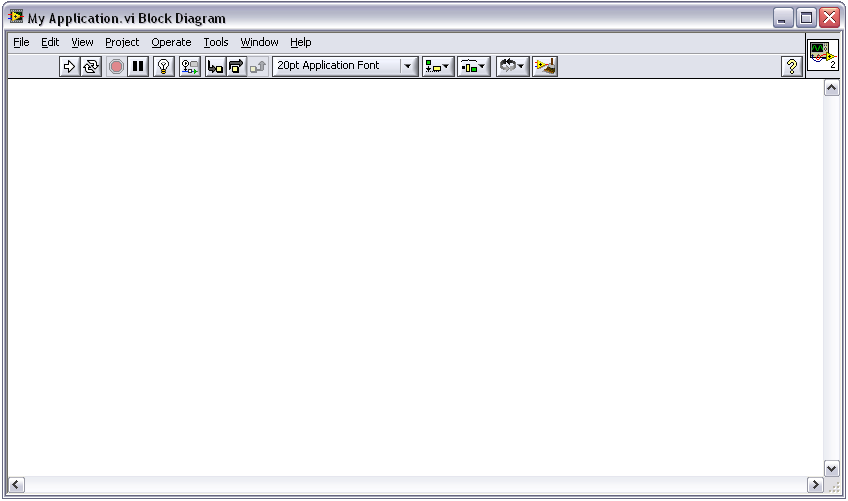
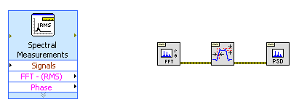
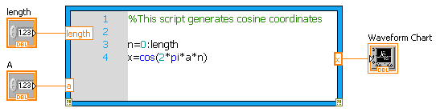
使用分析函数VI
可编程的底层VI
基于配置的Express VI
基于文本的
MathScript节点
Notes:
Like other functions in the block diagram, analysis functions are available in standard VIs and Express VIs. Standard VIs will give you greater control over the order, inputs and execution of your application’s analysis. Express VIs make adding analysis functionality quick and easy at the expense of some control in your application’s execution.
In addition to the over 600 analysis VIs in LabVIEW, there is LabVIEW MathScript, which enables you to implement your algorithms textually and incorporate your .m files into your application. This seminar does not include further detail concerning LabVIEW MathScript. For more information visit ni.com/mathscript.

Slide 16
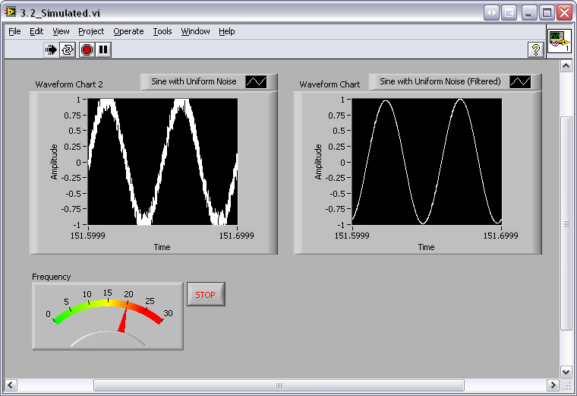
练习 2 – 信号分析
使用LabVIEW Express VIs to:
  使用仿真的数据采集卡采集一个信号，并在前面板显示其幅值和频率
仿真硬件
Notes:
Exercise 2.2 – Analysis (Track B)
Create a VI that measures the frequency of a filtered simulated signal and shows the difference between the filtered and unfiltered signal. You have to simulate the noise in the Simulate Signal Express VI. Try to do this without following the instructions.
Open a blank VI.
Place two waveform charts on the front panel. Right-click to open the Controls palette and select Controls»Modern»Graph»Waveform Chart.
Place a numeric meter on the front panel. The Meter is found in Controls»Modern»Numeric»Meter.
Right-click the y-axis on each waveform chart and deselect “AutoScale Y.”
Change the scale on the y-axis on both charts to -1 to 1 v by double-clicking the maximum and minimum axis values and typing the new value. Change the scale of the meter to 0 to 30.
Go to the block diagram and place a while loop around the charts and the meters (Express»Execution Control»While Loop).
Place a Simulate Signal Express VI on the block diagram (Express»Input»Simulate Sig). Change the Frequency (Hz) to 20, Select to add noise, and set the Samples per Second (Hz) to 10000.
Ensure that the Noise Type is “Uniform White Noise” and the Noise Amplitude is “0.2.”
Place the Filter Express VI to the right of the DAQ Assistant on the block diagram. From the Functions palette, select Express»Signal Analysis»Filter and place it on the block diagram inside the while loop. In the configuration window under Filtering Type, choose “Lowpass.” Under Cutoff Frequency, use a value of 35 Hz. Click “OK.”
Connect the output terminal of the Simulate Signal VI to the “Signal” input of the Filter VI. Connect the waveform charts to the “Filtered Signal” output and the output of the Simulate Signal VI.
Place a Tone Measurements Express VI on the block diagram (Express»Signal Analysis»Tone). Select “Frequency” under Single Tone Measurements.
Connect the output of the Filter VI to the “Signals” input of the Tone Measurements Express VI. Also, connect the “Frequency” output to the meter.
Return to the front panel and run the VI. Observe your acquired signal and its frequency and amplitude. Hum or whistle into the microphone and observe the frequency that you are producing.
Save the VI as “Exercise 3.2 - Data.vi.”
Close the VI.
Note: The solution to this exercise is printed in the back of this manual.
(End of Exercise)
Introduction to LabVIEW Hands-On 46 ni.com

Slide 17
报表生成与数据表达

Slide 18
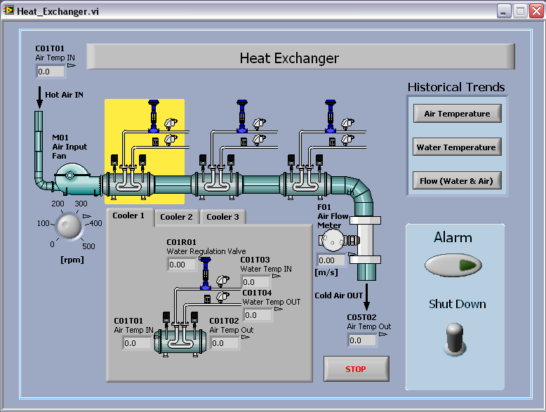
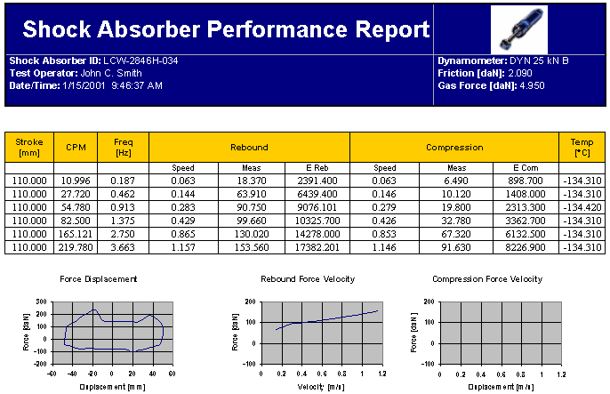
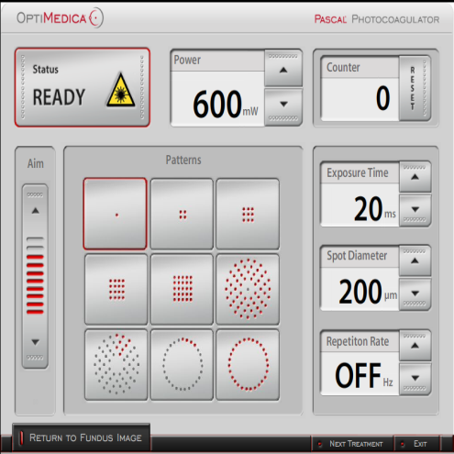
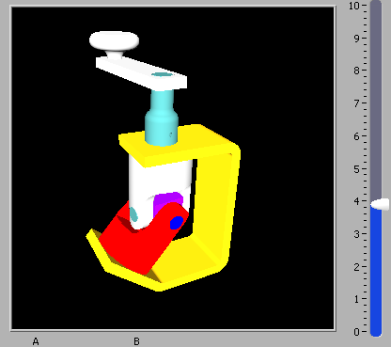
有效的数据表达与存储
数据可视化
报表生成与数据存储
内置用户界面控件
波形图与波形图表
远程应用程序控制
文件 I/O 功能
基于HTML的报表生成
Microsoft Word and Excel 报告
Notes:
A fundamental aspect of all programming languages is the ability to create well designed user interfaces to interact with you application. Effective visualization and presentation of results is essential for making decisions, monitoring processes, and sharing information. LabVIEW includes a wide array of visualization tools to display your data. Some of these tools include charting and graphing utilities, and built-in 2D and 3D visualization tools. Attributes of your presentation such as color, font size, and graph type can be reconfigured, and you can even rotate, zoom, and pan your graphs at run­time.
LabVIEW also contains functions for storing your data in a variety of ways. You can write data to ASCII and binary files, publish it in standard formats such as HTML or XML, and programmatically create custom reports. LabVIEW offers several reporting options, including documentation-generation tools, HTML reports, programmatic generation of Microsoft Word and Excel reports, and interactive report generation with NI DIAdem.
Finally, we must consider data management and connectivity. NI DIAdem offers data management and offline analysis for large data sets, tools such as the Database Connectivity Toolkit allow you to connect to third-party databases, and standard File I/O to save data. LabVIEW also offers a full range of options for communications and data standards, such as TCP/IP, BlueTooth, OPC, SQL database connectivity, and XML data formats.

Slide 19

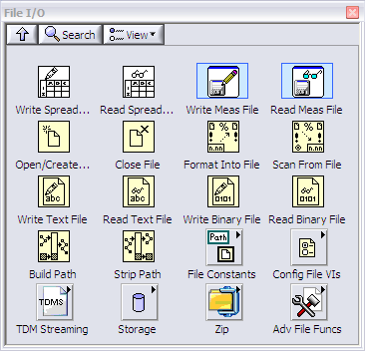




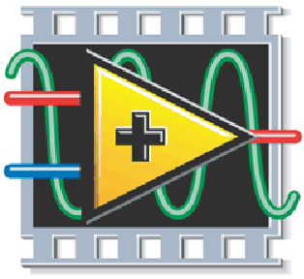
LabVIEW 支持的存储类型
ASCII
Binary
HTML
XML
LVM
TDM(S) *
Excel
Word
Datalog
数据库
Notes:
A main part of your applications will include saving data to disk for later analysis and reporting. You have several choices in LabVIEW to save data in a variety of different formats. If you do not want to worry about the details of saving your data, LabVIEW has several options to save data in industry standard formats that are portable to applications such as Excel. If you do need to conform to a particular data format standard, LabVIEW offers all the low level file I/O functions you need to write data out exactly as you need it.
File I/O can be a major pain point for companies, especially when multiple people need to share data. To help solve these challenges NI developed a file format called TDM. TDM is designed to help you make your “data search” ready. To see how you can benefit from TDM, see the additional information included in this manual’s appendix.

Slide 20
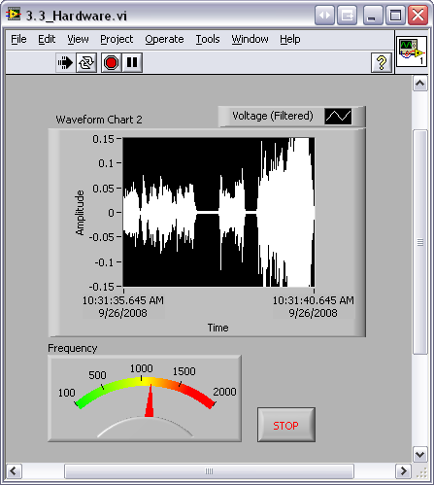
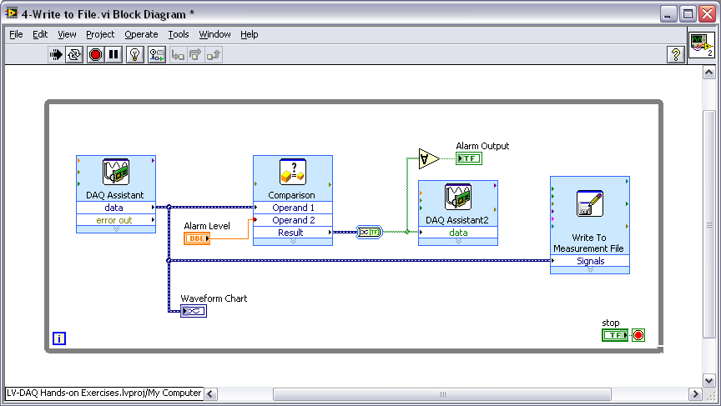
练习 3 –数据存储
使用Case结构判断:
  条件满足时，进行虚拟信号数据存储
Track A,B,C
Notes:
Exercise 2.3 – Decision Making and Saving Data (Tracks A, B, and C)
Create a VI that you can use to save your data to file if the frequency of your data
goes below a user-controlled limit.
Open Exercise 3.2 – Data.vi.
Go to File»Save As… and save it as “Exercise 3.3 – Decision Making and Saving Data.” In the “Save As” dialog box, make sure substitute copy for original is selected and click “Continue…”
Add a case structure to the block diagram inside the while loop (Functions»Programming»Structures»Case Structure).
Inside the “true” case of the case structure, add a Write to Measurement File Express VI (Functions»Programming»File I/O»Write to Measurement File).
a. In the configuration window that opens, choose “Save to series of files
(multiple files).” Note the default location your file will be saved to and change it if you wish.
b. Click “Settings…” and choose “Use next available file name” under the
Existing Files heading.
c. Under File Termination, choose to start a new file after 10 segments. Click “OK” twice.
Add code so that if the frequency computed from the Tone Measurements Express VI goes below a user-controlled limit, the data will be saved to file. Hint: Go to Functions»Programming»Comparison»Less?
Remember to connect your data from the Filter Express VI to the “Signals” input of the Write to Measurement File VI. If you need help, refer to the solution of this exercise.
Go to the front panel and run your VI. Vary your frequency limit and then stop the VI.
Navigate to My Documents»LabVIEW Data (or the location you specified) and open one of the files that was saved there. Examine the file structure and check to verify that 10 segments are in the file.
Save your VI and close it.
Note: The solution to this exercise is printed in the back of this manual.
(End of Exercise)
Introduction to LabVIEW Hands-On 50 ni.com

Slide 21
LabVIEW Case Studies
What can you do with LabVIEW? Tons!
Two-Player Chess
Ballistic Trajectory Calculator
Mouse Position Calculator
Notes:
Introduction to LabVIEW Hands-On 78 ni.com

Slide 22
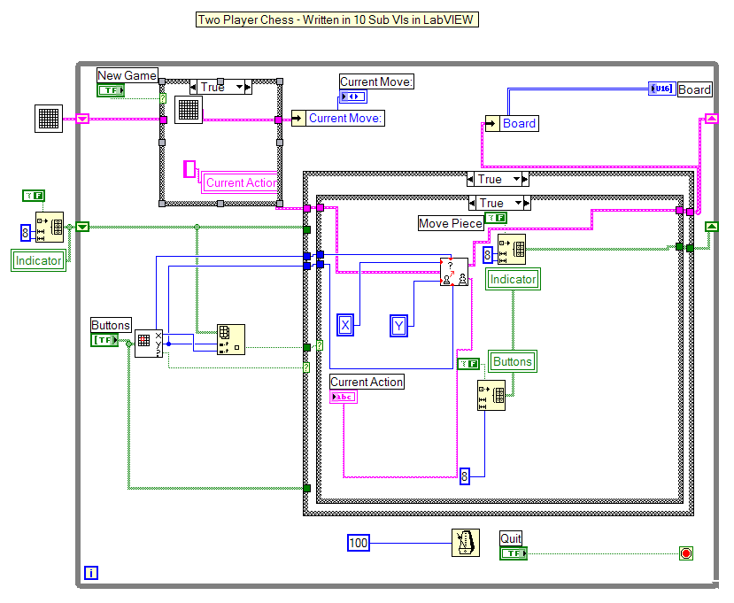
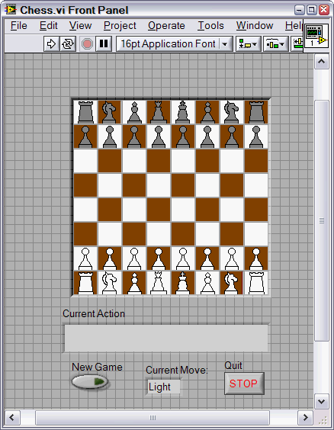
Two-Player Chess
Written in LabVIEW using subVIs and custom controls
Notes:
This LabVIEW VI allows two human players to play chess. Using several custom controls and many of the LabVIEW constructs that you’ve worked with in this manual, the VI determines legitimate moves and displays the game in real time. The block diagram shown in the above slide handles the high-level management of the subVIs and acts as the user interface. The block diagram shown below is used to reset the board.
© National Instruments Corporation 79 Introduction to LabVIEW Hands-On

Slide 23
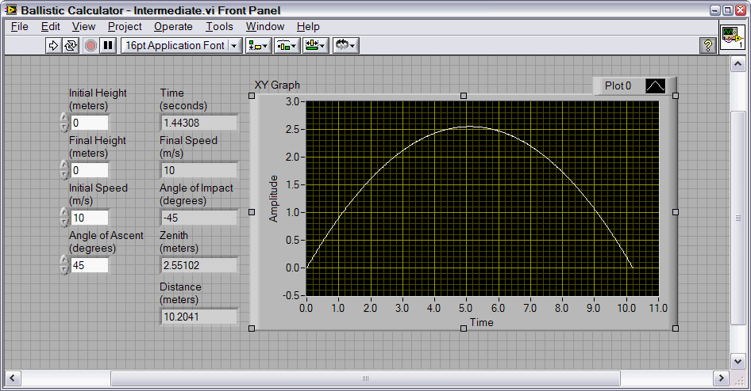
Ballistic Trajectory Calculator
This LabVIEW VI calculates and graphs a ballistic trajectory based on the given parameters.
Notes:
Using the code shown in the block diagram below, this LabVIEW VI calculates a projectile’s ballistic trajectory based on the fundamental kinematic equations. Note the use of decision making using case structures and the modularity provided by the three subVIs.
Introduction to LabVIEW Hands-On 80 ni.com

Slide 24
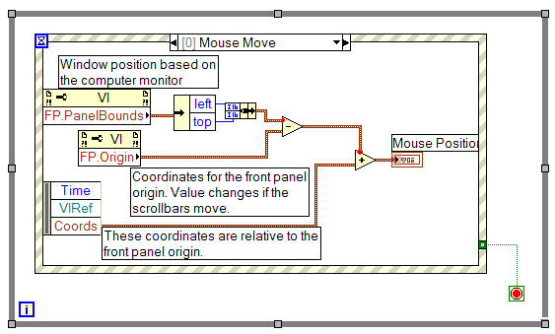
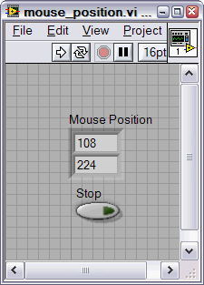
Mouse Position Calculator
Calculate the position of your mouse cursor on the monitor using LabVIEW and event structures.
Notes:
This VI uses several more advanced LabVIEW functions to calculate the position of your mouse cursor on the monitor. The VI uses two key elements. The first, event structures, are like case structures, but they are triggered from events instead of front panel elements. These events can include moving or clicking the mouse, using the keyboard, and many, many others. The other element that the VI uses are property nodes. With property nodes, you can read or set many properties of various VI elements and elements of the system. These are just some of the many powerful tools in LabVIEW that remain for you to discover.
© National Instruments Corporation 81 Introduction to LabVIEW Hands-On

Slide 25
The LabVIEW Certification Program
Architect
Mastery of LabVIEW
Expert in large application development
Skilled in leading project teams
Certified
LabVIEW
Architect
Developer
Advanced LabVIEW knowledge and application development experience
Project management skills
Certified LabVIEW Developer
Associate Developer
Proficiency in navigating the
LabVIEW environment
Some application
development experience
Certified LabVIEW Associate Developer
Fundamentals Exam
Pre-certification skills test
Free Online Fundamentals Exam
Notes:
Today, more and more companies and hiring managers are looking for LabVIEW expertise when they evaluate job candidates. The LabVIEW Certification Program is built on a series of professional exams. LabVIEW certifications are used to validate LabVIEW expertise and skills for employment opportunities and for project bids.
The Certified LabVIEW Associate Developer is the first step for LabVIEW certification and it demonstrates a strong foundation in using LabVIEW and the LabVIEW environment. As a student, your Certified LabVIEW Associate Developer certification differentiates your LabVIEW skills for employment opportunities and helps potential employers recognize your LabVIEW expertise. The CLAD is a one-hour multiple-choice exam conducted at Pearson VUE testing centers around the country. The exam covers multiple topics on the LabVIEW environment including dataflow concepts, programming structures, advanced file I/O techniques, modular programming practices, VI object properties, and control references.
Thinking about getting your CLAD certification? Take the free online LabVIEW Fundamentals Exam as a sample test.
The Certified LabVIEW Developer and Architect professional certifications validate advanced LabVIEW knowledge and application development experience. Additionally, the Architect certification also demonstrates skills in leading project teams and large application development experience. These four-hour practical exams are conducted by National Instruments.
The NI LabVIEW Academy provides classroom curriculum and hands-on exercises to colleges and universities. After completion of the LabVIEW Academy program, students have the knowledge and tools to attempt the Certified LabVIEW Associate Developer certification exam with confidence.
Introduction to LabVIEW Hands-On 84 ni.com

Slide 26

Your Next Step
Take the free LabVIEW Fundamentals Exam at ni.com/academic
  Your first step to LabVIEW certification!
Notes:
Linux® is the registered trademark of Linus Torvalds in the U.S. and other countries.
©2008 National Instruments. All rights reserved. LabVIEW, Multisim, National Instruments, NI, and ni.com are trademarks of National Instruments. Linux® is the registered trademark of Linus Torvalds in the U.S. and other countries. Other product and company names listed are trademarks or trade names of their respective companies.
© National Instruments Corporation 87 Introduction to LabVIEW Hands-On

