Slide 1
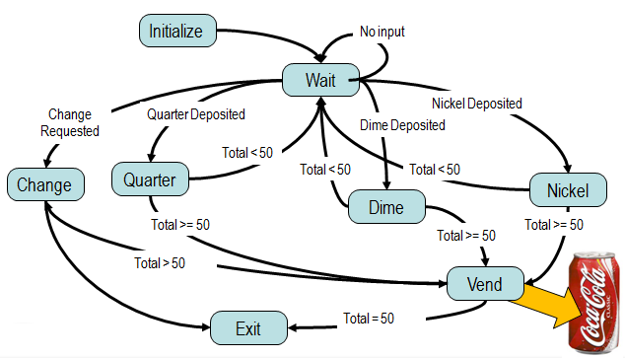
LabVIEW 程序设计模式
Notes:
Comment: 多与实际应用相关，不要太纯。
Producer/Consumer 可以引申到 Multicore .

Slide 2
什么是设计模式？
一种LabVIEW程序模板与架构
具有灵活的配置功能
被广泛使用
Notes:
Design patterns are a hot topic amongst LabVIEW developers. There are a number of different design patterns out there, all of which have their merits and potential drawbacks. Design patterns have emerged over the years as the LabVIEW development community has sought to solve a common set of problems and have emerged with these various design patterns to address some of the primary concerns. They are essentially templates and make up the foundations of many large LabVIEW applications. The frameworks that are most commonly referred to as design patterns are widely accepted by the LabVIEW development community and are very likely to be recognized by anyone who has familiarized themselves with the pattern before.
So why should you care about design patterns? As many of you who are here are aware, there are a number of potential benefits when using design patterns…

Slide 3
使用设计模式的益处
简化整个开发过程
更容易理解程序代码
代码可重用
可靠性
被使用多年，被证明其“可用并可靠”
大量技术资源与例程
Notes:
LabVIEW is often used to rapidly prototype small applications, but there is a rapidly increasing number of large applications being developed using LabVIEW. These applications often encompass large numbers of VIs being developed by groups of developers. Using a design pattern makes it easier for LabVIEW users to read and edit existing code and prevents them having to figure out how to solve classic problems for which the best possible answers already exist.
Also, they’ve been put through the hoops. They’ve been refined and improved over the years and there are a handful of patterns that have emerged as being exceptionally useful, elegant and powerful. Because these design patterns are such a popular topic of discussion there are a number of online forums with examples, content and thoughts on various patterns (some even ship within LabVIEW)

Slide 4
注意！
有些时候你没有必要选用最
复杂的设计模式
不要忘记最常见的设计模式
——数据流！
Notes:
Also, after this training when you go back to your LabVIEW application to apply what you’ve learned here, don’t forget my words of caution… basic dataflow is the most basic design patterns and a lot of times it’s all you need to get the job done
There’s an entire thread on the NI discussion forums called ‘please don’t do it’ that discusses the ramifications of using an overly complicated design pattern for a fairly simple task. Make sure you select the least common denominator, ie: what is the least complicated method by which you can satisfy all the goals of your application?

Slide 5
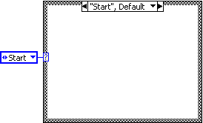
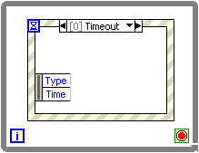
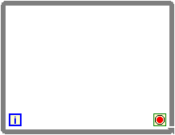
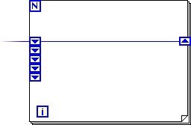
基本工具
循环结构
移位寄存器
分支结构
枚举型常量
事件结构
Notes:
Loops – the two most common loops and the only ones we’ll need for this discussion are the for loop and while loop. The most significant difference is that the while loop iterates indefinitely until stopped, whereas a for loop always has a maximum number of iterations
Shift registers – these are used instead of tunnels if you want to preserve data between iterations of a loop such as a for loop or while loop. On the for loop below I’ve used a set of stacked shift registers, which will remember values from previous iterations
Case Structures – allow you to conditionally execute code depending upon an input, which can be a boolean, string, number, etc… if the input has infinite possibilities, you can set a default case.
Enumerated constants – Allow you to enmuerate integer values using words. This is commonly used to govern the case of a case structure instead of just a number. We’ll discuss these more later
Event structures – are similar to case structures, but they interrupt data flow by responding to events that occur. We’ll talk more about this in a moment as well

Slide 6
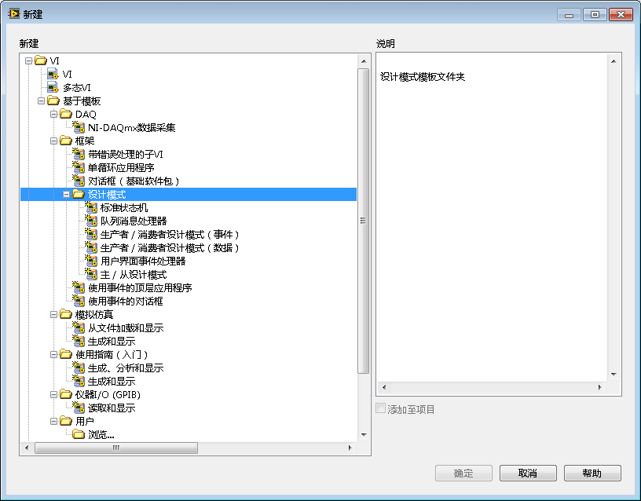
设计模式－LabVIEW模板

Slide 7
LabVIEW经典设计模式
事件驱动用户界面
状态机结构
生产者/消费者
Notes:
We’ll start with a couple of simple design patterns and spend most of our time discussing the three I’ve highlighted on this slide. I’ll try to go into low level detail on the last few and we’ll spend some time discussing variations of implementation and any other considerations.

Slide 8
事件驱动用户界面
“我需要轮询用户的操作，但是这样会降低我程序的运行速度，并且有时我还检测不到……”

Slide 9
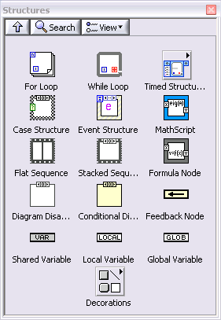
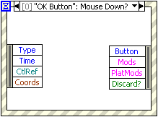
LabVIEW中基于事件驱动的编程
LabVIEW事件示例
按下鼠标
键盘按键
前面板的用户交互
Notes:
With event-driven programming, your application can sleep until something of interest occurs on the front panel instead having to explicitly poll for such activity yourself repeatedly.
The Event Structure makes the event-driven programming approach possible in LabVIEW. When an event occurs, the operating system broadcasts that event information so that applications such as LabVIEW can respond. You can configure an Event Structure to only detect and respond to the events that are important for your application. One of the benefits of using the event-driven approach is that the OS can give the CPU to other programs running on your computer while your application is idle.

Slide 10
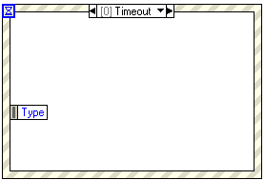
LabVIEW 事件结构
什么是事件结构?
带有多个子框图的结构节点，
就像条件结构
事件结构是如何工作的?
当面板上事件发生时才被唤醒
自动执行相应事件框图内的事件代码
当处理完成相应事件后便结束，并不一直循环等待
Notes:
An Event Structure is a cross between a Wait on Occurrence function and a Case Structure. Like a Case Structure, the Event Structure contains multiple sub-diagrams, each of which is configured to handle one or more events, which are user actions such as Key Down or Mouse Move. You drop an Event Structure on your block diagram the same way you would any other G object, and it executes according to LabVIEW’s normal data-flow rules.
When LabVIEW executes the Event Structure, it puts the structure to sleep until one of the events it is configured to listen for occurs, just as a Wait on Occurrence sleeps until an occurrence is fired. When an event of interest happens, the Event Structure automatically wakes up and executes the appropriate sub-diagram to handle that event. When that sub-diagram completes, the Event Structure completes. Note that when the Event Structure has handled one event, it has completed execution. The Event Structure does not automatically loop to handle multiple events, but this is a common misconception.

Slide 11
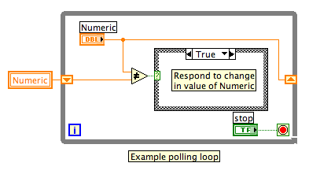
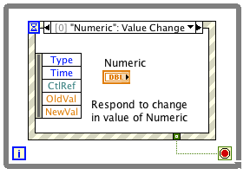
为什么要使用事件结构 ？
用更简单的事件处理替代原来的查询循环
最小化 CPU 的使用
不会遗漏用户界面交互事件
可检测更多的交互事件
编程生成您自己的事件
Notes:
A brief history of Event handling support in LabVIEW:
In LabVIEW 6. 1, we introduced the Event structure to make it easier to detect user interactions and manage your user interface. This allowed you to:
replace your polling loop with an event-handling loop, which iterated only when necessary rather than at a regular interval, thus requiring minimal CPU usage.
not miss any user interactions because LabVIEW passes all interactions as events to the diagram; the diagram does not need to detect them programmatically
detect and respond to more user interactions, such as mouse clicks or movement, closing the front panel window, attempting to exit the application, and so on.
In LabVIEW 7.0, we enhanced Event-handling functionality by adding Dynamic Event registration, allowing you to:
watch for events on the front panels of other VIs. This lets you create a common event-handling sub-VI to be used for multiple front panels.
control the duration during which events are monitored. You can start watching for events mid-way through the run of your VI, change which objects generate events on-the-fly, or disable event handling before the VI completes execution.
programmatically generate Value Change events
programmatically define your own events, with your own user-defined data
register for for a Filter event multiple times.
While LabVIEW 7.1 introduced no new event features, it improved the efficiency and robustness of dynamic events.

Slide 12
Demo
事件驱动用户界面

Slide 13
状态机结构
“我需要执行一系列的事件步骤，但是步骤顺序可通过编程决定的。”

Slide 14
自动贩卖机模型
Initialize
No input
Wait
Nickel Deposited
Change Requested
Quarter Deposited
Dime Deposited
Total < 50
Quarter
Total < 50
Total < 50
Change
Nickel
Dime
Total >= 50
Total >= 50
Total >= 50
Total > 50
Vend
Exit
Total = 50
Soda costs $0.50
Notes:
Each state has decision making code inside of it. For example, if you consider the Quarter state, it examines the total amount of money that has been added. If it is equal to or greater than the amount owed, it sends the application to the ‘vend’ state; otherwise, it returns to wait

Slide 15
背景
静态顺序结构
动态结构：允许不同的状态，按通过编程决定的顺序进
行执行
Notes:
Allows you to execute code in an order determined at run-time

Slide 16
在LabVIEW下实现状态机结构
While循环+Case结构
每一Case即为一个状态
当前状态中需有决定下一状态的判定代码
使用枚举常量通过移位寄存器传递至下一状态

Slide 17
工作流程
Case结构对每一状态都配备一个分支
切换代码根据执行步骤中的结果来决定下一状态
FIRST STATE
执行步骤
移位寄存器用于传递状态
切换代码
下一状态
初始状态

Slide 18
Demo
状态机结构

Slide 19
生产者/消费者
“我需要可以同时间执行的两个过程，并且需保证它们不会互相影响执行速度。”

Slide 20
在LabVIEW下实现生产者/消费者
无数据相关的多个循环
主 / 从关系
在循环间实现通讯与同步

Slide 21
工作流程
主循环
主循环负责通知各个从循环是否执行
允许循环间异步执行
数据的非相关性实现多线程
程序过程分解
从循环1
从循环2
Notes:
This gives you more control on how your application is timed, and gives the user more control over your application.
Counterexample: Data-acquisition and data-logging in the same loop. It would be difficult to increase the rate of DAQ without increasing rate of data logging. If they are separate of each other then this is easier to do
The standard Master/Slave design pattern approach for this application would be to put the acquisition processes into two separate loops (slave loops), both driven by a master loop that polls the user interface (UI) controls to see if the parameters have been changed. To communicate with the slave loops, the master loop writes to local variables. This will ensure that each acquisition process will not affect the other, and that any delays caused by the user interface (for example, bringing up a dialog) will not delay any iteration of the acquisition processes.
Define data dependency: Loop B is dependent upon Loop A if any of Loop B inputs require values from loop A outputs

Slide 22
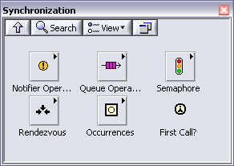
实现循环间的数据通讯
变量
通知器
队列
信号量
集合
Notes:
Now that we’ve discussed the concept of having multiple loops for separate processes, lets talk about how we can bridge those loops in order to communicate without creating any data-dependency. There are a number of different mechanisms we can use depending upon the communication required. For synchronization and timing an occurance or rendezous are helpful.
We’re going to focus on the use of queues
Notifier Operations Functions Use the Notifier Operations functions to suspend the execution of a block diagram until you receive data from another section of the block diagram or from another VI running in the same application instance.
Occurrences Functions Use the Occurrences functions to control separate, synchronous activities.
Queue Operations Functions Use the Queue Operations functions to create a queue for communicating data between sections of a block diagram or from another VI.
Rendezvous VIs Use the Rendezvous VIs to synchronize two or more separate, parallel tasks at specific points of execution. Each task that reaches the rendezvous waits until the specified number of tasks are waiting, at which point all tasks proceed with execution.
Semaphore VIs Use the Semaphore VIs to limit the number of tasks that can simultaneously operate on a shared (protected) resource. A protected resource or critical section of code might include writing to global variables or communicating with external instruments.

Slide 23
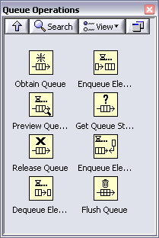
队列
在队列中添加元素
选择队列中元素的数据类型
Reference to existing queue in memory
从队列中释放元素
出列操作需要等待数据进入或者超时情况
Notes:
Subsequent and repeated implementation of this same code will grab an existing queue reference of the specified name. This is typically done to give access of queue reference to subVIs which also avoids
The typedef enumerated constant enlists your chosen names of the state machine cases in the consumer process. Each time a command is added to the queue, the enum should be set to the machine’s STATE name which will handle or process the command. Therefore, the type-def STATE items are like command names that designate which state name contains the relevant code for processing the command. Typical function enum state names: ‘INITIALIZE’, ‘IDLE’, ‘ERROR’, and ‘EXIT’ should be included.
the need to wire a queue reference to the subVI.
You must ensure that the enum constant is a copy of a typedef-based custom control so that you can add or remove command items from the enum and have your changes propagated to all instances of the typedef constant throughout your LabVIEW code.

Slide 24
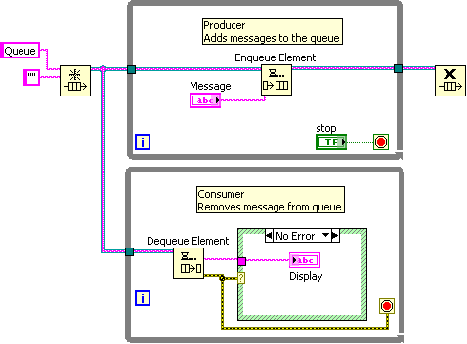
生产者 / 消费者循环

Slide 25
Demo
生产者 / 消费者

Slide 26
总结
设计模式
简化LabVIEW开发过程
被广泛使用及证明其可用
常用的LabVIEW设计模式
数据流
事件驱动
状态机结构
生产者/消费者
Notes:
We’ll start with a couple of simple design patterns and spend most of our time discussing the three I’ve highlighted on this slide. I’ll try to go into low level detail on the last few and we’ll spend some time discussing variations of implementation and any other considerations.

Slide 27
练习6：创建一个简单VI
使用自定义枚举型，实现状态机VI

