Slide 1
NI MultisimTM Basics
Schematic Capture & Simulation
Hands-On Training

Slide 2

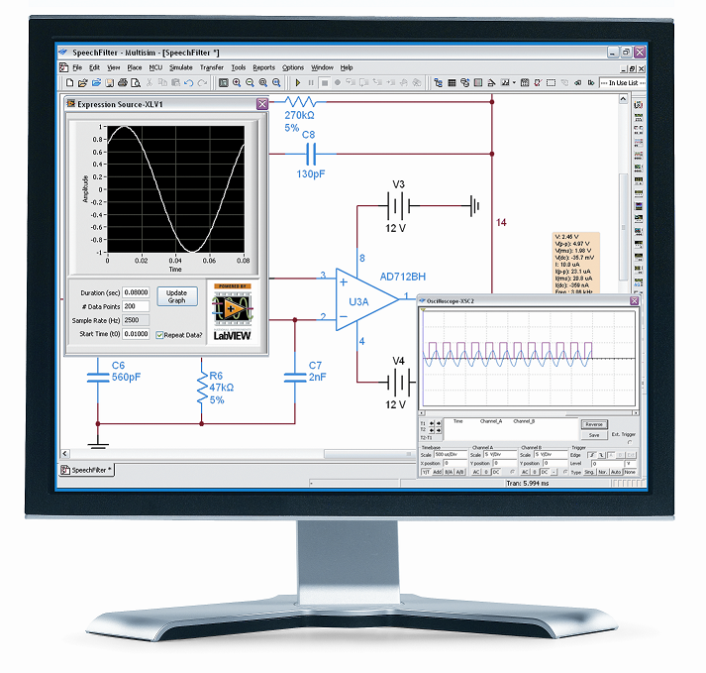
What You Need To Get Started
Multisim Basics Exercise Manual (Workbook)
Multisim Basics Course CD
Computer running:
Windows Vista, 7 or 8
Multisim 14.0 or higher (Power Pro)
Ultiboard 14.0 or higher

Slide 3

File Locations
The course installer places the course files in the following location:
Root Directory
Exercises
<or>
Solutions
Multisim
Notes:
Replace <Course Name> with the name of the course.

Slide 4
Getting the Most out of this Course
Experiment with hands-on exercises
Do your best to finish all exercises
If time permits, experiment with different scenarios
Ask questions
Please switch your cell phone to vibrator mode
This course is not designed or intended for teaching:
Electronics theory
SPICE theory
C/Assembly programming

Slide 5
Course Learning Map
Lesson 1
Analyses
Lesson 4
Lesson 2
Schematic Capture
Simulation and Virtual Instruments
Lesson 3
Working with SPICE
Lesson 5
Lesson 6
Advanced Schematic Capture
Communication and Transfer
Projects and Design Sharing
Lesson 7
Lesson 8
Educational Features
Lesson 9
MCU Co-simulation
Create Components
Lesson 10
Note: Not all features described in this course are available in all versions.
Notes:
<Replace text with your lesson titles. Click each smart art, press the left expand icon, and add or remove Lessons as needed. Resize the smart art to fit the actual number of lessons.>

Slide 6
Course Goals
At the end of this course, you will:
Understand the features of the Multisim user interface
Capture schematics in Multisim
Use interactive simulation to check your design
Use virtual instruments and analyses
Work with basic SPICE syntax
Create custom components
Co-simulate MCU with SPICE

Slide 7
Lesson 1
Schematic Capture
The Multisim GUI
Placing components
Placing wires

Slide 8
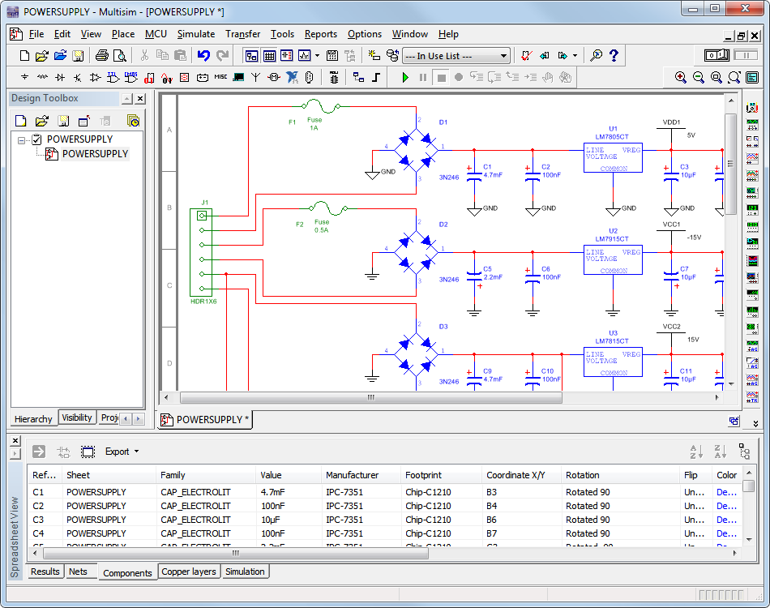
What is Multisim?
General purpose EDA tool
Schematic Capture
Simulation
Analyses
Integrated Environment

Slide 9
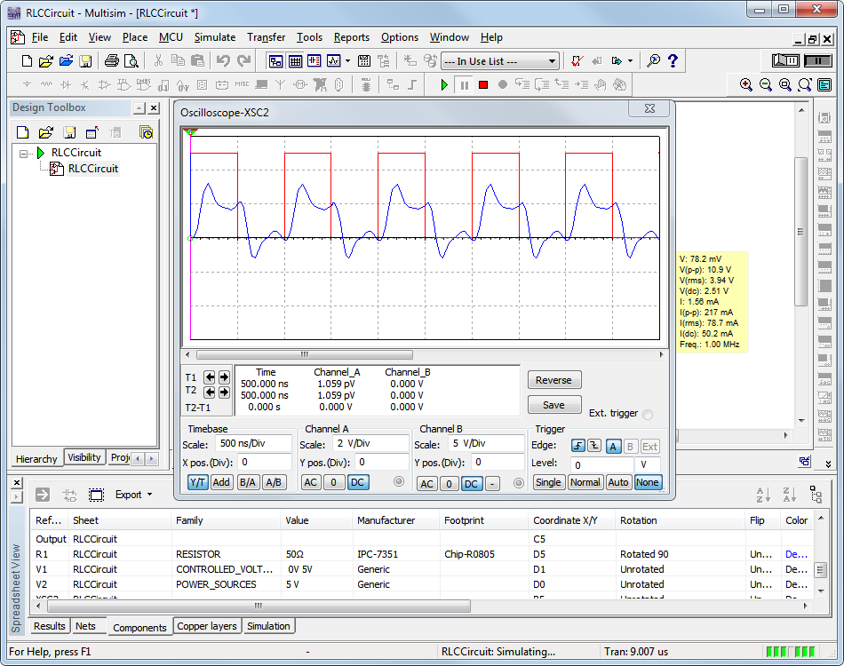
Benefits of Integrated Capture & Simulation
Preparation for simulation is as simple as drawing a circuit
Interactive Simulation
Animated Parts
Virtual Instruments
Analyses and Graphs
Effective use of your time!

Slide 10




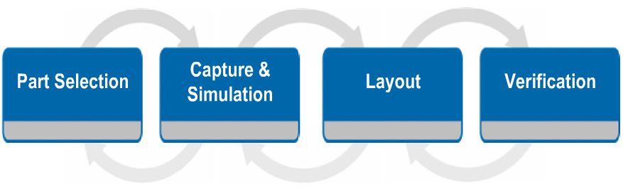
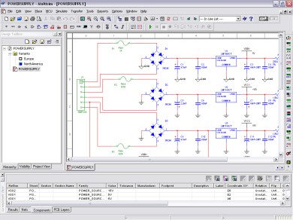
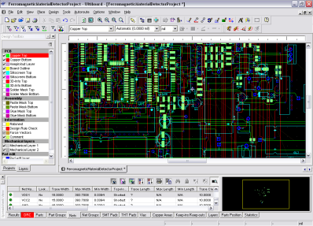
The Design Process
Where does Multisim fit in the design flow?

Slide 11
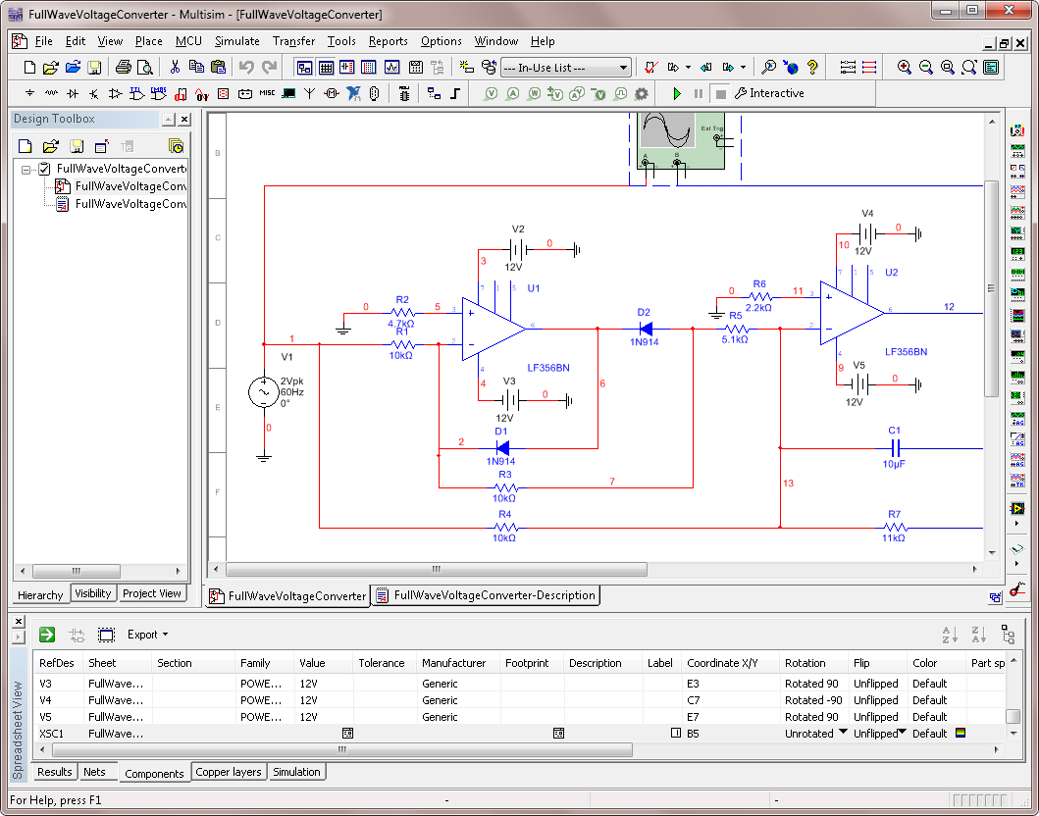
The Multisim GUI
Design Toolbox
Menus
Toolbars
Title Bar
Workspace Area
Organized menus
Quick access toolbars
Design Toolbox
Spreadsheet View
Resizable Workspace
Spreadsheet View
Instruments Toolbar

Slide 12
Global Options
Options»Global options
Vary from computer to computer
Stored in the User configuration file
  Change config file and database paths
  Save settings (security copy, backup, simulation data)
  Component placement mode, symbol standard
  Rectangle behavior, mouse wheel behavior, bus wiring
  Message prompts and general simulation settings

Slide 13
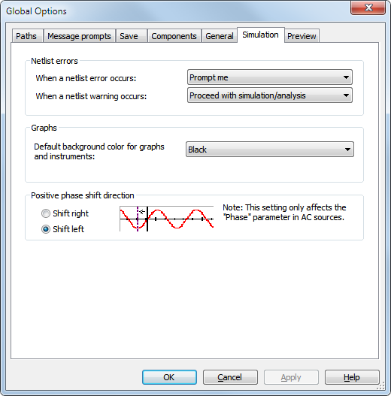
Global Options Simulation tab
Netlist errors action
Default background
Phase shift direction

Slide 14
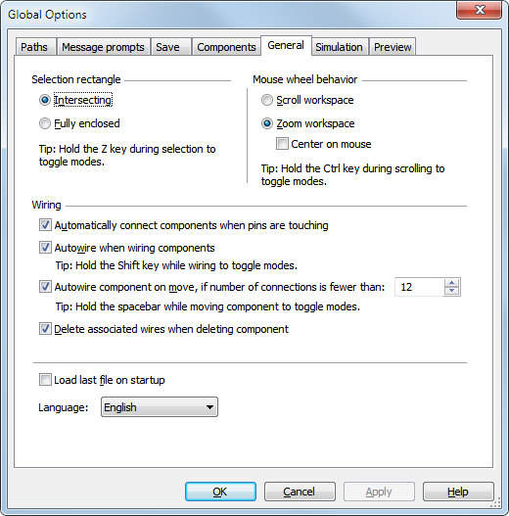
Global Options General tab
Selection rectangle
Mouse-wheel behavior
Wiring mode
Localization

Slide 15
Sheet Properties
Options»Sheet properties
Saved with the design file, if opened in another computer same settings will be used.
Color scheme and display properties
Sheet size
Wire and bus options
Font properties
PCB settings
Visibility status for annotation layers

Slide 16
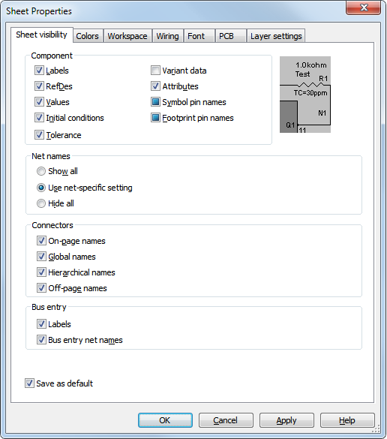
Sheet Properties—Sheet visibility tab
Component display properties
Net names display properties
Connectors display properties
Bus entry display properties
Tip: Experiment with changing the display properties of components, keep a balance between good visibility and optimum information display.

Slide 17
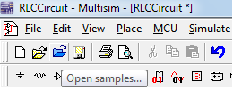

Toolbars and Menus
Click this section of the
toolbar and drag to relocate.
Organized based in functionality
All toolbar functions found in menus
Right-click toolbar area and toggle toolbars
Customizable (functions, location)
ToolTips
Lock toolbars
Menu commands use the
same icon as in the toolbar.

Slide 18
Customize the Environment
Options»Customize interface
Add/remove functions in toolbars and menus
Create new menus and toolbars
Set shortcut keys
Display properties for toolbars and menus

Slide 19
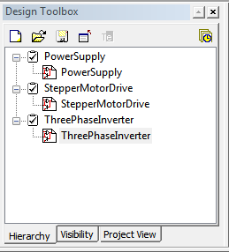
Design Toolbox
View»Design Toolbox
Manage various elements in the schematic design
Great tool for medium- and large-complexity designs
Control visibility of annotation layers
Access to the Project View
Design Toolbox toolbar
Design Toolbox tabs

Slide 20
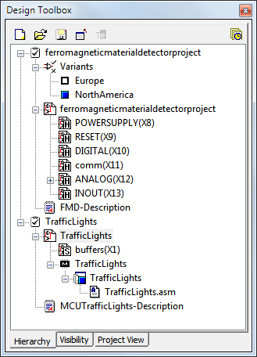
Design Toolbox Hierarchy tab
Design files
Design blocks
Variants
Description Box
Breadboard (Educational Edition)
MCU Projects
Main design file name
Variants
1st page/sheet of design
Hierarchical blocks and
subcircuits of the 1st
sheet
Description box file
MCU workspace
Tip: You can open, close, rename files from the design toolbox. You can also set active variants, active MCU projects and so on.

Slide 21
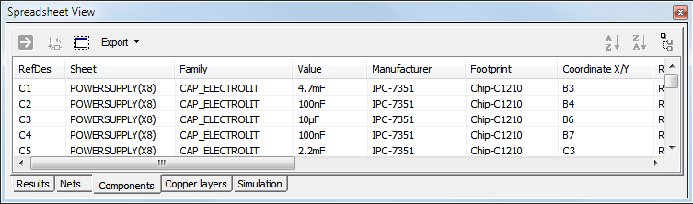
Spreadsheet View
Tip: You can modify properties for multiple components or nets at once if you use the <SHIFT> or <CTRL> keys for multiple selection.
Advanced parameter viewing and editing
Global perspective of objects and properties
Find and select components
Modify component or net properties
Review ERC, Simulation and other results

Slide 22
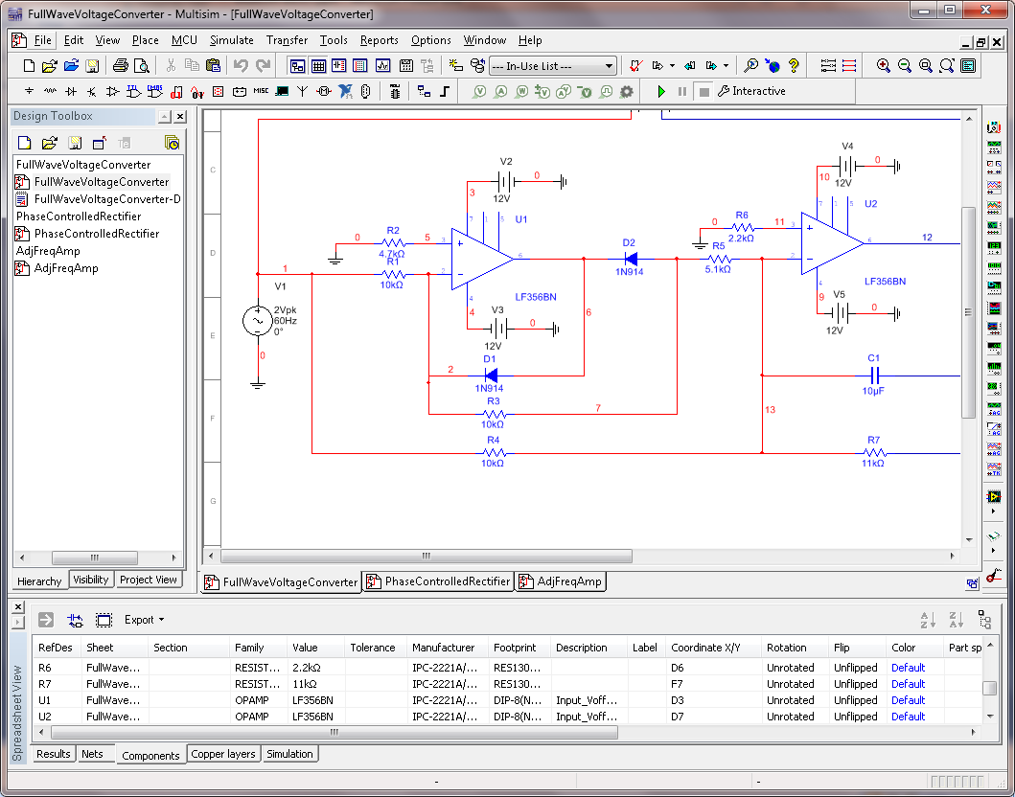
Workspace Area
Page Borders
Design
Workspace Area
Schematic area
Multiple tabs
Zoom in and out with the mouse wheel (default)
Use View menu to show/hide Grid and Page Border
Multiple Design Tabs

Slide 23
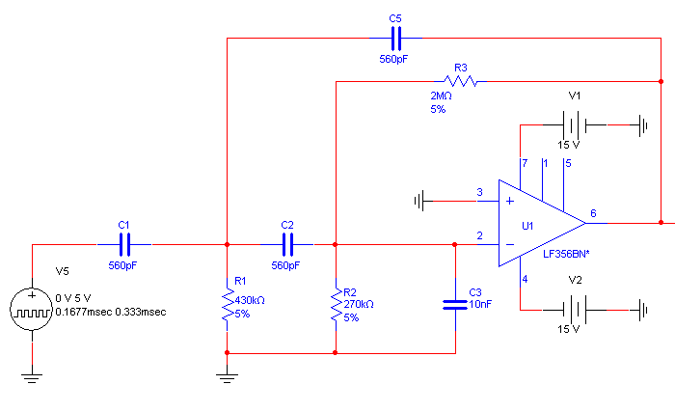
Schematic Capture
Multisim offers click-and-place capture mode
Integrated with simulation
Three step process:
Select
Place
Wire
Component Database
In-Use List
Copy
Replace
Rotate
Flip
Multi-section
Automatic
Touching-pins
Dropping

Slide 24
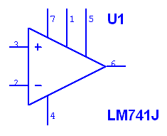
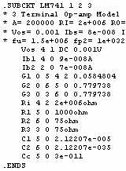
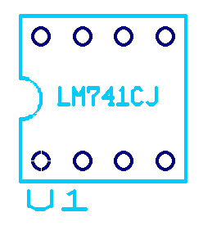
Components
Symbolic representation of actual parts
All components have a symbol
Many components have a SPICE model and footprint
Capture Area
Simulation Engine
PCB Layout
Symbol
SPICE Model
Footprint

Slide 25
Components—Properties
Double-click component to:
Change Label, RefDes
Display properties
Value
Faults
Check Pin assignment
Set Variant information
Modify User Field information
In the Value tab, click Edit component in DB to customize the component.
(not for RLC components)

Slide 26
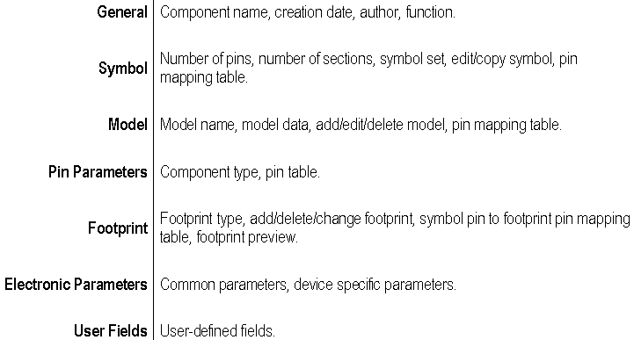
Components—Edit Component in DB

Slide 27
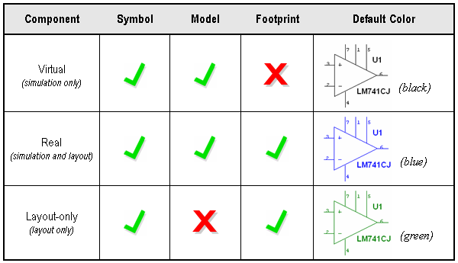
Components —Virtual, Real, Layout-only

Slide 28

Component Database
Tools»Database»Database manager
Three levels:
26,000+ parts (Power Pro edition)
Master database cannot be edited
Database utilities let you merge other users database, or convert a database from a previous version

Slide 29
Component Database
Corporate database
Share components with colleagues
Located in local disk or network drive
User database
Store your own custom components
If you modify a Master database component, save it into the Corporate or the User database.
Caution: Always backup your Corporate or User database.

Slide 30
Component Browser
Place»Component
Most common tool to place components.
You can select:
  Database
  Component
  Model
  Footprint
  Search for components
Tip: Right-click anywhere in the workspace and select Place Component to access the Component Browser.

Slide 31
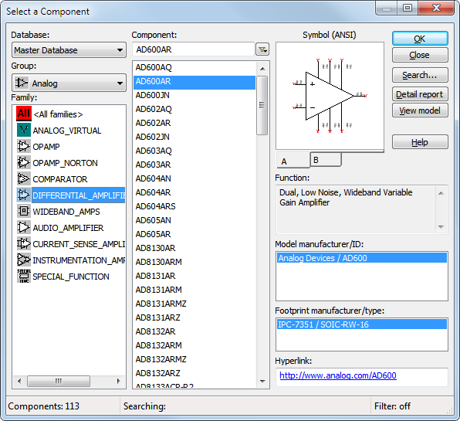
To place a part, select:
Database
Group
Family
Part
Model
Footprint
You can also:
Search
Obtain datasheet
Print a detail report
View model
1
2
4
3
5
6

Slide 32
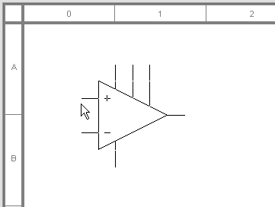
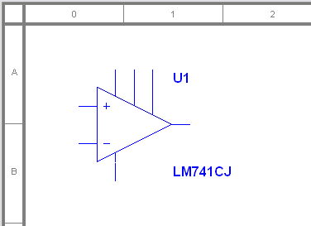
Placing a Component
After selecting a component, a ghost image is attached to the mouse pointer
Click to place
Next RefDes is assigned

Slide 33

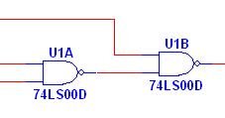
Placing Multi-section Components
Select any section for a new IC
Select C or D to place unused sections of U1
U1, section A and B are already placed, therefore they are not selectable

Slide 34

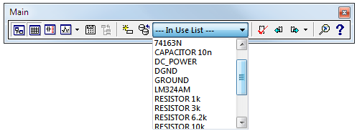
Component Toolbar and the In-Use List
Access Master database Groups from the Components toolbar.
Use the In Use List to place another instance of an already placed component.

Slide 35
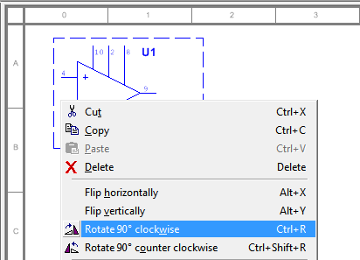
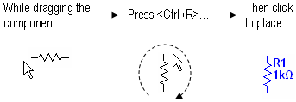
Rotating a Component
If already placed
While placing

Slide 36
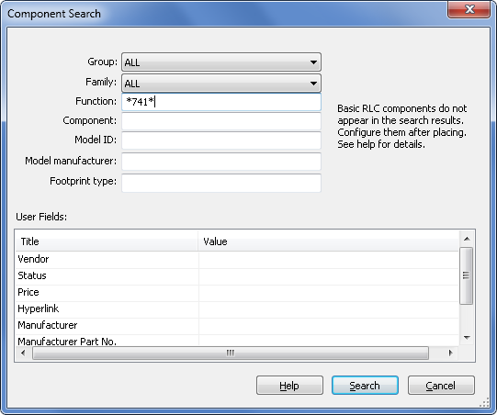
Component Search
From the Component Browser, click Search
Use * as a wildcard

Slide 37
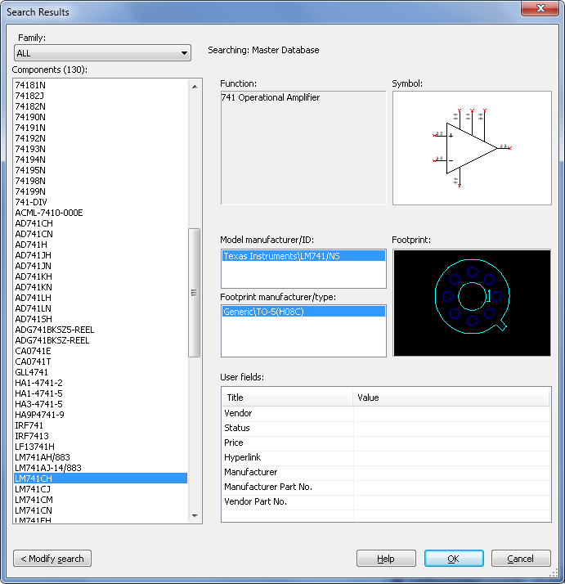
Component Search—Results
Details of component selected
Number of components matching search criteria
List of components matching search criteria
OK will take you to the exact database location

Slide 38
Nets
Wires are the graphical representation of nets
Modeless (no placing vs. wiring mode)
Mid-air wiring is allowed
Real-time netlist is updated behind the scenes
Easy to change wire connections once placed

Slide 39
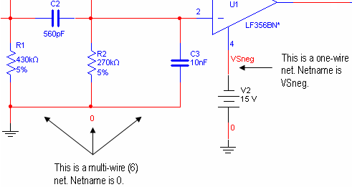
Nets
Multiple wires can make one net or node

Slide 40
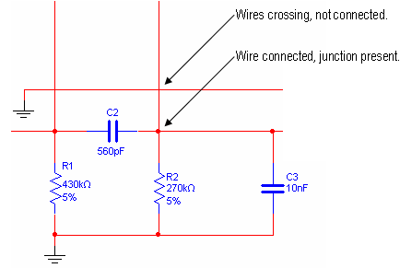
Junction Dots
Junction dots represent a wire connection

Slide 41
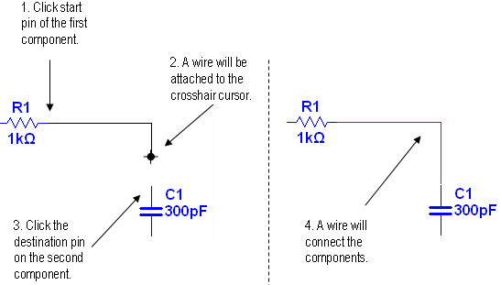
Methods for Wiring—Automatic

Slide 42
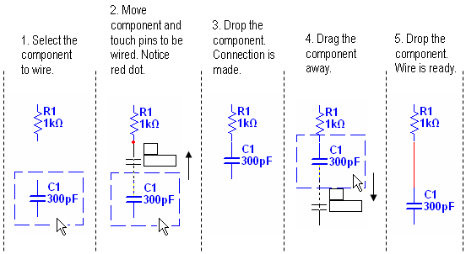
Methods for Wiring—Touching Pins

Slide 43
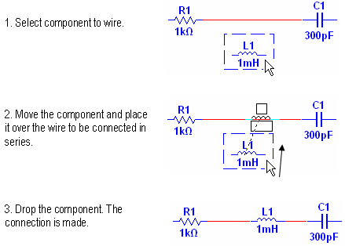
Methods for Wiring—Dropping

Slide 44
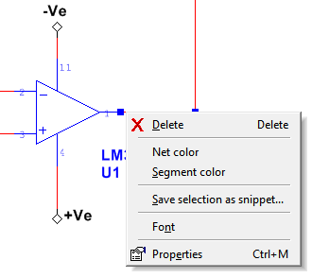
Changing Wire Properties
Right-click the wire to access the run-time menu
Change colors, net name font and properties
Delete
Change color
Net properties
(rename)

Slide 45
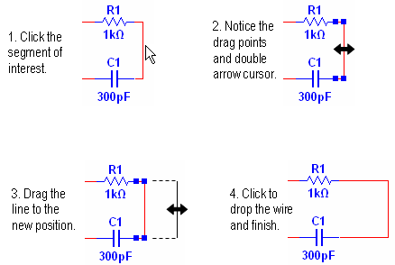
Moving Wires

Slide 46
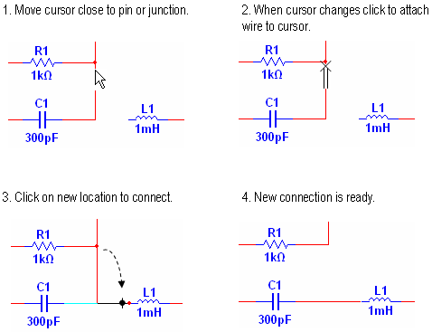
Re-wiring a Net

Slide 47

Virtual Wiring
Useful in large designs
Avoids unnecessary wires crossing the schematic
Give a net a name that already exists to create the virtual connection
Use Global or On-page connectors
  Global connectors are visible to the whole design
  On-page connectors are visible to the sheet
  On-page connectors may connect to Global connectors

Slide 48
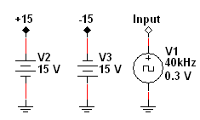
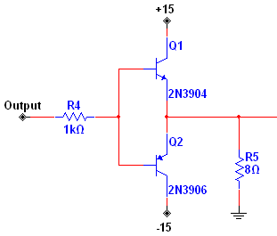
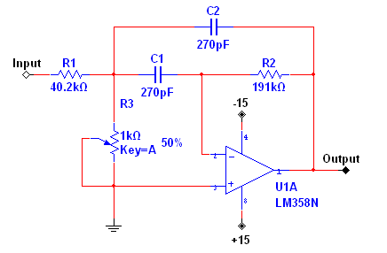
Virtual Wiring
My Design
Page X
Page Y

Slide 49
Lesson 1 Exercises
Drawing a Schematic
Set environment preferences
Build and wire a filter circuit
Use different methods for wiring
NI Multisim Basics Exercises
Page 1-1
40 minutes

Slide 50
Lesson 2
Simulation and Virtual Instruments
Interactive simulation settings
Virtual instruments
Probes
Circuit Wizards

Slide 51
Multisim Treats Simulation Differently
Most users are not experts in simulation
User wants the benefit of simulation without having to know the details of SPICE
Netlist is hidden from the main schematic, visible through the SPICE Netlist Viewer
If you want to use advanced SPICE syntax you can, using the Arbitrary SPICE Block or the XSPICE Command Line

Slide 52
Types of Simulation
Multisim supports the following types of simulation:
  SPICE / XSPICE / PSPICE¹
  MCU / RF
Code Modeling
Multisim supports these types of simulation individually as well as together using a unique patented co-simulation technology.
¹ Most PSPICE models will work with no problems, if you have a model that doesn’t, contact Support.

Slide 53
Simulation Models
SPICE model is required to simulate a component
SPICE models are usually available from manufacturers
Accuracy of simulation is directly tied to the complexity of a model
Not all components have a SPICE model
In this course, SPICE models also refer to XSPICE, PSPICE and Code Modeling in most cases.

Slide 54
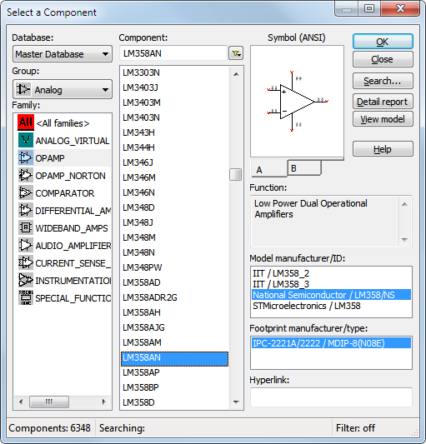

Multiple Models Available
Some components offer more than one model
Higher level models simulate more sophisticated or unique effects of the component’s behavior

Slide 55
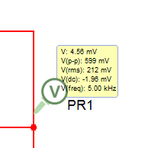
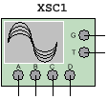


Interactive Simulation
Set the simulation to Interactive on the toolbar
Set simulation to Interactive when:
  Using virtual instruments
  Using interactive components
  Viewing results from probes, LEDs and so on

Slide 56

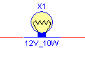
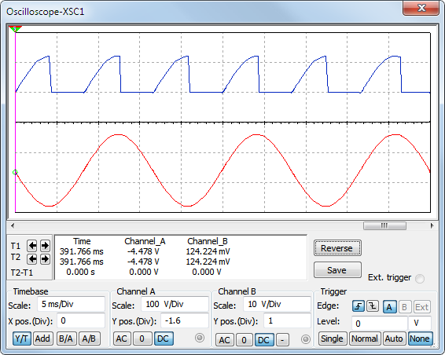
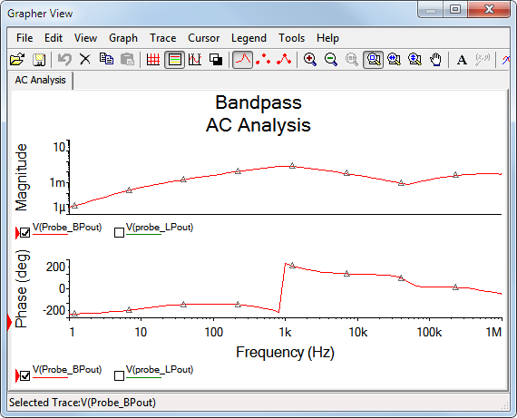
Observing a Circuit Simulation
Start/Pause/Stop functions
Animated parts
Virtual Instruments
Analyses and Graphs

Slide 57
Creating Circuits for Simulation
Use parts with models
Add models to part without models
Place sources and ground
Use Circuit Wizards
  555 Timer
  Filter
  Opamp
  CE BJT Amplifier

Slide 58
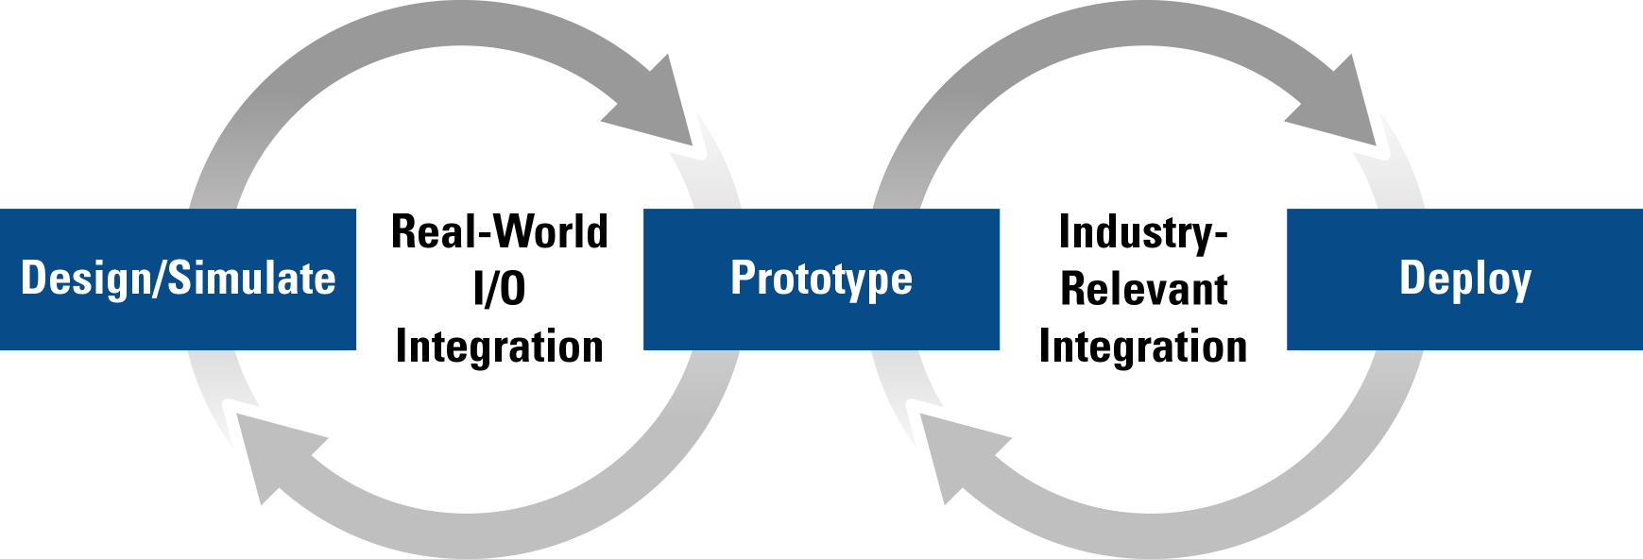
Simulation with Real-world Signals
Integrating NI measurement & automation products into the design stage allows real-world stimuli to be used
  Automate testing and validation of design

Slide 59



LabVIEW and LabVIEW SignalExpress
Use LVM and TDM files with real-world data as input signals
Create and use custom LabVIEW VIs in your circuits
  Input data
  Output data
  Input/Output
Save simulation data as LVM files
Overlay simulation data with measurement results
Verify simulation model accuracy

Slide 60

Virtual Instruments
Select instruments from the Instruments toolbar
Multimeter | Word Generator | Agilent Function Generator
Function Generator | Logic Analyzer | Agilent Multimeter
Wattmeter | Logic Converter | Agilent Oscilloscope
2-ch Oscilloscope | IV-Analysis | Tektronix Oscilloscope
4-ch Oscilloscope | Distortion Analyzer | Measurement Probe
Bode Plotter | Spectrum Analyzer | LabVIEW Instruments
Frequency Counter | Network Analyzer | ELVISmx Instruments*
 |  | Current Probe
* When the NI ELVISmx driver is installed.

Slide 61
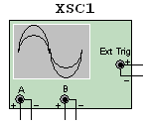
Virtual Instruments—Front Panel
Double-click instrument icon to open front panel
Set instrument settings just like a real instrument

Slide 62
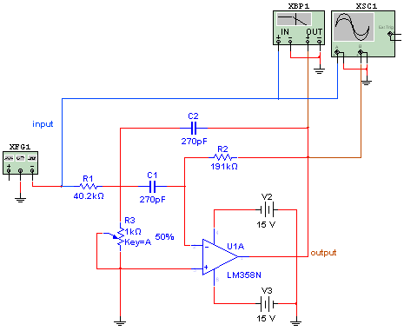
Using Instruments in Circuits
Place instruments like any other object
Wire the instrument to the circuit
Configure instrument settings

Slide 63

Probes
Probes can display:
  Current
  Voltage
  Component power
  Digital state
Probes will appear as an output for the analysis by default
Save space in the schematic

Slide 64
Lesson 2 Exercises
Working with Instruments
Examine the response of the bandpass filter
Learn how to use various instruments
Use probes to examine circuit
Import LabVIEW instrument
NI Multisim Basics Exercises
Page 2-1
40 minutes

Slide 65
Lesson 3
Analyses
Analyses available in Multisim
Expressions
Grapher

Slide 66
Analyses in Multisim
Multisim provides analyses for examining circuit behavior
Analyses require a circuit ready for simulation
Custom expression can be added
Grapher View helps to take precise measurements

Slide 67
Analyses in Multisim
The following analyses are available:
DC Operating Point | Distortion Analysis | Transfer Function
AC Analysis | DC Sweep | Worst Case
Single Frequency AC Analysis | Sensitivity | Monte Carlo
Transient Analysis | Parameter Sweep | Trace Width Analysis
Fourier Analysis | Temperature Sweep | Batched Analysis
Noise Analysis | Pole Zero | User Defined Analysis

Slide 68
Using Analyses
Four step process:
Select
Configure
Simulate
Review
Select analysis
Enter expressions
Select output variables
Configure analysis parameters and options
Click Run
Grapher View
Tip: Click Help on any window to access analysis-specific information.

Slide 69

Selecting an Analysis
Simulate»Analyses and simulation or click Active Analysis button on the Simulation toolbar
Select an analysis from the Active Analysis list

Slide 70

Selecting Output Variables
Probes placed in circuit will appear as output by default
View voltages, current and power
Add model or device parameters
  Resistance
  Capacitance, and so on
Add expressions

Slide 71

Adding Custom Expressions
Double-click variable or operand to add it to the expression
Type expression manually
Use built-in functions to help create custom analysis outputs

Slide 72

The Grapher
Displays simulation results from:
  Virtual Instruments
  Analyses
View, adjust, save, print export data
Precise cursor measurements
Overlay different results to compare
Make annotations and place data labels

Slide 73

The Grapher—Cursors
Take precise measurements with the cursors
Right-click cursor to access functions for positioning and data labels

Slide 74

The Grapher—Overlay Traces
Compare different graphs

Slide 75

The Grapher—Properties
Set custom properties for pages and graphs
Modify the appearance of traces and axes
Grapher properties can be copied to another graph

Slide 76

The Grapher—Mixed Displays
Some analyses output table data instead of plot data

Slide 77
Lesson 3 Exercises
Working with Analyses
Explore characteristics of the bandpass filter with analyses
Configure analyses
Use the Grapher to visualize results
NI Multisim Basics Exercises
Page 3-1
40 minutes

Slide 78
Lesson 4
Working with SPICE
Basic SPICE syntax
Circuit parameters
Simulating SPICE netlist

Slide 79
What is SPICE?
Simulation Program with Integrated Circuit Emphasis
SPICE developed by University of California, Berkeley
Several spin-off SPICE simulators exist today
Multisim supports the following SPICE models:
  Berkeley SPICE
  XSPICE
  PSPICE (most models can be imported directly some requires syntax changes)

Slide 80
What you should know
You do not need to have in-depth knowledge of SPICE
You should recognized the basic syntax to be able to add a new parts or import netlist for simulation
  How a component is declare and the nodes it is connected to
  What a model looks like
  Comments to provide users with information about the model

Slide 81

Component Declaration
Component declaration have the following information:
  The first letter is reserved for the component type
  Component reference ID
  Nodes the component is connected to
  Value (100 Ω) or model ID
D is for diode
1 is unique reference
ID for diode
Node connection
Diode model reference
The model must exist
In the netlist
Note: Refer to a SPICE manual for more detail information about specific component.

Slide 82
Type of Models
There are two types of SPICE models
Primitive models
  Predefined models have known number of pins and parameters
  Example: transistor, MOSFET and diode
Sub-circuit models
  Models created from a circuit using basic components, sources and primitive models
  Sub-circuit model can exist inside another sub-circuit model

Slide 83

Primitive Model Syntax
Primitive model begins with a .model statement
General form:
.model name type ( parameters)
Note: The letter D indicates diode model.
The plus (+) sign at the beginning
of each line indicates a line wrap and should be included with the model

Slide 84
Sub-circuit Model
Model begins with .subckt and end with .ends statement
Most models will have comments to define the input and output nodes to the model
The model nodes declare on subckt line have no relationship with the IC pin number
A line with an asterisk (*) at the beginning is a comment
Most model only modeled typical usage and some features or pins are not modeled

Slide 85


Sub-circuit Macro-model
Note: The nodes 1,2 and 3 on the subckt line are not the same as the IC pin number display on the symbol
Input/output nodes
Begin of model
Comments provide
node information (*)
Model circuitry
End of model

Slide 86

SPICE Functions
Mathematical functions are available to create behavioral models
Refer to the Multisim Help or SPICE manual for details

Slide 87

Using Functions in Component
Functions available in the analyses for adding expressions
You can create behavioral models using functions
Note: The voltage source V3 reads the voltage at node 2 and if the voltage is greater or equal to 1V, it generates 5V otherwise it generates 0V.

Slide 88

Circuit Parameters
View»Circuit Parameters
Circuit parameters allow you to declare variables
  Multiple components can use the same variable
  Variables can be used in an expression
  Parameters are visible in the analyses

Slide 89

Using Parameters in Circuit
Use declared variables as component values
Enter expression using variables in the textbox
Using variable
Two variables used
in an expression

Slide 90

Parameters in Analyses
Parameters you declared are visible in all analyses

Slide 91

Import SPICE Netlist for Simulation
The Arbitrary SPICE Block allows you to copy a SPICE netlist for simulation
You do not have to rebuild the circuit
Use the analyses to simulate the netlist circuit

Slide 92
Lesson 4 Exercises
Working with SPICE
Use Circuit Parameters
Create a sub-circuit macro
Import SPICE netlist for simulation
NI Multisim Basics Exercises
Page 4-1
30 minutes

Slide 93
Lesson 5
Advanced Schematic Capture
Graphic Annotations
Description Box
Spreadsheet View
Title Blocks

Slide 94

Graphic Annotations
Document your schematics
Place meaningful:
  Text
  Comments
  Pictures
  Geometric Shapes (lines, arcs, rectangle, and so on)
Place»Graphics»…
Control visibility in the Design Toolbox

Slide 95

Graphic Annotations – Text
Use text to add notes in the schematic diagram

Slide 96

Graphic Annotations – Comments
Comments help to save space in the diagram and still have important notes added to a component, net, or schematic section

Slide 97

Description Box
Complete Rich-Text word processor
Add full text document to explain your project
Accepts objects such as pictures, sound, video, and so on
Saved with the design file
Access through the Design Toolbox
Synchronize with events
Add forms and questionnaires

Slide 98

Spreadsheet View Advanced Uses
Export data to Excel®
Change component or net properties
Multiple selection
Go to and select the component
Note: Export to Excel® available in the Power Pro edition only. In Education Edition you can select all cells and copy then paste them into Excel®.

Slide 99


Title Blocks
Identify the schematic
Document:
Title
Description
Designer
Approver
Revision
Document No.
Option to fix position

Slide 100

Title Block Editor
Specialized graphics editor
Create or modify title blocks
Position title block data
Change font properties
Place or move graphics

Slide 101
Lesson 5 Exercises
Advanced Schematic Capture
Use advanced features to edit the bandpass filter
Document your schematic
NI Multisim Basics Exercises
Page 5-1
40 minutes

Slide 102
Lesson 6
Communication and Transfer
Reports
Transfer to PCB Layout software

Slide 103
Reports
Use to aid manufacturing
Prepare production plans
Reports available:
  Bill of Materials
  Component Detail Report
  Netlist Report
  Cross Reference Report
  Schematic Statistics
  Spare Gates

Slide 104

Bill of Materials (BOM)
Lists components used in the design
Summary of components needed for manufacture
Reports»Bill of Materials
Separates real vs. virtual
Exports to Excel®
Customize columns

Slide 105

Schematic Statistics
Quantitative report
Reports»Schematic statistics

Slide 106
Other Reports
Spare Gates Report
  Reports which ICs have unused gates
Netlist Report
  Details relationship between nets, pins, blocks, pages
Cross Reference Report
  RefDes, description
  Family, package
  Page

Slide 107
Transfer
Transfer design to PCB Layout
  Transfer»Transfer to Ultiboard»Transfer to Ultiboard 14.0
  Versions prior to 14.0 are also supported and are listed if that version is installed
Transfer to third-party PCB Layout
  Mentor Graphics PADS Layout® 2005
  Special library added for PADS
Forward and back annotate changes from Ultiboard
Highlight selection in Ultiboard

Slide 108
Export Netlist
Create a complete SPICE netlist (*.cir file)
Used for troubleshooting simulation problems
Used for non-supported third-party applications
Transfer»Export SPICE netlist
Alternatively, you could open the SPICE Netlist Viewer
Tip: A netlist can also help to transfer a schematic to legacy software.

Slide 109
Lesson 6 Exercises
Communication and Transfer
Generate meaningful reports
Transfer your design to Ultiboard
NI Multisim Basics Exercises
Page 6-1
30 minutes

Slide 110
Lesson 7
Projects and Design Sharing
Design Blocks (Hierarchical Blocks, Subcircuits)
Buses
Electrical Rules Check (ERC)
Project View

Slide 111
Design Blocks
Build a library of commonly used circuits
Reuse circuit models
Changes propagate
Cleaner, modularized architecture
Use the Design Toolbox to browse through the hierarchy
Three options:
  Hierarchical Blocks
  Subcircuits
  Multi-page

Slide 112

Design Blocks—Before

Slide 113

Design Blocks—After

Slide 114



Design Blocks – Connectors
Interconnect circuits with hierarchical connectors
Rename connectors
Connector name = netnames

Slide 115

Nested Circuits
Hierarchy tree organization
Use Design Toolbox
2nd Child Nested Circuit (HB/SC)
1st Child Nested Circuit (HB/SC)
Page Level (Single or Multi-page design)
Design Level (Main filename)

Slide 116

Creating Design Blocks
Multiple options to create or use blocks
  Place»New subcircuit (or hierarchical block)
  Place»Hierarchical block from file
  Place»Replace by subcircuit (or hierarchical block)

Slide 117

Multi-page Design
For flat design
Split in pages

Slide 118


Multi-page Design
Same hierarchy level as top-level page
Workspace tabs per page (reorder in Design Toolbox)

Slide 119

Multi-page Design
Interconnect pages with Off-page connectors.
Alternatively, you could use Global with On-page connectors.

Slide 120
Modular Design Summary—Pros & Cons
Pros
Cons
Multi-page
Good for flat designs
Every page saved in the same circuit file
Organized horizontal view of design
Not for reusing blocks in a later project
Not recommended for non-flat designs
File size is bigger
Updating a section requires the complete circuit to be open
Recommended
Subcircuits
(SC)
Every page saved in the same circuit file
Symbol is editable
Easy to visualize functional blocks
Not for reusing blocks in a later project
File size is bigger
Updating a section requires the complete circuit to be open
Hierarchical
Blocks (HB)
Best option to reuse circuit blocks
Symbol is editable
Smaller file size
Easy to visualize functional blocks
Updating the HB updates all designs where it is used
HBs need to accompany the main design file every time you move it

Slide 121

Electrical Rules Check (ERC)
Verify your circuit for electrical errors
GND pins connected to PWR pins
User-defined rules matrix
Tools»Electrical rules check
ERC Markers show
error location

Slide 122

ERC Rules Matrix
Click color box to change status code
Match row by column connection

Slide 123

ERC Rules Matrix—Definitions

Slide 124


ERC—Finding and Clearing Markers
Double-click error line in the Results tab of the Spreadsheet View
Easy to clear markers:
Tools»Clear ERC markers
Error location

Slide 125

ERC—Component Properties
Set ERC Include or Exclude status from each component’s properties window

Slide 126


Buses
Buses simplify wiring
Carry multiple nets
Used within:
  a page
  across pages
  across design blocks

Slide 127








Bus Wiring Modes
Set mode in Options»Sheet properties»Sheet visibility tab
Bus wiring modes:
  no labels,
  net names,
  busline names

Slide 128



Bus Vector Connect

Slide 129


Bus Entry Connect

Slide 130



Bus Manipulation

Slide 131
Team Design
Multisim provides many tools for team design environments:
Corporate Database
User Fields
Project View, Project Packing and Version Control
Design Blocks
Reports

Slide 132
Corporate Database
Store Corporate database in a network location for sharing, download to update (Database Merge) your local database
Provides companies with the ability to specify “approved/preferred” parts
Maintains standard use of components across projects
Caution: Always back up your Corporate or User database.

Slide 133
User-defined Fields
Define up to 20 fields
Fill up with information important to your business
Most common use:
  Company Part#
  Preferred Supplier
  Cost
  Lead Time
Search parts using User Field information

Slide 134

User-defined Fields
Manage user fields through the Database Manager
Each component has the User Field tab on the component’s properties

Slide 135
Project Management—The Project View
Single view of all project files
Right-click to:
  Lock
  Remove
  Open
  Read-only
Integrate related files (PDF, CAD drawings, PCB layouts) in a single view

Slide 136



Project Management—Organization
Use the Design Toolbox to organize and access files
Add any kind of files

Slide 137

Project Management—Sharing
Pack the project into a special MPZIP file
  All files are compressed and added to a single file
Unpack at the new location
  Option to use original hierarchy or select a new one
Ideal for teamwork or migration of documents

Slide 138

Project Management—Version Control
Create “restore” points of the project
Backup regularly for safety
Choose custom names easy to identify (for example, dates)

Slide 139
Lesson 7 Exercises
Working with Projects and Design Sharing
Divide the circuit into design blocks
Use buses to connect components
Run ERC
Setup a Project
NI Multisim Basics Exercises
Page 7-1
40 minutes

Slide 140
Lesson 8
MCU Co-simulation
Co-simulation with MultiMCU
Co-simulation with MPLAB© X

Slide 141


MCU Options
Multisim Offers two MCU simulation options:
  MultiMCU
  MPLAB X

Slide 142

MCU Co-simulation
Adds co-simulation capabilities
  C,C++ or assembly with SPICE components
Simulate like any other circuit

Slide 143

MultiMCU Support
Note: The Multisim Education Edition is required for this lesson.
MCU Support:
  8051, 8052
  PIC16F84, PIC16F84A
Language Support:
  Assembly
  C

Slide 144

MultiMCU Features
Compiler is installed with Multisim
Build-in text editor to enter your code
Code is build within Multisim
Debug tools similar to other IDE are available
  Break point, step in, step out, step over
MCU Memory View displays internal MCU information

Slide 145
MPLAB X MCU Installation
Tools to co-simulation with MPLAB X are not installed with Multisim
You will need to install the following:
  Multisim 14
  Java Run Time Environment
  Microchip MPLAB X IDE
  Microchip XC Compilers (XC8, XC16, XC32)
  Microchip MCU Simulator Plug-in
Search NI Labs Community for installation instructions

Slide 146

MPLAB X MCU Co-simulation Support
Over 900 unique Microchip MCUs
Any future MCUs supported by MPLAB X can be added to to Multisim database
Language support:
  Microchip MCU assembly
  C
  C++
Refer to the MPLAB X Help to
learn what can/cannot be simulated

Slide 147

MCU Project
Enter your code in MPLAB X IDE
Build your code in MPLABX IDE to generate a debug file
Multisim uses the debug file for co-simulation
The compiler you select depends on the selected MCU
  XC8, XC16 or XC 32

Slide 148

MCU Setup for Co-simulation
Double-click on the placed MCU
Refer to MCU datasheet for MCU instruction rate
Select the debug file generated by MPLAB X IDE
Pause simulation at first instruction allows user to set breakpoints after the first instruction

Slide 149

MCU Simulator
Multisim controls MPLAB X simulator through the MCU Simulator Java™ application
Display internal MCU memory (register, memory etc…)
Source code view and disassembly view
Debug tools:
  Step into
  Step over
  Breakpoint
Run and pause simulation

Slide 150
Lesson 8 Exercises
Working with MCU
Build circuit to co-simulate MultiMCU
Co-simulation with MPLAB X
NI Multisim Basics Exercises
Page 8-1
45 minutes

Slide 151
Lesson 9
Custom Components
Component Properties
Component Wizard
Symbol Editor

Slide 152
Tools Available to Customize Components
Component Properties
Corporate/User DB
The Component Wizard
Model Makers
The Symbol Editor
Database Manager
– edit components
– save custom components
– create new components
– create new SPICE models
– create new symbols
– manage custom components

Slide 153



Component Properties
create a new component by editing an existing component
Double-click a component to access the Properties window
Click Edit component in DB to edit the component
Use the tabs to modify component information or configuration

Slide 154
The Component Wizard
Step by step assistant guides you in the new component creation
Store the new component in the User or Corporate database
Number of steps depend on intended use of component:
  Simulation and Layout (model and footprint)
  Simulation only (model)
  Layout only (footprint)
Tools»Component wizard

Slide 155

The Component Wizard Step 1
Step 1: Enter Component Information
Name, author, function
Component type:
Analog for most components
Digital if you have XSPICE
Select use of component

Slide 156

The Component Wizard Step 2
Step 2: Enter Footprint Information
Select footprint from database
Use custom footprints from Ultiboard
Define number of sections
Define number of pins per section

Slide 157

The Component Wizard Step 3
Step 3: Enter Symbol Information
Copy symbol from database components
Copy symbol to IEC
Create symbol per section
Click Edit to launch Symbol Editor

Slide 158

The Symbol Editor
Specialized graphics editor
Create / modify symbols
Save symbol files
Also access from:
  Tools»Symbol Editor

Slide 159


The Symbol Editor
Define pin shapes
Define pin names and properties using the Spreadsheet View

Slide 160


The Symbol Editor—Repeated Pins
Method 1: One single pin representing multiple pins

Slide 161

The Symbol Editor—Repeated Pins
Method 2: One pin with an appended suffix

Slide 162


The Symbol Editor—One Shared Pin
If a component shares one single pin across multiple sections, such as a GND connection:
Create a duplicate pin per section
In Step 5 assign the same footprint pin to every instance of that pin in each symbol
The other option is to add that pin as a hidden pin, which is part of the model and/or footprint but does not show in the schematic.

Slide 163

The Component Wizard Step 4
Step 4: Set Pin Parameters
Set sections:
A, COM, Power, …
Set pin types for ERC
Set ERC status
Add hidden pins (not in the symbol but needed for model and/or footprint

Slide 164

The Component Wizard Step 5
Step 5: Set Mapping Information Between Symbol and Layout Footprint
Multiple footprint pins can be mapped to a single symbol pin
Set Pin and Gate Swap Group Information
Caution: The accuracy of this mapping will impact the PCB layout design.

Slide 165

The Component Wizard Step 6
Step 6: Select Simulation Model
Define model per section
Copy model from database
Load model from file
Use the Model Maker
Note: The quality and sophistication of a SPICE model directly impacts the ability to simulate that component correctly and accurately.

Slide 166

Model Maker
Automatically generate simulation models
Use datasheet parameters
Preset values provided
Caution: Model accuracy can only be guaranteed by the component manufacturer.

Slide 167

The Component Wizard Step 7
Step 7: Set Mapping Information Between Symbol and Simulation Model
Model nodes are in order of appearance
Set model node per pin
Set model nodes per section
Caution: The accuracy of this mapping will impact the simulation results.

Slide 168

The Component Wizard Step 8
Step 8: Save Component to Database
Select User or Corporate Database
Select Group and Family
Modify Family icon from the Database Manager

Slide 169

Database Manager
Manage Master, Corporate and User database
Edit, copy, delete and move parts
Import and export components
Filter allows you to browse quickly
Create and modify new Families
Set User Fields

Slide 170

Converting and Merging Databases
Tools»Database»Convert database
Convert an older version (6-13) database to 14
Tools»Database»Merge database
Merge an existing version 14 database

Slide 171


Importing and Exporting Components

Slide 172
Lesson 9 Exercises
Creating Components
Create a new Opamp using the Component Wizard
Edit the properties of a component
Use the Symbol Editor
NI Multisim Basics Exercises
Page 9-1
40 minutes

Slide 173
Lesson 10
Educational Features
Note: The Multisim Education Edition is required for this lesson.
Component Faults
Ladder Diagrams
Circuit Description Box
Circuit Restrictions
3D ELVIS Virtual Breadboard

Slide 174

Component Faults
Access through the Fault tab in the component’s properties window
Use to simulate faults on components
  Open
  Short
  Leakage

Slide 175



Rated Virtual
Multisim includes rated virtual components
Virtual components
They “blow” if pre-set tolerance is exceeded at simulation
Tolerance is set in the value tab of the properties dialog

Slide 176

Global and Circuit Restrictions
Hide component faults to force students to find the fault using virtual instruments
Disable access to features that you do not want students to have
Lock subcircuits to create a “black-box” circuit which students need to analyze
Password protect

Slide 177


Ladder Diagrams
Create interactive ladder diagram logic
Use PLC-like components

Slide 178
Forms
Used with the Circuit Description Box
Include questions:
  Multiple Choice
  True/False
  Data Entry
  Free Form
Use for assignments or tests
Email circuit file and answers to instructor
Edit»Forms/questions

Slide 179


3D Breadboard
Place components in 3D on a virtual breadboard
Practice wiring a breadboard based on a circuit diagram
Component symbols and wires turn green when placed correctly on breadboard

Slide 180


3D ELVIS Breadboard
File»New»NI ELVIS I design ... Or NI ELVIS II design
Interact with NI ELVISmx instruments
Place and verify diagram similar as the virtual breadboard

Slide 181
Lesson 10 Exercises
Educational Features
Experiment with the Educational features of Multisim
NI Multisim Basics Exercises
Page 11-1
40 minutes

Slide 182
Conclusion
Technical Support
Ultiboard Training
Contact Information

Slide 183


Technical Support
ni.com/multisim
ni.com/ask
NI Circuit Design Suite
Technical Library

Slide 184

Ultiboard Basics: PCB Layout
1-day Hands-on Training
Learn the next step of the design flow:
PCB Layout
Work with:
Parts
Board Outline
Copper
Copper Areas

Slide 185
Thank you!
Please complete the course survey
and retrieve your course CD.

