Slide 1
NI MultisimTM Basics
Schematic Capture & Simulation
Hands-On Training

Slide 2

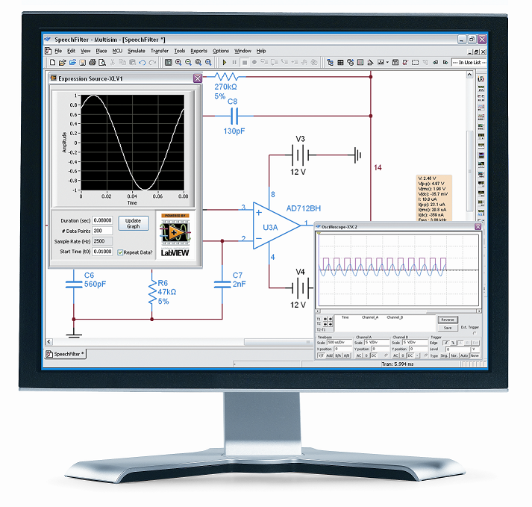
What You Need To Get Started
Computer running:
Windows Vista, 7 or 8
Multisim 14.0 or higher (Power Pro)
Ultiboard 14.0 or higher

Slide 3

File Locations
The course installer places the course files in the following location:
Root Directory
Exercises
<or>
Solutions
Multisim
Notes:
Replace <Course Name> with the name of the course.

Slide 4
Getting the Most out of this Course
Experiment with hands-on exercises
Do your best to finish all exercises
If time permits, experiment with different scenarios
Ask questions
Please switch your cell phone to vibrator mode
This course is not designed or intended for teaching:
Electronics theory
SPICE theory
C/Assembly programming

Slide 5
Contents
Part I
Schematic Capture
Part II
Simulation and Virtual Instruments
Notes:
<Replace text with your lesson titles. Click each smart art, press the left expand icon, and add or remove Lessons as needed. Resize the smart art to fit the actual number of lessons.>

Slide 6
Course Goals
At the end of this course, you will:
Understand the features of the Multisim user interface
Capture schematics in Multisim
Use interactive simulation to check your design
Use virtual instruments and analyses
Work with basic SPICE syntax
Create custom components
Co-simulate MCU with SPICE

Slide 7
Part 1
Schematic Capture
The Multisim GUI
Placing components
Placing wires

Slide 8
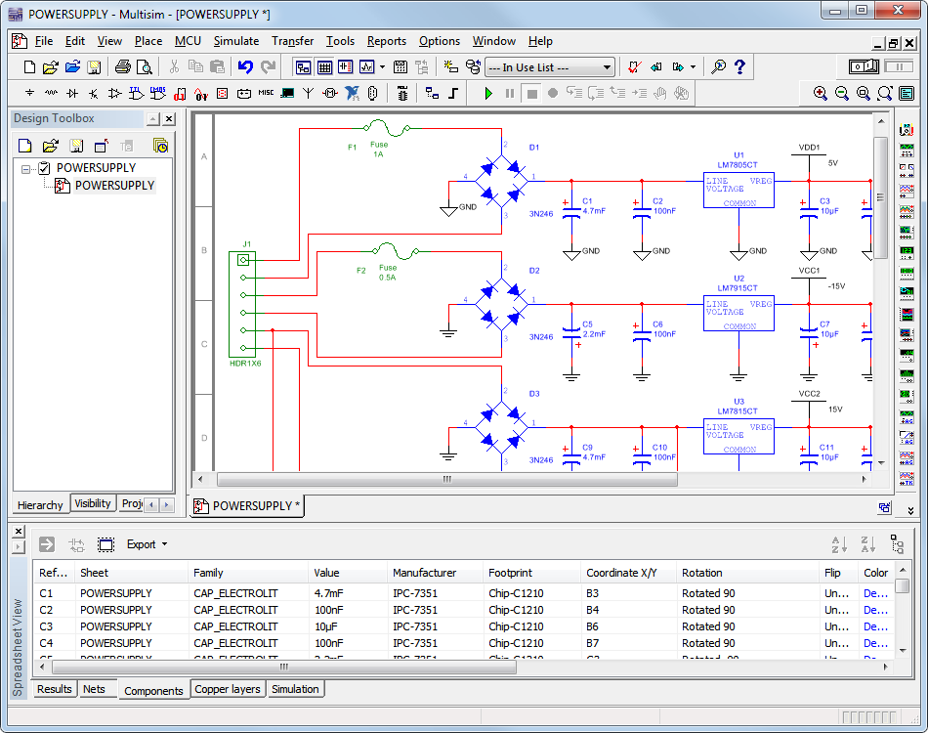
What is Multisim?
General purpose EDA tool
Schematic Capture
Simulation
Analyses
Integrated Environment

Slide 9
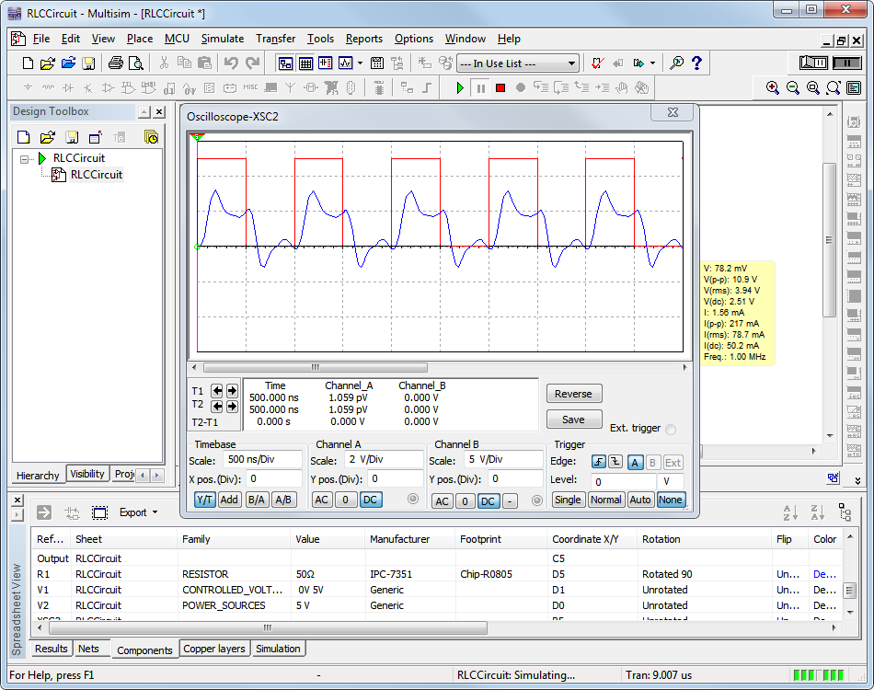
Benefits of Integrated Capture & Simulation
Preparation for simulation is as simple as drawing a circuit
Interactive Simulation
Animated Parts
Virtual Instruments
Analyses and Graphs
Effective use of your time!

Slide 10




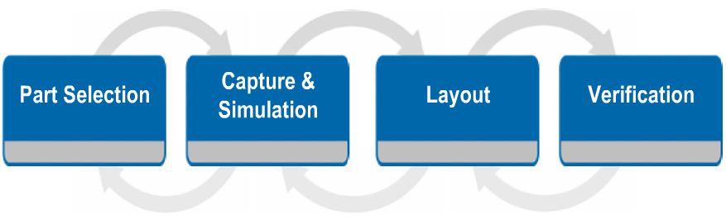
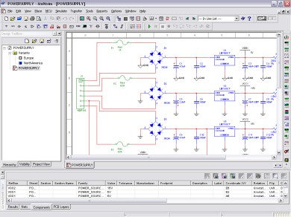
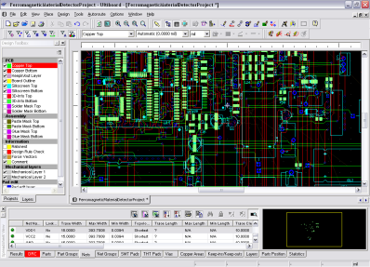
The Design Process
Where does Multisim fit in the design flow?

Slide 11
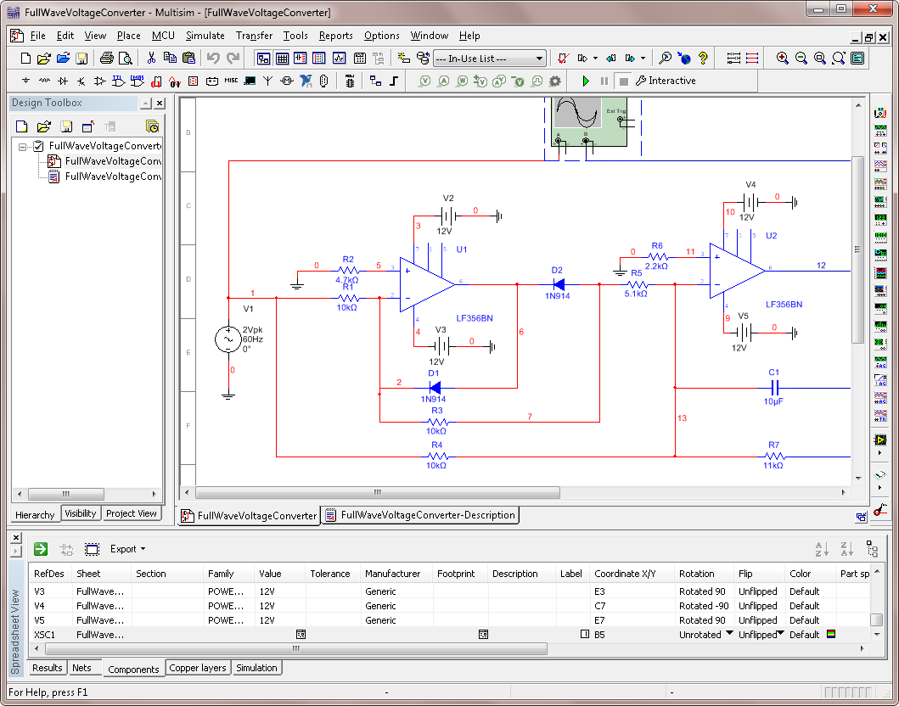
The Multisim GUI
Design Toolbox
Menus
Toolbars
Title Bar
Workspace Area
Organized menus
Quick access toolbars
Design Toolbox
Spreadsheet View
Resizable Workspace
Spreadsheet View
Instruments Toolbar

Slide 12
Global Options
Options»Global options
Vary from computer to computer
Stored in the User configuration file
  Change config file and database paths
  Save settings (security copy, backup, simulation data)
  Component placement mode, symbol standard
  Rectangle behavior, mouse wheel behavior, bus wiring
  Message prompts and general simulation settings

Slide 13
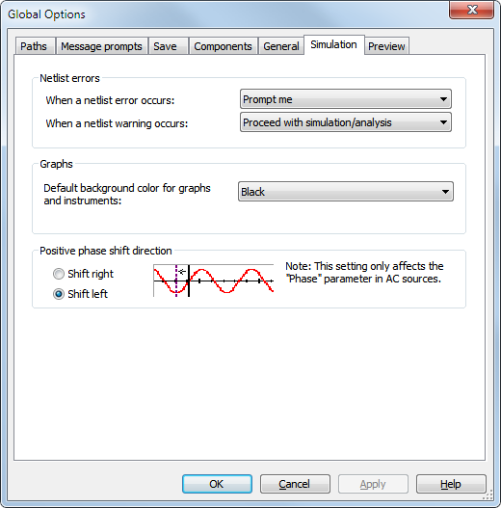
Global Options Simulation tab
Netlist errors action
Default background
Phase shift direction

Slide 14
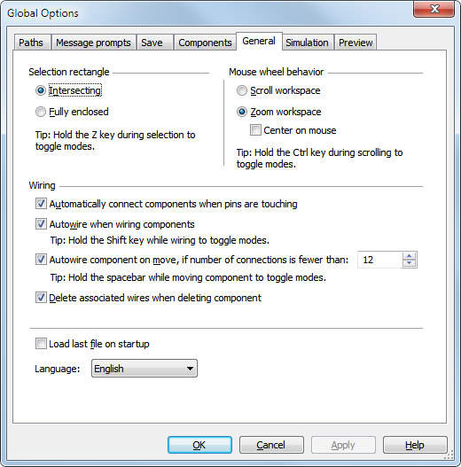
Global Options General tab
Selection rectangle
Mouse-wheel behavior
Wiring mode
Localization

Slide 15
Sheet Properties
Options»Sheet properties
Saved with the design file, if opened in another computer same settings will be used.
Color scheme and display properties
Sheet size
Wire and bus options
Font properties
PCB settings
Visibility status for annotation layers

Slide 16
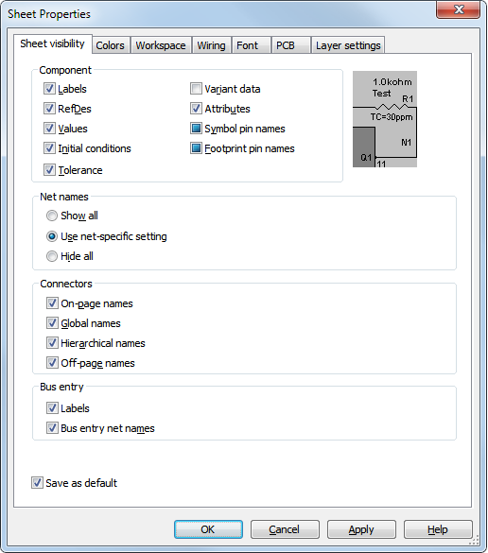
Sheet Properties—Sheet visibility tab
Component display properties
Net names display properties
Connectors display properties
Bus entry display properties
Tip: Experiment with changing the display properties of components, keep a balance between good visibility and optimum information display.

Slide 17
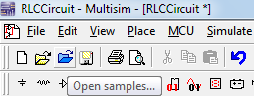

Toolbars and Menus
Click this section of the
toolbar and drag to relocate.
Organized based in functionality
All toolbar functions found in menus
Right-click toolbar area and toggle toolbars
Customizable (functions, location)
ToolTips
Lock toolbars
Menu commands use the
same icon as in the toolbar.

Slide 18
Customize the Environment
Options»Customize interface
Add/remove functions in toolbars and menus
Create new menus and toolbars
Set shortcut keys
Display properties for toolbars and menus

Slide 19
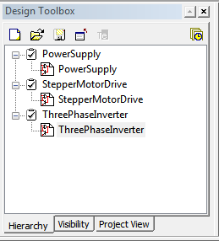
Design Toolbox
View»Design Toolbox
Manage various elements in the schematic design
Great tool for medium- and large-complexity designs
Control visibility of annotation layers
Access to the Project View
Design Toolbox toolbar
Design Toolbox tabs

Slide 20
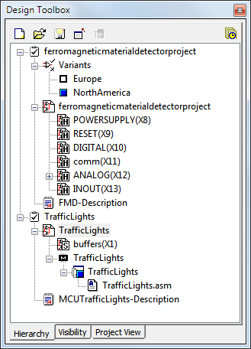
Design Toolbox Hierarchy tab
Design files
Design blocks
Variants
Description Box
Breadboard (Educational Edition)
MCU Projects
Main design file name
Variants
1st page/sheet of design
Hierarchical blocks and
subcircuits of the 1st
sheet
Description box file
MCU workspace
Tip: You can open, close, rename files from the design toolbox. You can also set active variants, active MCU projects and so on.

Slide 21
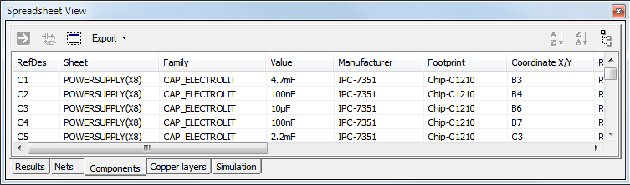
Spreadsheet View
Tip: You can modify properties for multiple components or nets at once if you use the <SHIFT> or <CTRL> keys for multiple selection.
Advanced parameter viewing and editing
Global perspective of objects and properties
Find and select components
Modify component or net properties
Review ERC, Simulation and other results

Slide 22
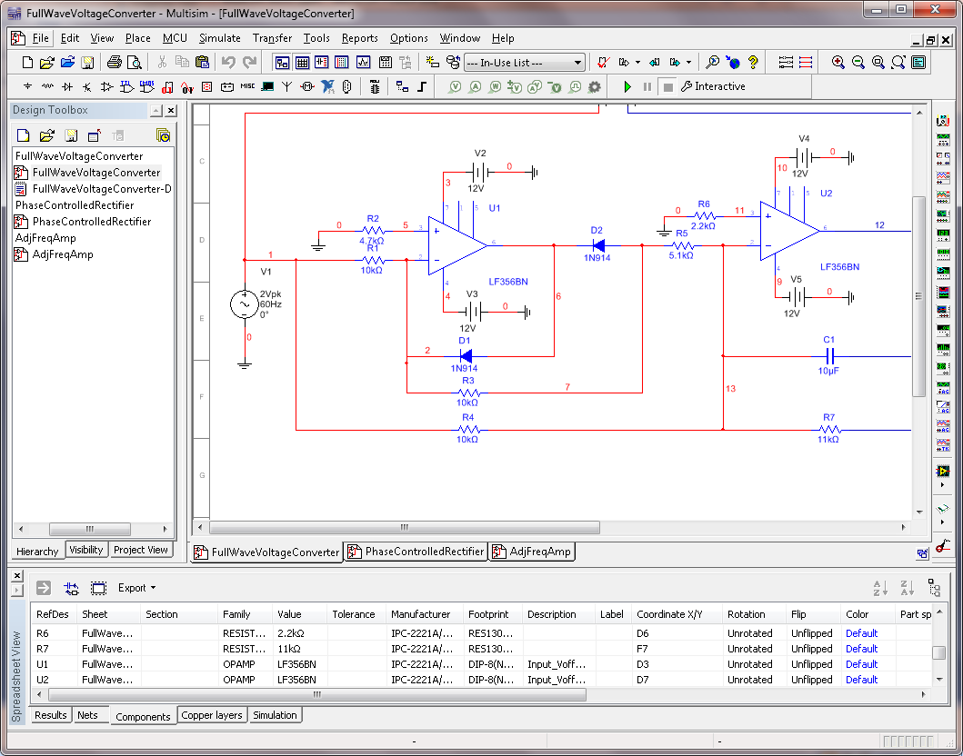
Workspace Area
Page Borders
Design
Workspace Area
Schematic area
Multiple tabs
Zoom in and out with the mouse wheel (default)
Use View menu to show/hide Grid and Page Border
Multiple Design Tabs

Slide 23
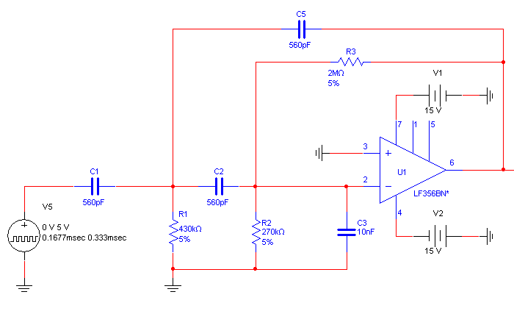
Schematic Capture
Multisim offers click-and-place capture mode
Integrated with simulation
Three step process:
Select
Place
Wire
Component Database
In-Use List
Copy
Replace
Rotate
Flip
Multi-section
Automatic
Touching-pins
Dropping

Slide 24
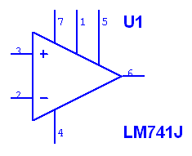
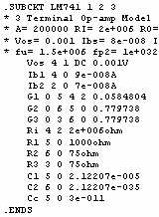
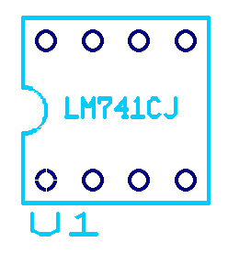
Components
Symbolic representation of actual parts
All components have a symbol
Many components have a SPICE model and footprint
Capture Area
Simulation Engine
PCB Layout
Symbol
SPICE Model
Footprint

Slide 25
Components—Properties
Double-click component to:
Change Label, RefDes
Display properties
Value
Faults
Check Pin assignment
Set Variant information
Modify User Field information
In the Value tab, click Edit component in DB to customize the component.
(not for RLC components)

Slide 26
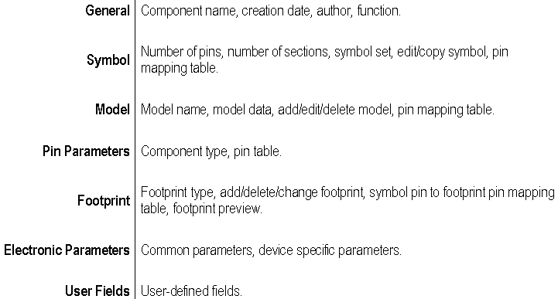
Components—Edit Component in DB

Slide 27
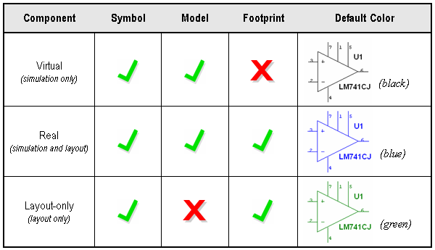
Components —Virtual, Real, Layout-only

Slide 28

Component Database
Tools»Database»Database manager
Three levels:
26,000+ parts (Power Pro edition)
Master database cannot be edited
Database utilities let you merge other users database, or convert a database from a previous version

Slide 29
Component Database
Corporate database
Share components with colleagues
Located in local disk or network drive
User database
Store your own custom components
If you modify a Master database component, save it into the Corporate or the User database.
Caution: Always backup your Corporate or User database.

Slide 30
Component Browser
Place»Component
Most common tool to place components.
You can select:
  Database
  Component
  Model
  Footprint
  Search for components
Tip: Right-click anywhere in the workspace and select Place Component to access the Component Browser.

Slide 31
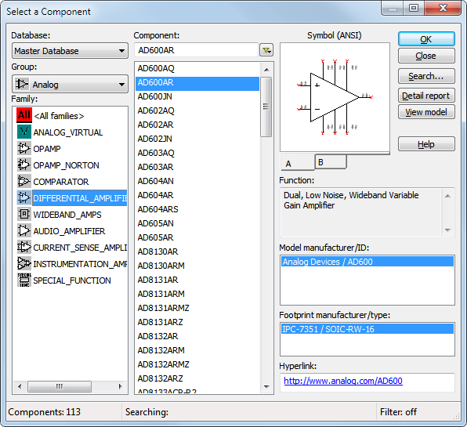
To place a part, select:
Database
Group
Family
Part
Model
Footprint
You can also:
Search
Obtain datasheet
Print a detail report
View model
1
2
4
3
5
6

Slide 32
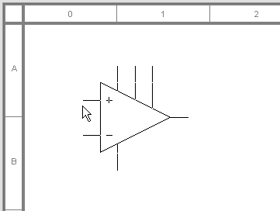
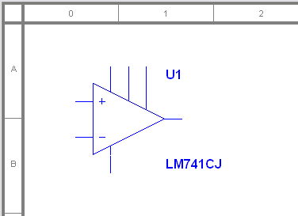
Placing a Component
After selecting a component, a ghost image is attached to the mouse pointer
Click to place
Next RefDes is assigned

Slide 33

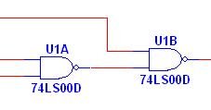
Placing Multi-section Components
Select any section for a new IC
Select C or D to place unused sections of U1
U1, section A and B are already placed, therefore they are not selectable

Slide 34

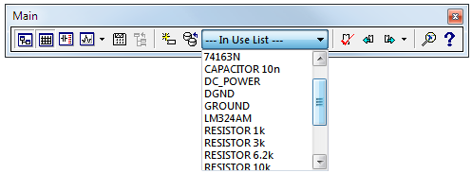
Component Toolbar and the In-Use List
Access Master database Groups from the Components toolbar.
Use the In Use List to place another instance of an already placed component.

Slide 35
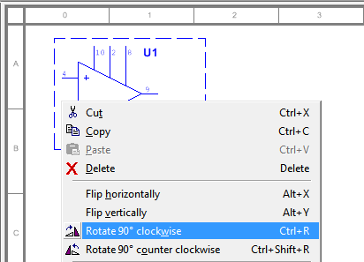
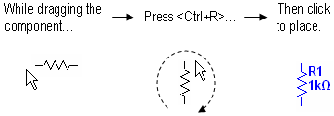
Rotating a Component
If already placed
While placing

Slide 36
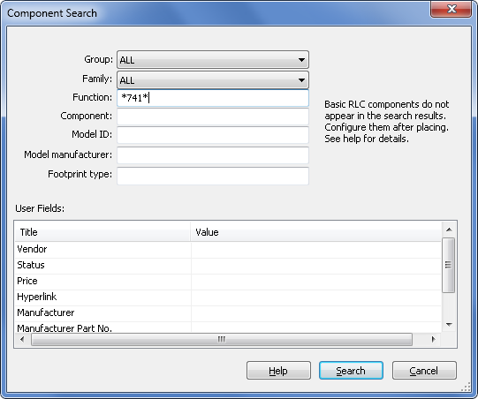
Component Search
From the Component Browser, click Search
Use * as a wildcard

Slide 37
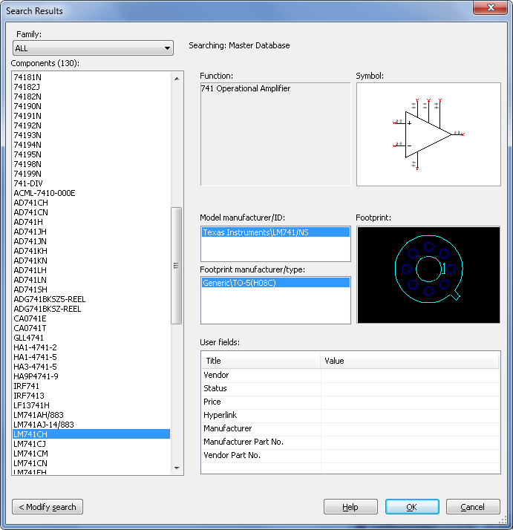
Component Search—Results
Details of component selected
Number of components matching search criteria
List of components matching search criteria
OK will take you to the exact database location

Slide 38
Nets
Wires are the graphical representation of nets
Modeless (no placing vs. wiring mode)
Mid-air wiring is allowed
Real-time netlist is updated behind the scenes
Easy to change wire connections once placed

Slide 39
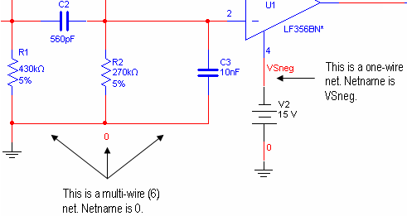
Nets
Multiple wires can make one net or node

Slide 40
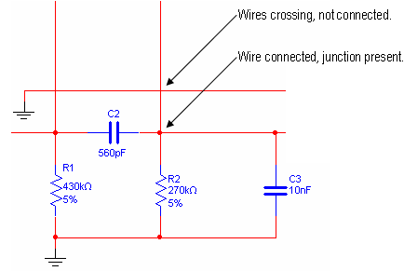
Junction Dots
Junction dots represent a wire connection

Slide 41
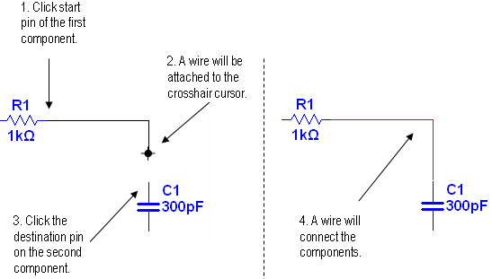
Methods for Wiring—Automatic

Slide 42
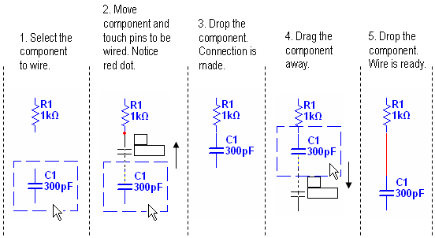
Methods for Wiring—Touching Pins

Slide 43
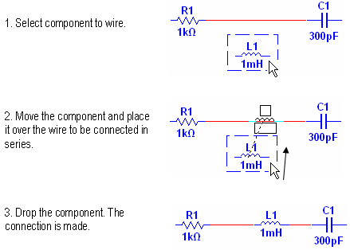
Methods for Wiring—Dropping

Slide 44
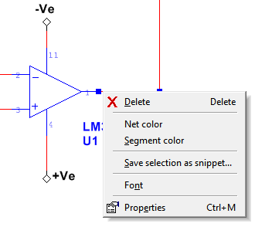
Changing Wire Properties
Right-click the wire to access the run-time menu
Change colors, net name font and properties
Delete
Change color
Net properties
(rename)

Slide 45
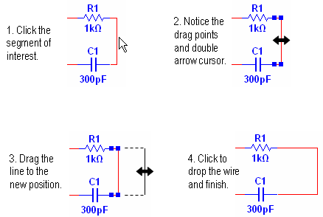
Moving Wires

Slide 46
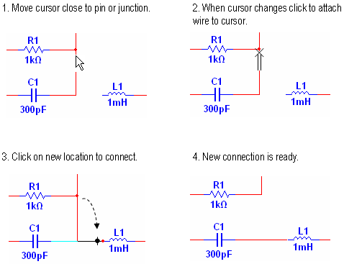
Re-wiring a Net

Slide 47

Virtual Wiring
Useful in large designs
Avoids unnecessary wires crossing the schematic
Give a net a name that already exists to create the virtual connection
Use Global or On-page connectors
  Global connectors are visible to the whole design
  On-page connectors are visible to the sheet
  On-page connectors may connect to Global connectors

Slide 48
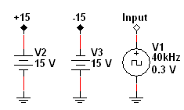
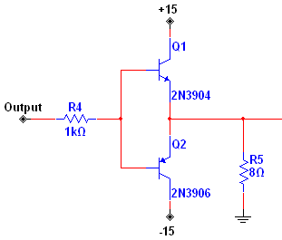
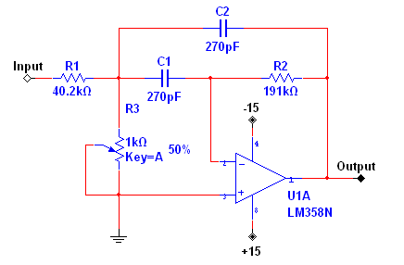
Virtual Wiring
My Design
Page X
Page Y

Slide 49
Lesson 1 Exercises
Drawing a Schematic
Set environment preferences
Build and wire a filter circuit
Use different methods for wiring
NI Multisim Basics Exercises
Page 1-1
40 minutes

Slide 50
Part 2
Simulation and Virtual Instruments
Interactive simulation settings
Virtual instruments
Probes
Circuit Wizards

Slide 51
Multisim Treats Simulation Differently
Most users are not experts in simulation
User wants the benefit of simulation without having to know the details of SPICE
Netlist is hidden from the main schematic, visible through the SPICE Netlist Viewer
If you want to use advanced SPICE syntax you can, using the Arbitrary SPICE Block or the XSPICE Command Line

Slide 52
Types of Simulation
Multisim supports the following types of simulation:
  SPICE / XSPICE / PSPICE¹
  MCU / RF
Code Modeling
Multisim supports these types of simulation individually as well as together using a unique patented co-simulation technology.
¹ Most PSPICE models will work with no problems, if you have a model that doesn’t, contact Support.

Slide 53
Simulation Models
SPICE model is required to simulate a component
SPICE models are usually available from manufacturers
Accuracy of simulation is directly tied to the complexity of a model
Not all components have a SPICE model
In this course, SPICE models also refer to XSPICE, PSPICE and Code Modeling in most cases.

Slide 54
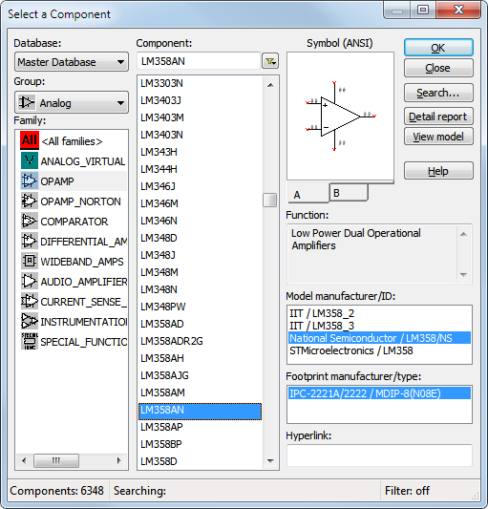

Multiple Models Available
Some components offer more than one model
Higher level models simulate more sophisticated or unique effects of the component’s behavior

Slide 55
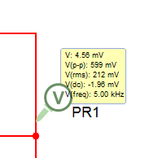
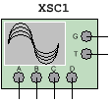


Interactive Simulation
Set the simulation to Interactive on the toolbar
Set simulation to Interactive when:
  Using virtual instruments
  Using interactive components
  Viewing results from probes, LEDs and so on

Slide 56

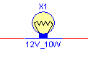
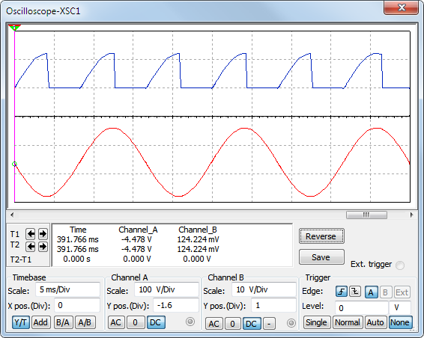
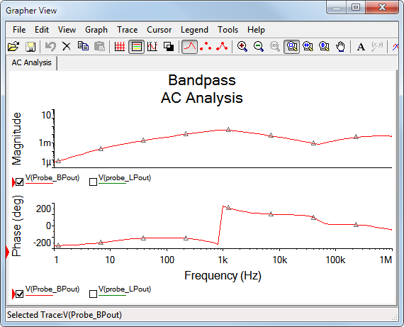
Observing a Circuit Simulation
Start/Pause/Stop functions
Animated parts
Virtual Instruments
Analyses and Graphs

Slide 57
Creating Circuits for Simulation
Use parts with models
Add models to part without models
Place sources and ground
Use Circuit Wizards
  555 Timer
  Filter
  Opamp
  CE BJT Amplifier

Slide 58
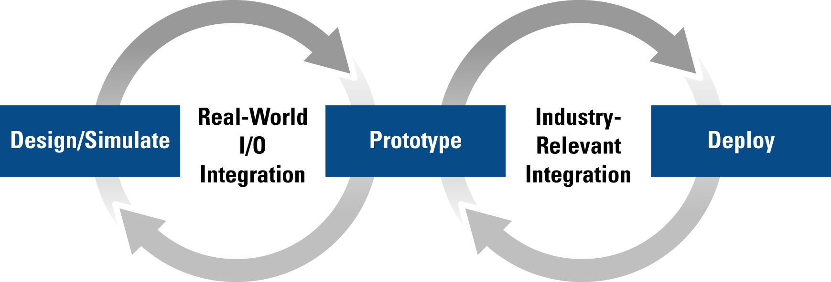
Simulation with Real-world Signals
Integrating NI measurement & automation products into the design stage allows real-world stimuli to be used
  Automate testing and validation of design

Slide 59



LabVIEW and LabVIEW SignalExpress
Use LVM and TDM files with real-world data as input signals
Create and use custom LabVIEW VIs in your circuits
  Input data
  Output data
  Input/Output
Save simulation data as LVM files
Overlay simulation data with measurement results
Verify simulation model accuracy

Slide 60

Virtual Instruments
Select instruments from the Instruments toolbar
Multimeter | Word Generator | Agilent Function Generator
Function Generator | Logic Analyzer | Agilent Multimeter
Wattmeter | Logic Converter | Agilent Oscilloscope
2-ch Oscilloscope | IV-Analysis | Tektronix Oscilloscope
4-ch Oscilloscope | Distortion Analyzer | Measurement Probe
Bode Plotter | Spectrum Analyzer | LabVIEW Instruments
Frequency Counter | Network Analyzer | ELVISmx Instruments*
 |  | Current Probe
* When the NI ELVISmx driver is installed.

Slide 61
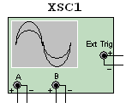
Virtual Instruments—Front Panel
Double-click instrument icon to open front panel
Set instrument settings just like a real instrument

Slide 62
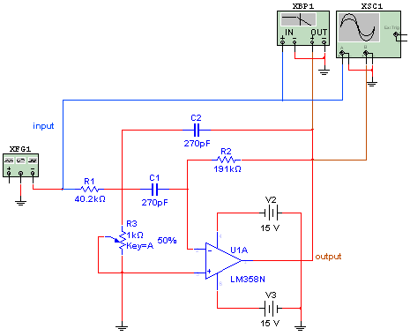
Using Instruments in Circuits
Place instruments like any other object
Wire the instrument to the circuit
Configure instrument settings

Slide 63

Probes
Probes can display:
  Current
  Voltage
  Component power
  Digital state
Probes will appear as an output for the analysis by default
Save space in the schematic

Slide 64
Lesson 2 Exercises
Working with Instruments
Examine the response of the bandpass filter
Learn how to use various instruments
Use probes to examine circuit
Import LabVIEW instrument
NI Multisim Basics Exercises
Page 2-1
40 minutes

Slide 65
Lesson 10
Educational Features
Note: The Multisim Education Edition is required for this lesson.
Component Faults
Ladder Diagrams
Circuit Description Box
Circuit Restrictions
3D ELVIS Virtual Breadboard

Slide 66

Component Faults
Component Faults
Access through the Fault tab in the component’s properties window
Use to simulate faults on components
  Open
  Short
  Leakage

Slide 67



Rated Virtual
Multisim includes rated virtual components
Virtual components
They “blow” if pre-set tolerance is exceeded at simulation
Tolerance is set in the value tab of the properties dialog

Slide 68

Global and Circuit Restrictions
Hide component faults to force students to find the fault using virtual instruments
Disable access to features that you do not want students to have
Lock subcircuits to create a “black-box” circuit which students need to analyze
Password protect

Slide 69


Ladder Diagrams
Create interactive ladder diagram logic
Use PLC-like components

Slide 70
Forms
Used with the Circuit Description Box
Include questions:
  Multiple Choice
  True/False
  Data Entry
  Free Form
Use for assignments or tests
Email circuit file and answers to instructor
Edit»Forms/questions

Slide 71


3D Breadboard
Place components in 3D on a virtual breadboard
Practice wiring a breadboard based on a circuit diagram
Component symbols and wires turn green when placed correctly on breadboard

Slide 72


3D ELVIS Breadboard
File»New»NI ELVIS I design ... Or NI ELVIS II design
Interact with NI ELVISmx instruments
Place and verify diagram similar as the virtual breadboard

Slide 73
Lesson 10 Exercises
Educational Features
Experiment with the Educational features of Multisim
NI Multisim Basics Exercises
Page 11-1
40 minutes

Slide 74
Conclusion
Technical Support
Ultiboard Training
Contact Information

Slide 75


Technical Support
ni.com/multisim
ni.com/ask
NI Circuit Design Suite
Technical Library

Slide 76

Ultiboard Basics: PCB Layout
1-day Hands-on Training
Learn the next step of the design flow:
PCB Layout
Work with:
Parts
Board Outline
Copper
Copper Areas

Slide 77
Thank you!
Please complete the course survey
and retrieve your course CD.

