Slide 1
虚拟仪器技术与LabVIEW

Slide 2
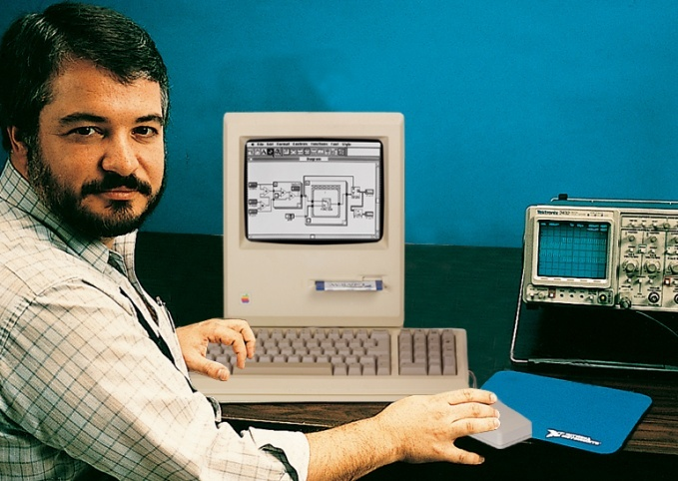
虚拟仪器技术的背景与早期发展
使仪器和PC得以有效连接
降低仪器控制的复杂程度
从手工测试迈向自动化测试
从此以后，软件在测控系统中发挥的作用越来越大
Notes:
LabVIEW

Slide 3
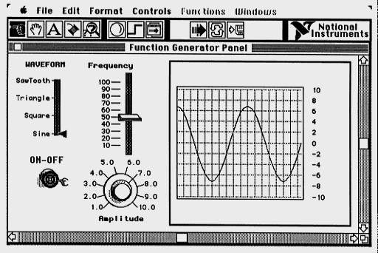
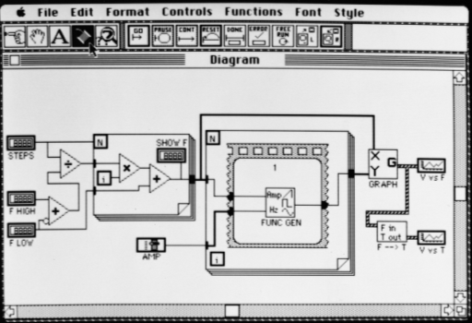
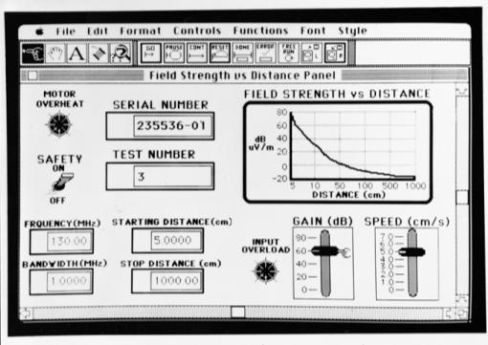
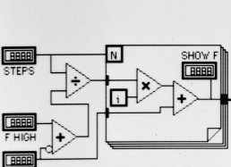
LabVIEW 1.0 革命性地改变编程方式
带来自定义图形界面和数据流编程模式
更加高效的编程体验

Slide 4
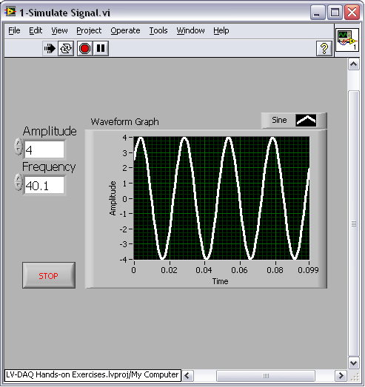
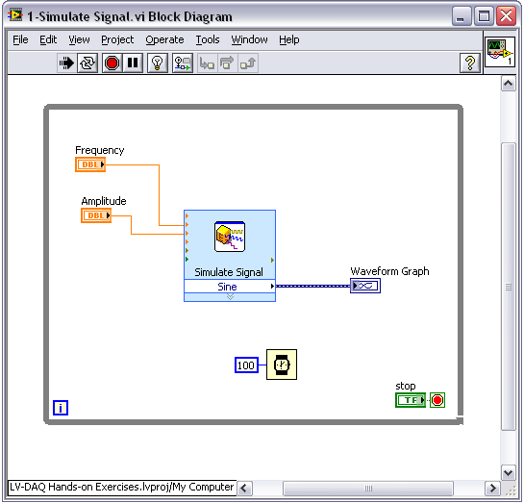
演示: 快速实现一个正弦波发生器
使用基本LabVIEW对象
仿真信号与显示

Slide 5
狭义的“虚拟仪器” 的概念
早期概念：1986年由NI公司提出，它是基于通用硬件平台，充分利用软件定义的仪器，用户可以通过友好的图形界面与仪器进行交互作用
狭义的虚拟仪器概念主要是在测量与测试系统的范畴内, 通过软件定义通用硬件的功能, 从而实现不同的自定义功能

Slide 6
狭义的“虚拟仪器”架构
原始数据
用户自定义功能
传统台式仪器
/模块化仪器
PC处理器
软件
信号
总线
配置
对系统中的模块化仪器/分立仪器进行配置(通过驱动程序完成)
对通过总线获取的原始数据进行信号处理等计算操作
用户界面、数据存储等

Slide 7
广义的“虚拟仪器” 概念
广义的虚拟仪器概念可进一步扩展到自动控制、通信系统等领域，只要是通过软件定义模块化硬件功能, 从而满足自定义应用需求的系统, 都可以看作虚拟仪器技术的应用
“图形化系统设计”（Graphical System Design）的概念也越来越多的取代“虚拟仪器”的提法，并且能更加准确地表达这种系统设计方式的优势
  现成可用的模块化硬件
  方便快速开发的软件工具
  加速系统级应用的设计与实现

Slide 8
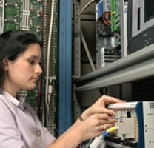
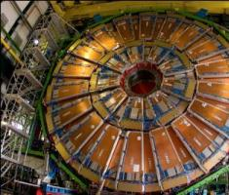
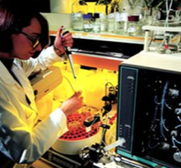

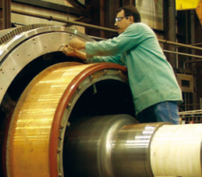
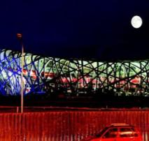
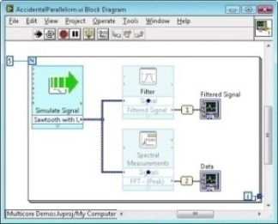
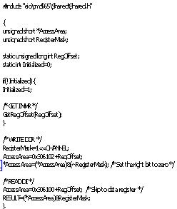
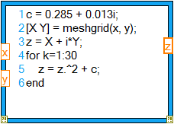
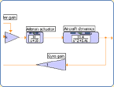
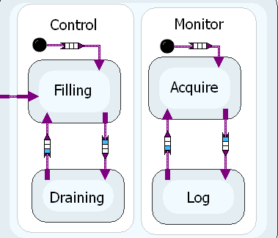

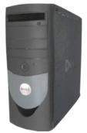
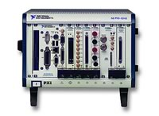
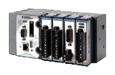



图形化系统设计 (Graphical System Design)
广泛用于自动化测试、自动控制、通信系统设计与验证、生物医电…
图形化编程环境或基于文本语言的开发环境
各种硬件模块
Notes:
核心就是模块化硬件+通过软件自定义硬件所实现的功能
从而满足不同行业不同的应用
下方的硬件模块(从左至右依次): 基于PC机的模块化硬件, PXI模块化测控平台、CompactRIO/Single-Board RIO、FlexRIO等带有FPGA的可重配置硬件

Slide 9
LabVIEW的发展
功能不断增加，效率不断提升
不断融合各种最新的技术发展，简化工程师在测控系统中利用新技术的复杂度
LabVIEW 6i
网络技术
LabVIEW 3.0
多平台
LabVIEW 2009
更高效率，机器人
LabVIEW 4.0
专业化开发
LabVIEW 8.20
20周年纪念版
简体中文版
LabVIEW 1.0
Macintosh
1990
1998
2003
2005
2008
2010
1986
1993
1997
2000
2006
2009
LabVIEW 2.0
编译语言程序
LabVIEW 5.0
实时技术
LabVIEW 8
分布式智能
LabVIEW 8.6
多核、FPGA、无线
LabVIEW 7 Express
PDA 和 FPGA
LabVIEW 2010
FPGA云编译

Slide 10

LabVIEW的本质是什么?
首先是一种编程语言
  只不过是图形化的而已
是一种针对工程师和科学家所设计的开发环境
  内置许多简化编程复杂度的功能和函数

Slide 11
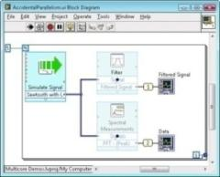
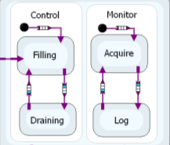









LabVIEW作为编程语言的优势
基于数据流的自然思维方式，但同时也支持调用文本语言的代码
Dataflow
C / HDL Code
Textual Math
Simulation
Statechart
LabVIEW
Desktop
LabVIEW
``
Real-Time
LabVIEW
FPGA
LabVIEW
MPU/MCU
Personal Computers
PXI Systems
CompactRIO
Single-Board RIO
Custom Design
支持连接各种硬件，而且支持发布到多种Target

Slide 12



LabVIEW在工业界的广泛使用

Slide 13
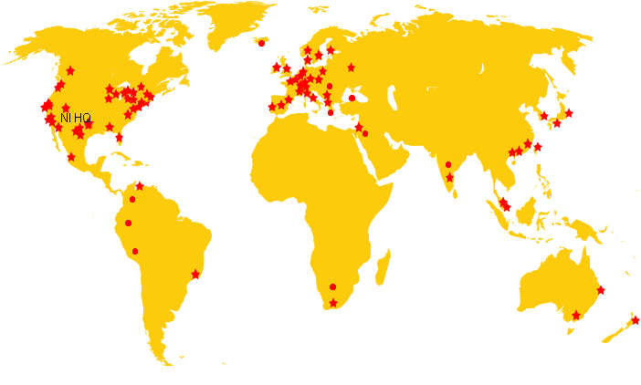









































LabVIEW在高校中的广泛使用
在中国
超过200所学校开设LabVIEW课程
建立了近300个教学和科研实验室
每年新增50000名学生学习LabVIEW，帮助学生提升动手与创新能力
全球110个国家,超过6,000所高校正在使用NI的产品
覆盖所有的工程和科学专业
Notes:
To end

Slide 14
应用案例与演示

Slide 15
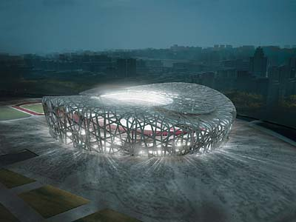

测试测量: 奥运鸟巢体育场结构监测
cRIO
. . .
应用
基于LabVIEW与CompactRIO平台，对2008北京奥运体育场进行连续时间振动监测，包括结构模型验证、监测突发事件等工作。
Kinemetrics Seismic Sensors
NI 产品
LabVIEW, CompactRIO
“不到一年的时间里，我们以LabVIEW和CompactRIO为计算平台实现了一个嵌入式监测系统，其在准确度、价格以及灵活性等方面的竞争力是无与伦比的。 ”
—— Chrise Mcdonald CGM 工程公司
Notes:
强调cRIO平台的小巧，坚固并集成了嵌入式实时系统和可重配置I/O即FPGA技术。专为要求高性能和高可靠性的集控制和采集功能的系统而提供。
Boeing Measures Reduced Aircraft Noise Emissions with NI PXI and LabVIEW
(http://sine.ni.com/cs/app/doc/p/id/cs-684)
Industry:
Aerospace/Avionics
Products:
LabVIEW , PXI
The Challenge:
Creating a scalable, low-cost system to test the effectiveness of designs in reducing commercial jetliner noise during takeoff, landing, and sustained flight.
The Solution:
As part of the Quiet Technology Demonstrator 2 (QTD2) project, Boeing flight tested new technologies intended to reduce noise generated by its aircraft. Measuring the improvement these technologies provide required a flexible, accurate, and scalable test system to perform phased array acoustic imaging during the tests. Boeing needed a distributed system architecture with the ability to expand to up to 1,000 channels or more while still maintaining tight timing and synchronization between channels.
Phased Array Data Acquisition and Analysis
To flight test new technologies for quieter operation, Boeing used an array of microphones to acquire noise data, which was then processed into noise-level maps showing from where and at what frequencies the noise was generated and how loud it was. By overlaying the noise-level maps with a visual image, they could assess the effectiveness of noise reduction technologies, identify opportunities for additional noise-source reductions, and distinguish between engine and airframe sources. Using NI tools, Boeing then validated several advanced noise-reduction concepts, including chevrons on the engine exhaust ducts, new acoustic treatment for the engine inlet, and aerodynamic fairings for the main landing gear.
NI System Solution
Using the flexibility and modularity of PXI, Boeing created a scalable system with virtually unlimited channel-count capability. In addition, by taking advantage of NI timing and synchronization cards, they could distribute the data acquisition hardware into the microphone array, decreasing cabling by nearly 80 percent while maintaining within one degree of phase match between channels. With increased performance and an unlimited, distributed architecture, they reduced the cost per channel by more than 50 percent compared to their previous system.
Software System Architecture
The system was developed completely in LabVIEW. Boeing was able to directly reuse or easily adapt code and designs from other Boeing developers and from the NI web site. Including time to learn LabVIEW, one person developed the entire application in less than six months. By taking advantage of a carefully chosen software architecture and the modular nature of PXI systems, they simplified the process of scaling the system. The scalability of LabVIEW was demonstrated when, midway through development, an additional 128 channels needed to be added to the system. It only took about two hours to scale the system from 320 to 448 channels – from unpacking and plugging in the input modules to making a two-minute update to a configuration file.

Slide 16

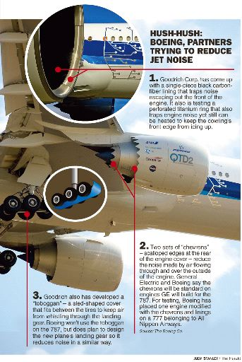
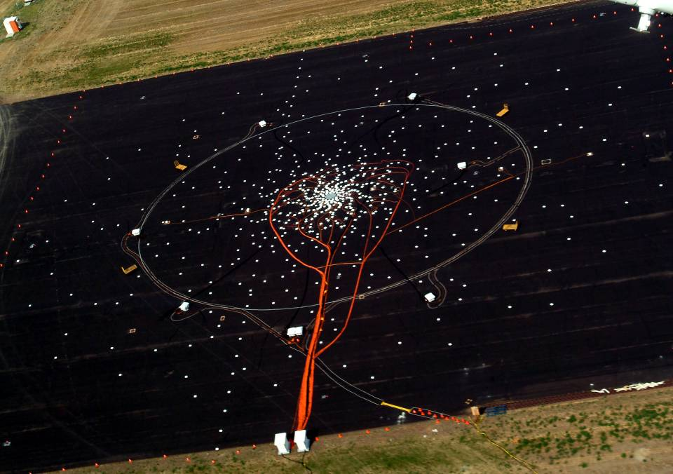
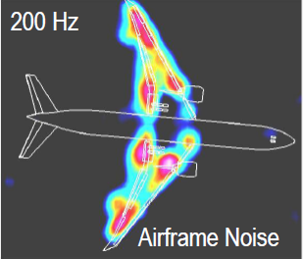
测试测量: 波音公司客机噪声定位系统
应用
波音公司使用LabVIEW与9台PXI机箱实现超过300通道振动信号的同步采样与分析，成功降低了客机起飞时的噪声
NI 产品
LabVIEW, PXI
“使用NI软硬件平台，我们成功构建在多台机箱间分布的高性能，低成本的灵活性振动信号采集系统，通道间实现紧密同步，并可以提供更多通道的扩展性。“
-- James Underbrink, 波音公司声音振动与污染试验室
Notes:
针对有兴趣或者已经参加综合组师生，概述介绍PXI和cRIO平台的特点和典型应用。
强调PXI平台的高性能、高坚固性、低成本。提供涵盖直流到6.6射频信号的IO模块。尤其是背板提供了定时与触发总线，支持开发出具有精确同步性能的系统，满足应用需求。供参赛选手选择是否有合适的方案可以使用PXI平台。
Boeing Measures Reduced Aircraft Noise Emissions with NI PXI and LabVIEW
(http://sine.ni.com/cs/app/doc/p/id/cs-684)
Industry:
Aerospace/Avionics
Products:
LabVIEW , PXI
The Challenge:
Creating a scalable, low-cost system to test the effectiveness of designs in reducing commercial jetliner noise during takeoff, landing, and sustained flight.
The Solution:
As part of the Quiet Technology Demonstrator 2 (QTD2) project, Boeing flight tested new technologies intended to reduce noise generated by its aircraft. Measuring the improvement these technologies provide required a flexible, accurate, and scalable test system to perform phased array acoustic imaging during the tests. Boeing needed a distributed system architecture with the ability to expand to up to 1,000 channels or more while still maintaining tight timing and synchronization between channels.
Phased Array Data Acquisition and Analysis
To flight test new technologies for quieter operation, Boeing used an array of microphones to acquire noise data, which was then processed into noise-level maps showing from where and at what frequencies the noise was generated and how loud it was. By overlaying the noise-level maps with a visual image, they could assess the effectiveness of noise reduction technologies, identify opportunities for additional noise-source reductions, and distinguish between engine and airframe sources. Using NI tools, Boeing then validated several advanced noise-reduction concepts, including chevrons on the engine exhaust ducts, new acoustic treatment for the engine inlet, and aerodynamic fairings for the main landing gear.
NI System Solution
Using the flexibility and modularity of PXI, Boeing created a scalable system with virtually unlimited channel-count capability. In addition, by taking advantage of NI timing and synchronization cards, they could distribute the data acquisition hardware into the microphone array, decreasing cabling by nearly 80 percent while maintaining within one degree of phase match between channels. With increased performance and an unlimited, distributed architecture, they reduced the cost per channel by more than 50 percent compared to their previous system.
Software System Architecture
The system was developed completely in LabVIEW. Boeing was able to directly reuse or easily adapt code and designs from other Boeing developers and from the NI web site. Including time to learn LabVIEW, one person developed the entire application in less than six months. By taking advantage of a carefully chosen software architecture and the modular nature of PXI systems, they simplified the process of scaling the system. The scalability of LabVIEW was demonstrated when, midway through development, an additional 128 channels needed to be added to the system. It only took about two hours to scale the system from 320 to 448 channels – from unpacking and plugging in the input modules to making a two-minute update to a configuration file.

Slide 17
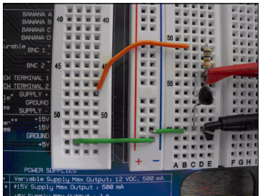
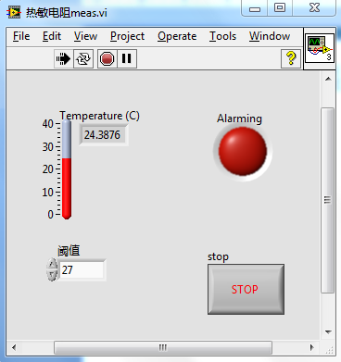
测试测量演示: 温度采集与报警

Slide 18
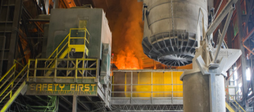
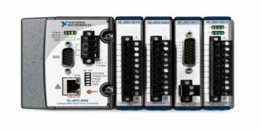
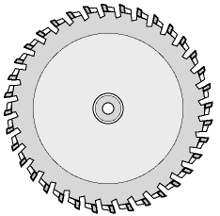
高速控制: 高速电锯制动系统
工业自动化
NI Compact RIO
PAC 平台
电机
发送500kHz正弦波
到锯条
制动
测量从锯条读回的
正弦波，判断幅度
Notes:
演示4. 高速电锯制动系统.wmv

Slide 19
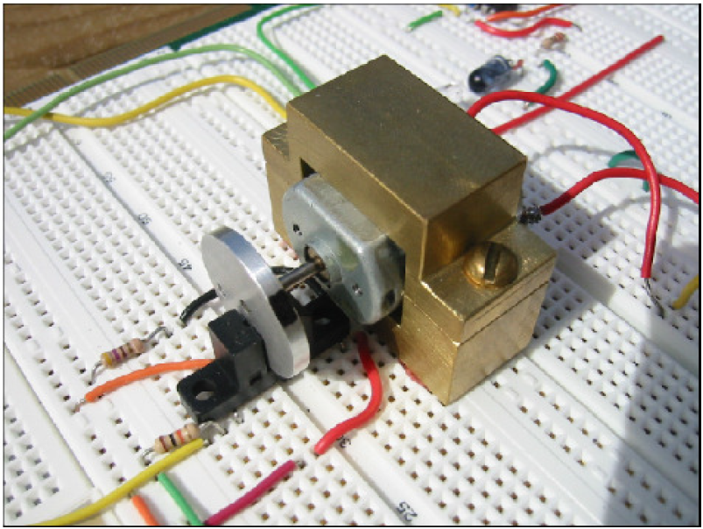
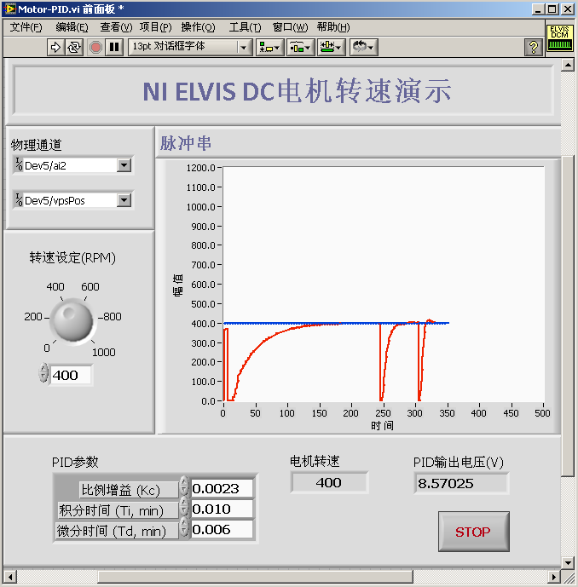
演示: 直流马达的PID转速控制

Slide 20
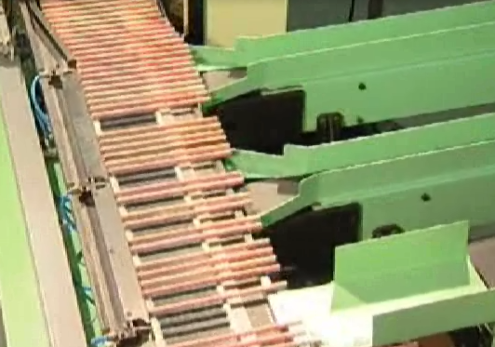
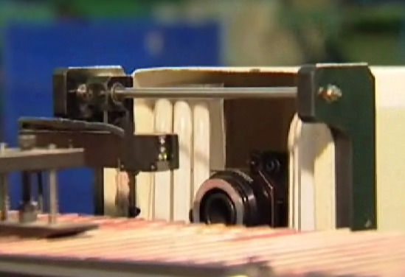
产线自动化: 铅笔分拣系统
工业自动化

Slide 21
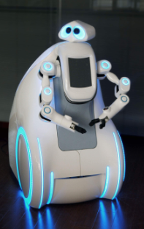
嵌入式应用: 上海世博服务机器人
由上海电气用LabVIEW开发的世博服务机器人采用NI CompactRIO作为机器人的“小脑”，负责路径规划、运动控制等

Slide 22
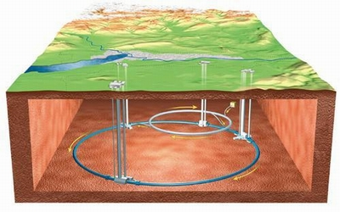
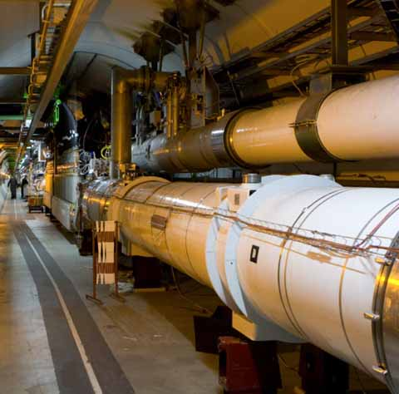
科研: 大型粒子对撞机的精确控制
构建大型强子对撞机(LHC)，实现粒子束的光速对撞，偏离轨道的高速碰撞会产生毁灭性灾难
利用FPGA实现高能粒子的瞄准
  120台PXI实现冗余控制
  借助步进电机快速、精确、同步排列石墨
  27km范围内运动控制同步率达ms级
欧洲核子研究中心(CERN)的LHC项目耗资38亿美元, 圆周长达27km, 位于法瑞边界地下150m深处
Notes:
由于粒子束具有极高的能量，可靠性成为关键因素。高速传播中的粒子束产生碰撞很可能产生毁灭性的灾难。为防止粒子偏离既定的路径，我们安装了超过100台称为瞄准仪的设备。瞄准仪通过石墨块或其它大质量材料来吸收粒子束核心中的高能粒子。每一台瞄准仪都由安装于独立NI PXI机箱中的可重新配置I/O模块控制，总共120 套PXI系统，以实现冗余。在标准配置下，每个机箱控制多达15台步进电机，它们被安装在3个不同瞄准仪上，在20分钟的运动中，精确、同步地排列石墨块；同时，另一个机箱用于检查瞄准仪的实时位置。在工程的第二阶段，将计划再加入约60台瞄准仪及60个PXI系统，最终达到约200个PXI系统。

Slide 23

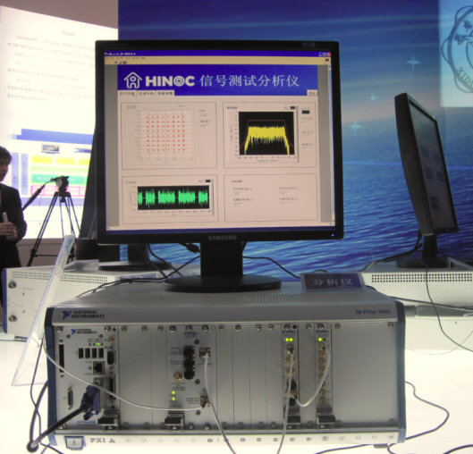
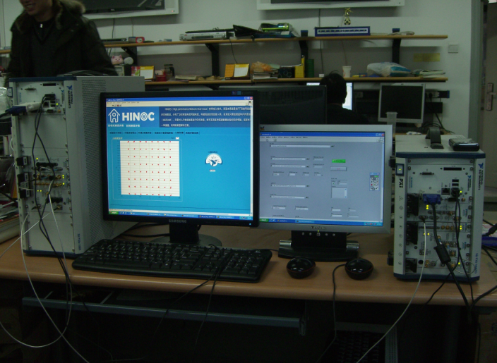
科研: “三网合一”研究平台
基于PXI实现自定义的验证与测试系统
  基于软件无线电方式
  在PXI平台中集成的FPGA上进行实时信号处理
Notes:
As the standard is still being developed, and thus there is no turn-key test solution available. PXI plays a key role here to help the researchers in Peking University to develop customized verification systems in a short time. PXI modular architecture with software customizable feature naturally makes it an ideal platform to quickly construct a validation system: either a signal source emulating signal into the HiNOC ASIC, or as a signal analyzer to analyze signal out of HiNOC ASIC.
Using NI PXIe-5641R IF transceiver module, which has onboard FPGA that can be programmed with LabVIEW, researchers from Peking University implements real-time signal generation and processing.
They are also working on leveraging the software developed and using PXI as the test platform later in the design cycle.
(Note: later in the morning, a senior engineer from Peking University will come on stage to talk about this research project more in detail)
HiNOC（High Performance Network over Coax）技术
—利用有线电视同轴电缆构建高速的信息接入网
—每个用户提供超过40Mbps的网络层接入速率
— 支持标清电视/高清电视、视频点播、网络电视、高速上网等

Slide 24
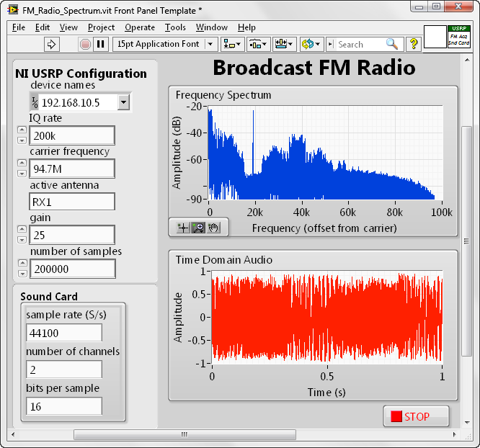
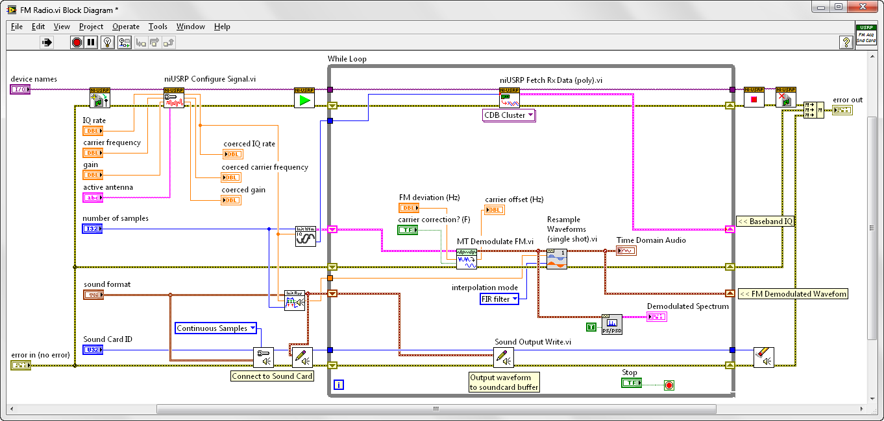
演示: 通过虚拟仪器实现的FM收音机
Mono
Audio
Left + Right
Stereo Audio
Left - Right
19kHz
Stereo
Pilot
(10%)
Direct Band
(10%)
Audos Subcarrier
(10%)
RBDS
(5%)
0
57
kHz
30
Hz
15
kHz
23
kHz
38
kHz
53
kHz
58.35
kHz
67.65
kHz
76.65
kHz
92
kHz
99
kHz

Slide 25
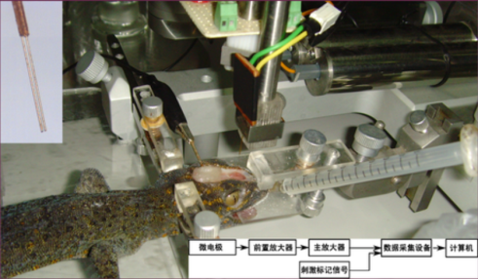
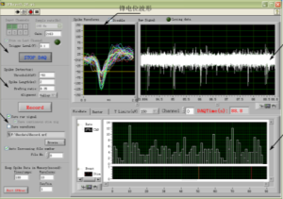
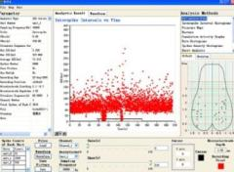
生物: 壁虎神经细胞记录与模式分析
实现对于大壁虎嗅球神经元的活动信息的胞外记录
  多电极多通道记录
  细胞外记录实验是研究脑功能的必要手段
  NI 4472动态数据采集卡
神经信号特征及模式分析
  LabVIEW事件架构实现
  十多种不同的分析方法
    散点图，簇节律分析，相关性分析，彭加莱图等等
微电极
前置放大器
主放大器
数据采集
计算机
刺激标记信号
Notes:
LabVIEW实现：
数据分析：散点图，彭加莱图，放电序列响应函数，放电频次图，簇节律分析，相关性分析等
波形显示，为用户对数据分析结果的合理性提供判断准则
微电极记录坐标显示
参数列表
图像操作，提供图像编辑保存和调用Matlab图像显示功能

Slide 26

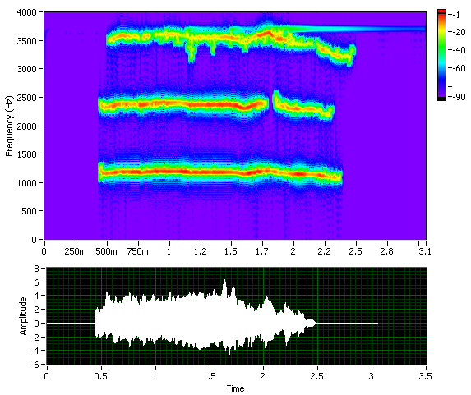
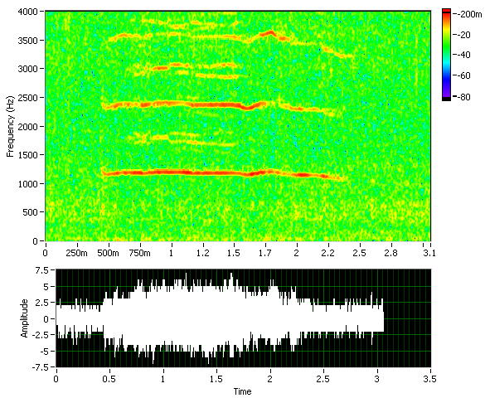
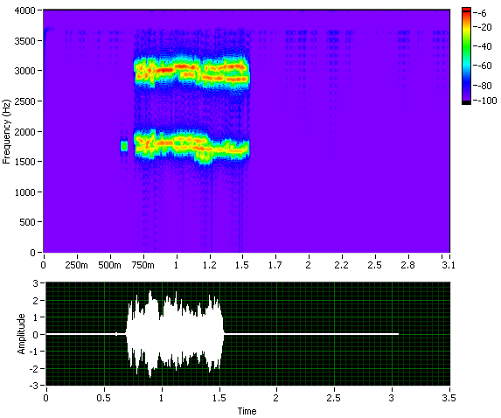


生物信号处理的其他应用
演示
深海中虎鲸的声音…
Notes:
用LV 2009演示
Please find the “Killer Whales” folder from material folder.
First, some definitions:
Echolocation, also called Biosonar, is the biological sonar used by several mammals such as bats and whales.
Toothed whales, including dolphins, porpoises, killer whales and sperm whales, use biosonar because they live in an underwater habitat that has favourable acoustic characteristics.
The Harbor Porpoise (left) is one of six species of porpoise. As its name implies, it stays close to coastal areas or river estuaries.
The Orca or Killer Whale (right) is the largest species of the oceanic dolphin family. It is found in all the world's oceans, from the frigid Arctic and Antarctic regions to warm, tropical seas.
The sound acquired by DAQ is contained the both porpoise and killer whale’s sound, as well as the sea wave background mixed as noise.
After using the LabVIEW ASPT toolkit, the different whales’ sound can be separated each other, and the background noise also released.
(In JTFA time varying filter VI, select the Masking tool Morphologic. Then the frequency of different whale can be highlight out manually.)

Slide 27
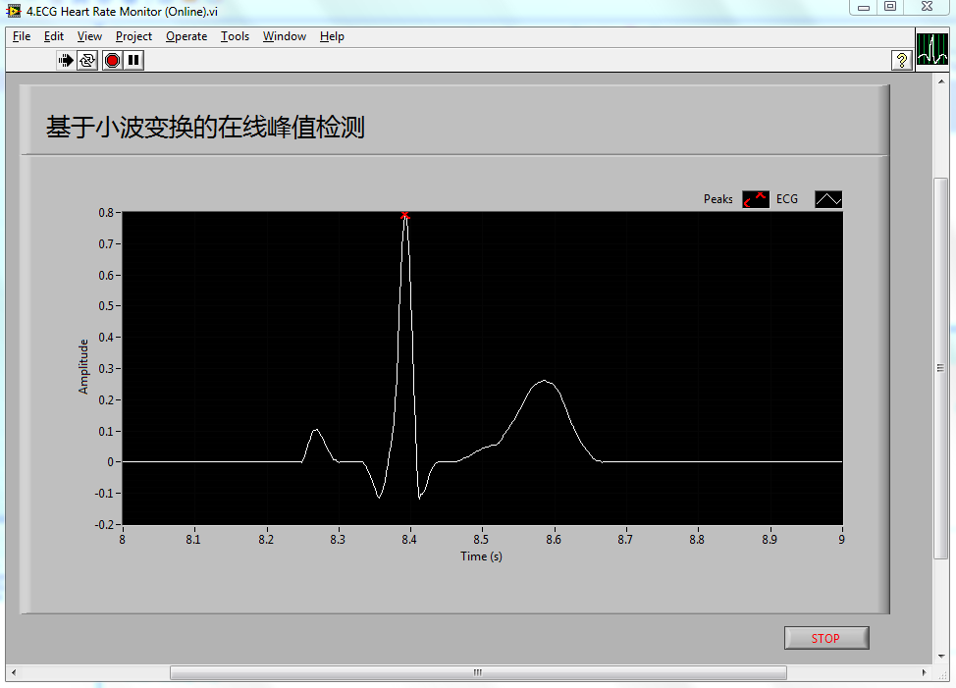
信号处理演示: ECG信号峰值提取

Slide 28






让信号处理“真实”起来
信号
采集
分析
表达

Slide 29


演示: 音频信号采集与处理

Slide 30













更多应用领域
混合信号测试
电能质量检测
生物医电
水质处理
自然环境监测
楼宇资源监控
虚拟现实
结构健康监测
节能减排
核能工程
太阳能电池板
风能发电
通信工程
…
机器人开发

